Slide 1
GENERAL MANAGER’S PROGRAM TO FOSTER EMPLOYEE ENGAGEMENT
January 12, 2017

Slide 2
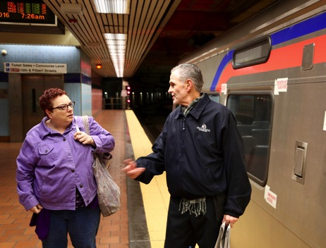
EMPLOYEE ENGAGEMENT
Every business wants to have highly engaged employees, but this is easier said than done.
How do you go about achieving this goal in the year 2017?
Does the modern employee have new needs?

Slide 3
EMPLOYEE ENGAGEMENT
MOTIVATING YOUR EMPLOYEES
What Motivates Today’s Employee?
Respect and appreciation from management
Provide them with a mission
Two-way communication in the chain of command (everyone has a voice)
Truth - no B.S.
Concerns get addressed by a management team that fully understands the challenges associated with the performance of their daily duties
Monetary compensation, of course

Slide 4
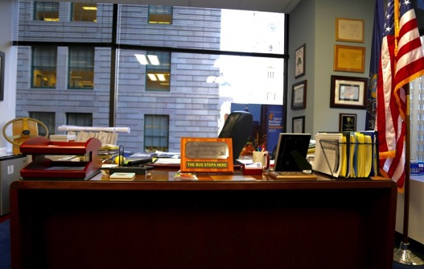
EMPLOYEE ENGAGEMENT
MOTIVATING YOUR EMPLOYEES
As GM, getting out from behind the desk is extremely important to creating an engaged workforce
Modeling appropriate management behavior from the very top of the company is critical to the success of a modern business.
It is hard to find the time, but the rewards can be great!

Slide 5
EMPLOYEE ENGAGEMENT
“Empathy is about getting out of your own head, ignoring ego, and getting into the heads and hearts of others – especially customers, and employees. Listen to people’s desires and feel their pain. Only when you understand other’s problems can you offer simple solutions”
Bill McDermott
Chief Executive Officer, SAP

Slide 6
EMPLOYEE ENGAGEMENT
CONNECTING WITH EMPLOYEES
Components of the GM Program:
On-site General Manager Team Meetings
(held on a quarterly basis)
General Manager/Deputy General Manager Breakfasts with hourly and management employees
(held every two months)
GM goes where the action is or serves as an Ambassador
Employees Shadowed by GM - I pick them
Show Jeff Your Work Day - they pick me

Slide 7
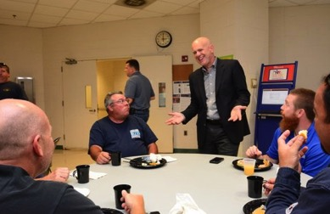
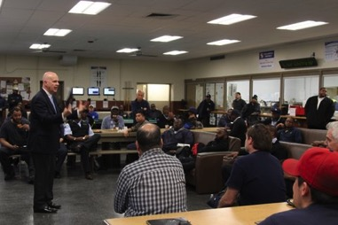
EMPLOYEE ENGAGEMENT
ON-SITE
GM TEAM MEETINGS
Regular Weekly GM Team Meeting held at field location
GM Team then meets the workforce (hourly and management)
Food and refreshments provided for all employees
GM opens up with comments germane to the location
Information gathered in advance on successes & challenges at the location

Slide 8
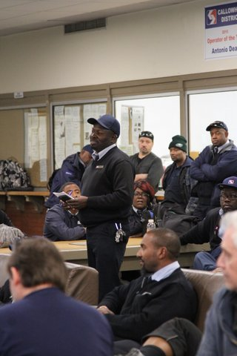
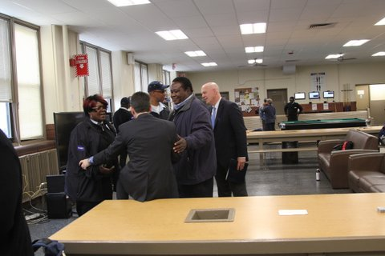
EMPLOYEE ENGAGEMENT
ON-SITE
GM TEAM MEETINGS
Open discussion follows (15-60 minutes)
Meeting with Location Management and the appropriate Assistant General Managers
Focus is on how the GM team can help them

Slide 9
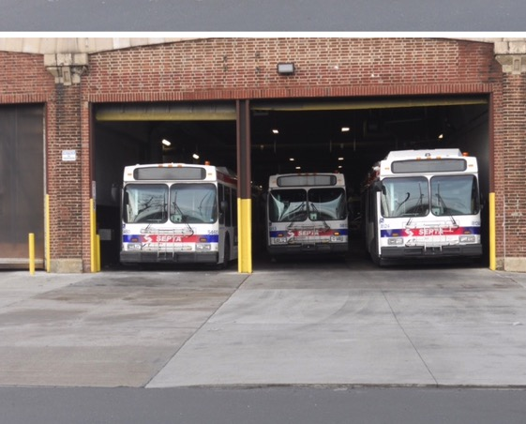
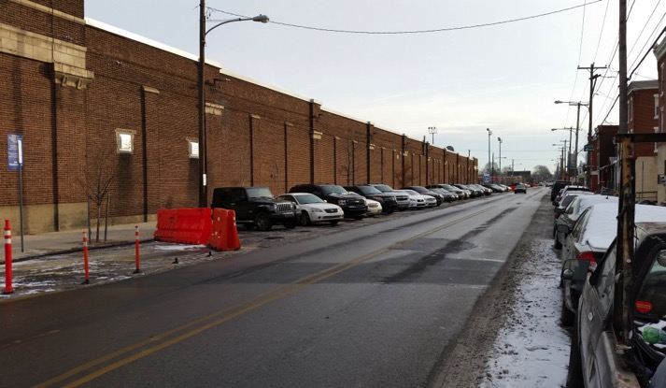
EMPLOYEE ENGAGEMENT
CALLOWHILL GM TEAM
MEETING RESULTS
Case Study: Callowhill District
Improvements made as a result of Employee Discussion:
Employee Parking - 41 spaces added.
Exterior lighting improved around the entire facility
Exterior cameras added for security
Concrete apron repairs made
Employee Parking & Concrete Apron Improvements

Slide 10
EMPLOYEE ENGAGEMENT
GM/DGM BREAKFASTS
AT WORK LOCATIONS
Brings Management and Hourly together to work as a TEAM
Small Breakfast Meetings for Specific Locations
Management & Hourly Employees – 12 maximum
GM, DGM, Director of Office of Innovation
GM BUILDING THE FUTURE PowerPoint presentation covering 5 strategic goal areas important to all SEPTA Employees
GM encourages employees to get the word out at their location (Be ambassadors)

Slide 11
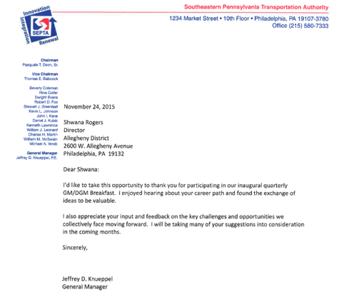
EMPLOYEE ENGAGEMENT
GM/DGM BREAKFASTS
AT WORK LOCATIONS
Full Employee participation
Everyone gives their background
Encouraged to discuss how things could be done better at their location
Letter sent afterward thanking them. No photos, no hype just real communication!

Slide 12
EMPLOYEE ENGAGEMENT
GM/DGM BREAKFASTS
Case Study: Midvale District Operator
Bus Operator was a long-term employee nearing retirement
Started out suspicious of the event but gave great ideas when his turn came to talk

Slide 13
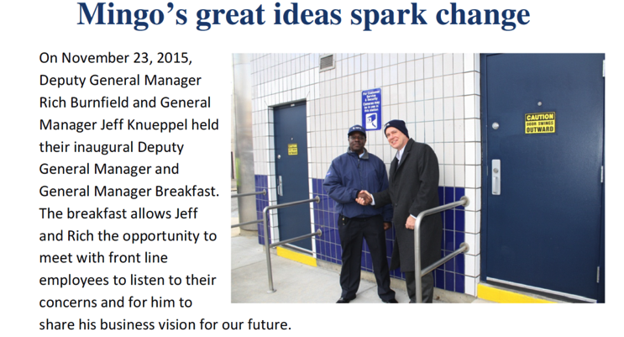
EMPLOYEE ENGAGEMENT
GM/DGM BREAKFASTS
Two of His Ideas:
Add a bathroom at busy Olney Bus Terminal COMPLETED
Add phones under bus canopy at Midvale so operators would not have to walk all the way back to the blocker’s booth if their bus had a problem COMPLETED

Slide 14
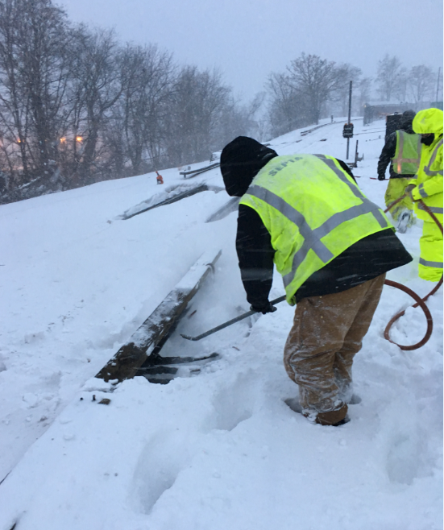
EMPLOYEE ENGAGEMENT
BEING PART OF THE ACTION
Affirms importance of what the employees are doing on-site
Participates, along with other members of GM Team, during special events/incidents, primarily as Ambassadors
ALWAYS Thank employees! Especially after difficult events or those requiring extended effort by employees
Winter Storm Jonas (2016)

Slide 15
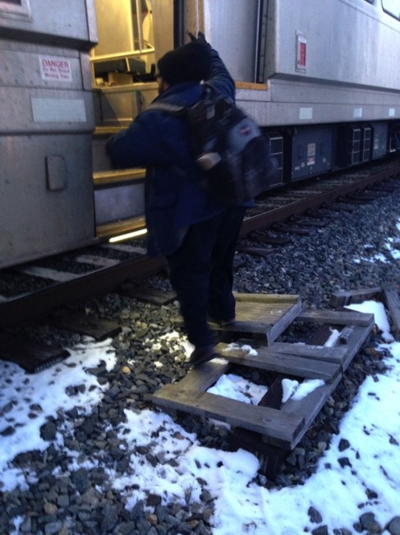
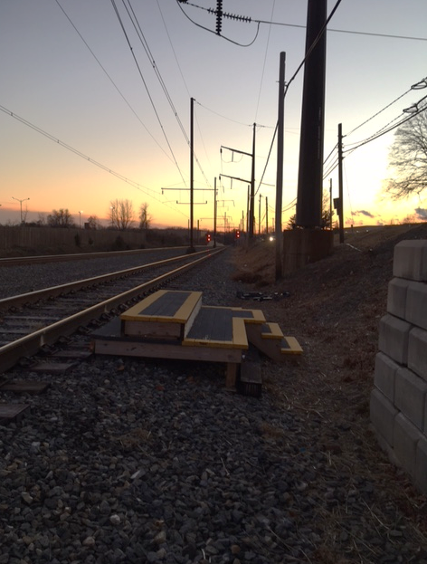
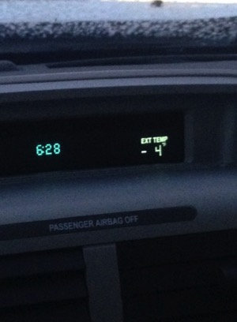
EMPLOYEE ENGAGEMENT
BEING PART OF THE ACTION SEVERE WEATHER RESPONSE
Nothing like a -4 degree day to be reminded of the importance of providing safe conditions for employees
Platform Safety at Warminster
New Platform Step-Up

Slide 16
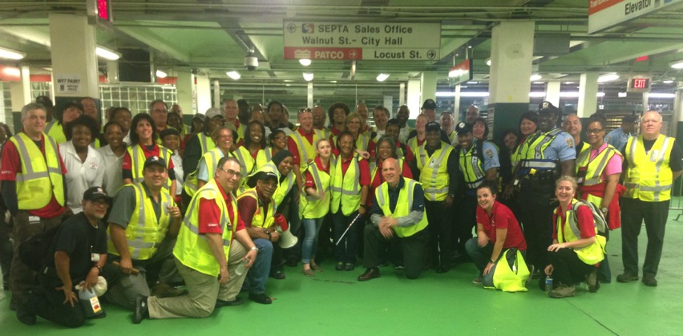
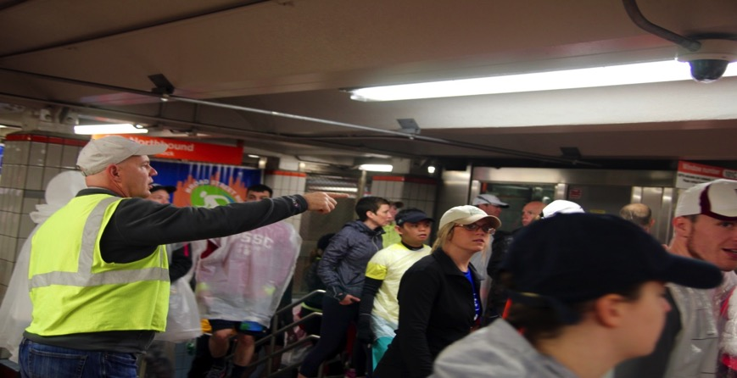
EMPLOYEE ENGAGEMENT
GENERAL MANAGER
AS AMBASSADOR
World Meeting of Families:
Sunday, September 27
Broad Street Run:
Sunday, May 1

Slide 17
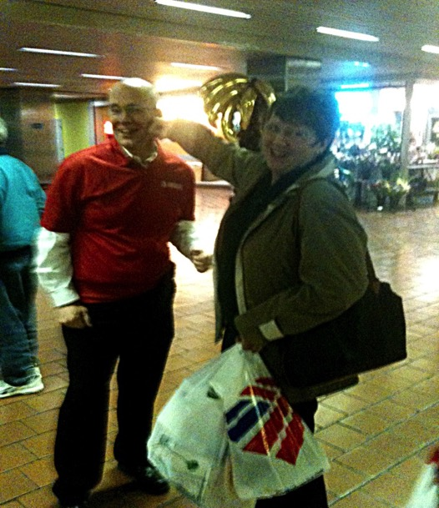
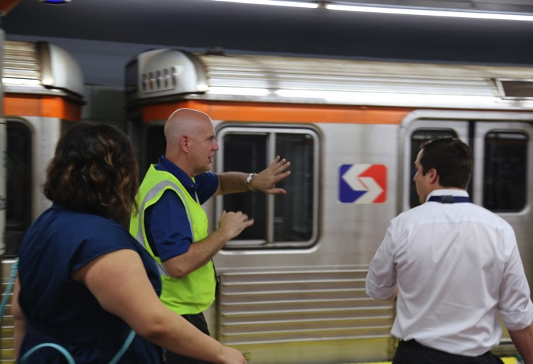
EMPLOYEE ENGAGEMENT
GENERAL MANAGER
AS AMBASSADOR
Democratic National Convention
July 2016
Philadelphia Flower Show
March 2014

Slide 18
EMPLOYEE ENGAGEMENT
SHADOWING EMPLOYEES
Field Engineer early part of my SEPTA career – working along side front line maintenance and transportation employees
As Chief Engineer, always visited maintenance and construction crews – focused on understanding their jobs
When I became Deputy General Manager, I wanted to better understand jobs of transportation employees
I always believe I make better decisions when I understand in detail what our employees do

Slide 19
EMPLOYEE ENGAGEMENT
SHADOWING EMPLOYEES
Big fan of the “Undercover Boss” TV show
Decided to start a SEPTA Employee Shadowing Program
No publicity, just real interactions
plus an opportunity for a safety culture push!
Primary contact is with the
employee – but always careful
not to undercut their manager
or supervisor

Slide 20
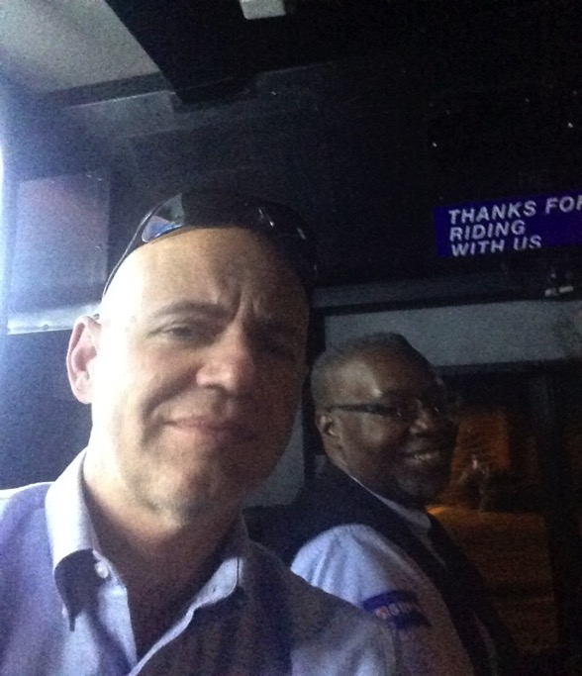
EMPLOYEE ENGAGEMENT
NOT SO UNDERCOVER BOSS
Bus Blocker at Midvale
Callowhill Operator

Slide 21
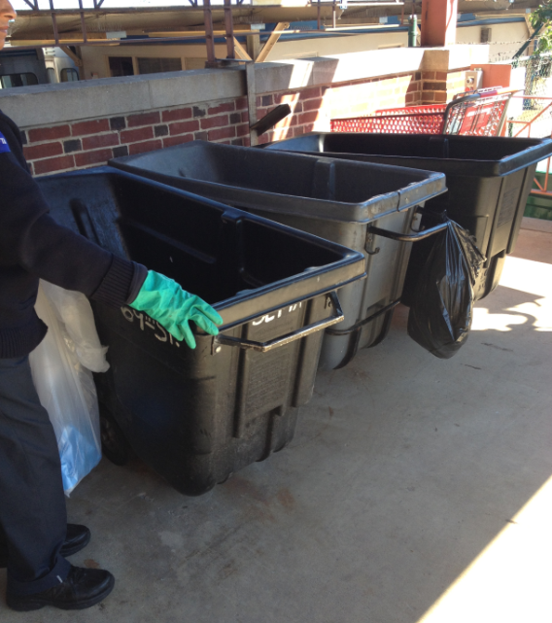
EMPLOYEE ENGAGEMENT
NOT SO UNDERCOVER BOSS
Dan Jones at Midvale
Maintenance Custodian at 69th Street
Broken Wheel Problem
SEPTA – PPTA – WINTER 2017

Slide 22
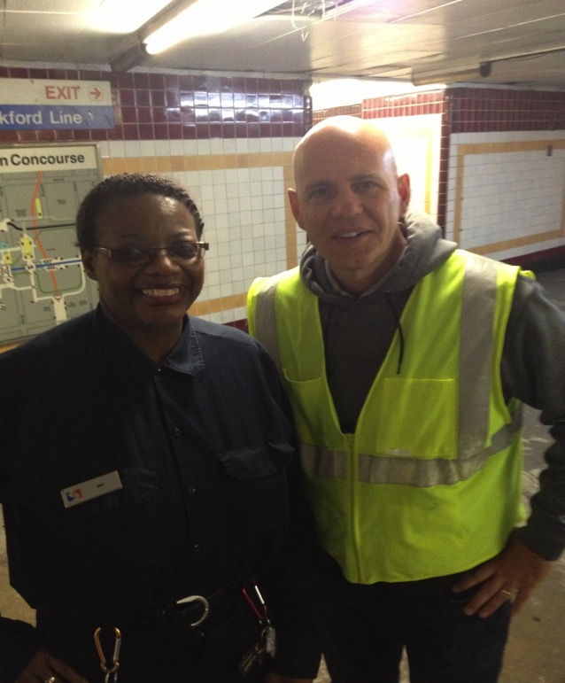
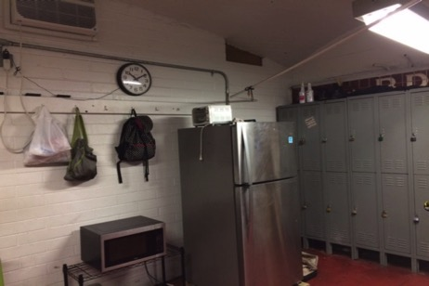
EMPLOYEE ENGAGEMENT
NOT SO UNDERCOVER BOSS
BEFORE
AFTER
Lounge at City Hall Station
Patricia Harvey – City Cleaner
SEPTA – PPTA – WINTER 2017

Slide 23
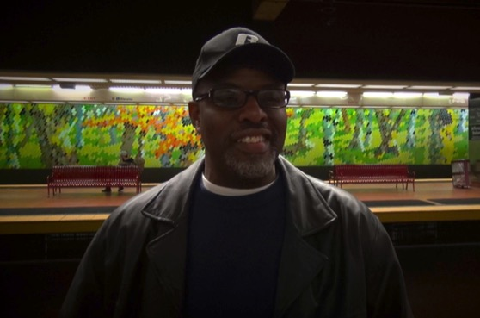
EMPLOYEE ENGAGEMENT
NOT SO UNDERCOVER BOSS
Case Study: Lansdale Yard
Shadowed these employees on overnight shift at Lansdale Yard
Important safety and productivity issues determined and led to major investment
Five of seven Railroad outlying yards have been improved with lighting, storage and office trailers/sheds, more secure access, water service, improved walking surfaces, etc.
Sixth yard currently in progress.

Slide 24
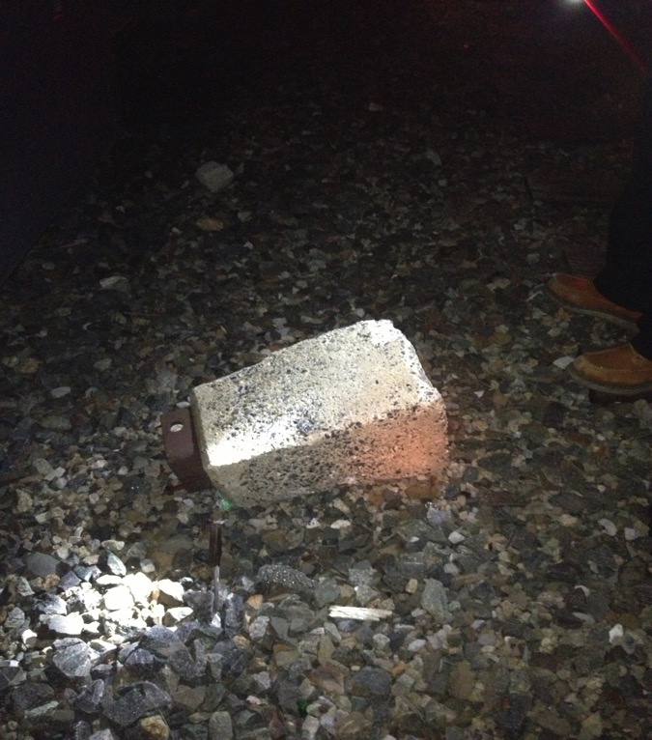
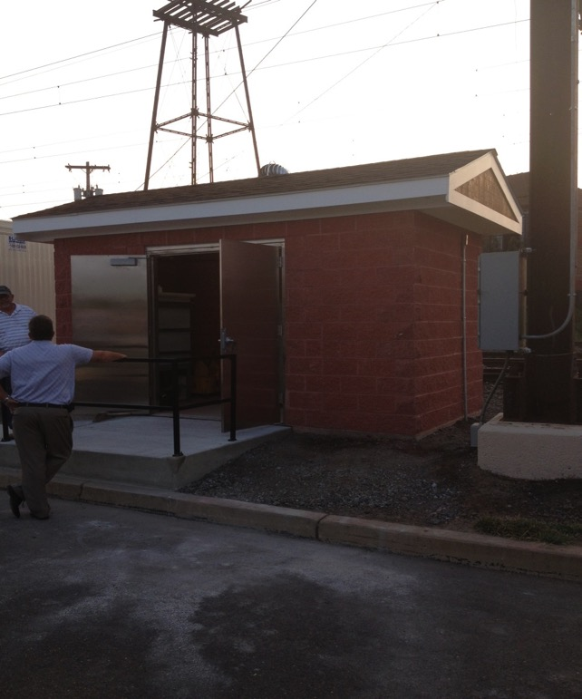
EMPLOYEE ENGAGEMENT
NOT SO UNDERCOVER BOSS
.
Debris at Lansdale Yard
New Shed at Lansdale

Slide 25
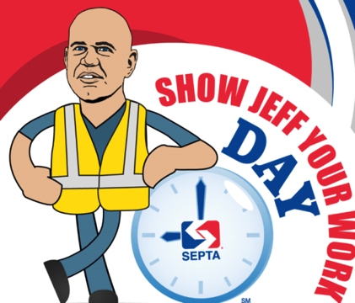
EMPLOYEE ENGAGEMENT
SHOW JEFF YOUR WORK DAY
Expanded Employee Shadowing Program through Building a SEPTA Customer Service Culture (BSCSC) Program
Created “Show Jeff Your Work Day”
Designed to be documented and publicized

Slide 26
EMPLOYEE ENGAGEMENT
SHOW JEFF YOUR WORK DAY RESULTS
Case Study: Midvale District
Stall numbers hung from ceiling above Buses
Bus Blocker booths replaced across Authority
Authority Supplied bottled water in ALL booths
Computerized paperwork process

Slide 27
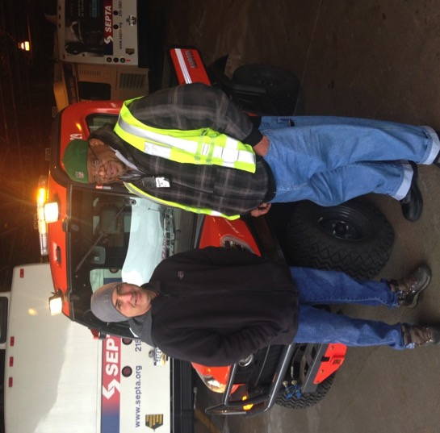
EMPLOYEE ENGAGEMENT
SHOW JEFF YOUR WORK DAY RESULTS
Case Study: Midvale District
Provided new utility vehicle
Increase in speed checks across Authority Bus storage areas
New Utility Ride

Slide 28
EMPLOYEE ENGAGEMENT
SHOW JEFF YOUR WORK DAY PARTICIPANTS
Show Jeff Your Work Day Participants:
Vehicle Readiness Coordinator -Southern
(at Midvale for Show Jeff Your Work Day)
Maintenance Custodian
(Now Auxiliary Supervisor)
Maintenance Manager - Overbrook Shop
Relief Cashier on the Broad Street Line

Slide 29
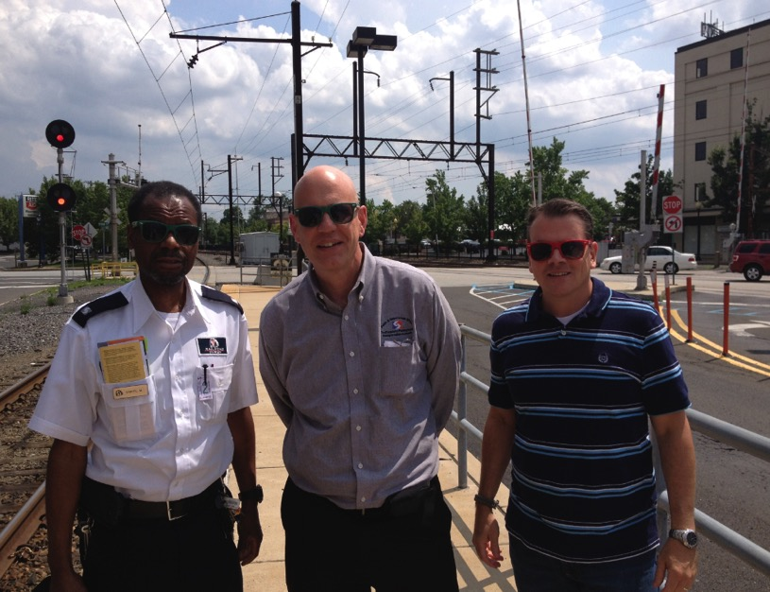
EMPLOYEE ENGAGEMENT
END OF OUR SHIFT AT LANSDALE WITH OUR FREE SUNGLASSES
“The times when employees invite me into their world and allow me to see all they do to contribute to our business and our customers are some of the best and strongest experiences that define my 29 year career at SEPTA.
Being in the field energizes me!”
Jeff Knueppel

Slide 30
GENERAL MANAGER’S PROGRAM TO FOSTER EMPLOYEE ENGAGEMENT
January 12, 2017

