Slide 1
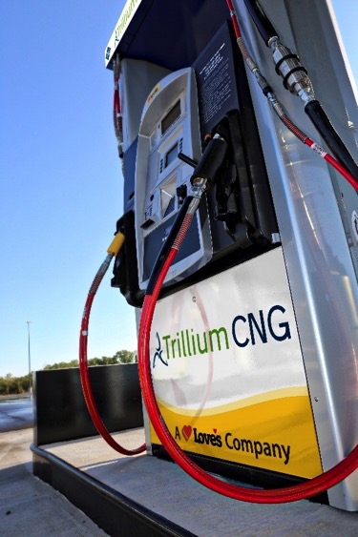
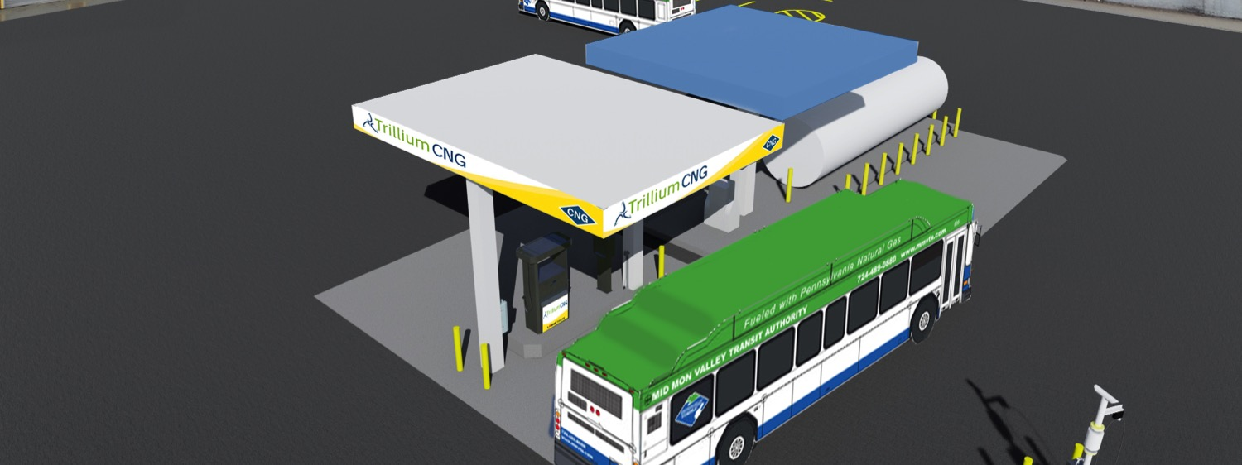
CNG P3 Project Update January 2017 PPTA Winter Meeting
Notes:
Bob

Slide 2
Overview
General Project Update
Current and Future Activities
Design and Construction Cycle
Gas and Electric Utilities
TAA
Notes:
Scott

Slide 3
PennDOT P3 Team
PennDOT, P3 Office
PennDOT, BPT
Bob Sharp
PennDOT, BPT
Nick Baldwin
Sam Plocinski
Trillium Project Manager
Guido Struyk
CNG P3
Program Manager
Scott Zeevaart
Program and Construction Management Team
Scott Schriner
Tim King
Brett Brenize
Mike MacAllister
Trillium Design Team
Transit Agencies
Trillium Construction Team
Trillium O&M Team
Notes:
Scott

Slide 4
2016 Activities
Site Visits
Surveys, Geo-Tech, TA meetings
Design Coordination and Approvals
% complete review meetings
Site design field amendments
Permitting – AHJs
Notice to Proceed 1 – Achieved 10/26/2016
Notice to Proceed 2 - (Site Specific)
Notes:
Scott

Slide 5
2017 Construction Initiation
Underway:
CAMTRAN-Johnstown
Near Term Initiation Q1 2017
CPTA – York
MMVTA – Donora
WCTA-Greensburg
CATA-State College
Notes:
Scott

Slide 6
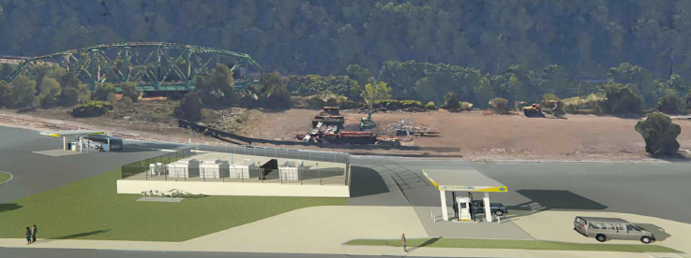
CAMTRAN – Johnstown Renderings
Notes:
Scott

Slide 7
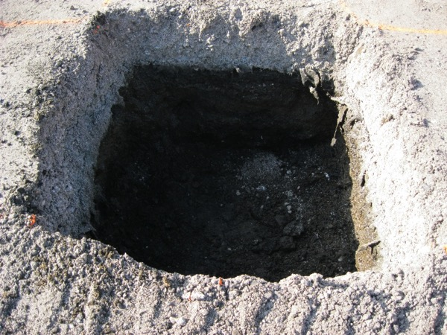
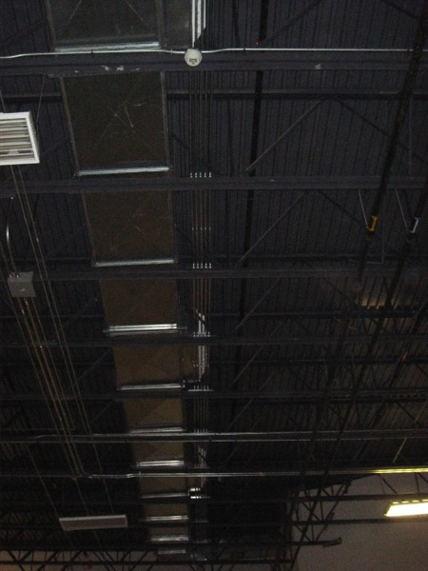
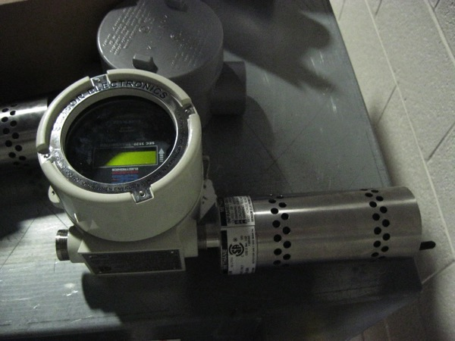
CAMTRAN-Johnstown 1/4/2017
Notes:
Scott

Slide 8
General Overview of Activities
Initial Site Visit
Design Coordination – 120+ days
Utility Coordination 150+ days
Permits – 100 days
Construction – 70-80 days
Commissioning – 14 days
Throughput Testing – 14 days
CNG Readiness
Notes:
Guido

Slide 9
On-Going Activities
Design and Permitting Underway for 16 Sites
Building and Maintenance Facility Modifications
Fueling Station Plans
Q1 2017
7 sites will be under construction
2017 – Target 12 CNG stations will be fully operational
Utility infrastructure design and upgrades
Long lead times
CNG Readiness Compliance Activities
Notes:
Guido

Slide 10
Utilities Overview
Trillium’s Responsibility - Distribution
Gas Infrastructure upgrades
Design and Routing – Gas Provider
Applicable $$ upgrades – Trillium
LEA – TA will need to execute with Guidance from Project Team
Electrical Infrastructure upgrades
Design and Routing – Electrical Provider
Applicable $$ upgrades – Trillium
LEA – TA will need to execute with Guidance from Project Team
Notes:
Guido

Slide 11
Utilities Overview
TA’s Responsibility – Commodity
TA is required to procure commodity supply with a natural gas provider
Needed in time for commissioning, approximately 8 weeks prior to CNG Readiness
Notes:
Guido

Slide 12
Operations and Maintenance (O&M)
O&M Webinar overview
February 2nd at 10:30 a.m.
Webex invitation to be sent to TAs and PPTA early next week
Opportunity to understand Trillium and TAs responsibility with regards to O&M
Hosted by PennDOT – Trillium Presenter
Be prepared to ask Questions
Notes:
Guido

Slide 13
Forthcoming Training
Basic Station Operation
Fueling
Defueling
Emergency Response
On-going Training
Annual Refresher
New Employees
Site-Specific Modifications
Notes:
Guido

Slide 14
TAA Update
TAA – Version 3 was sent out 1/10/17
17 Sent Out
Forthcoming Amendment regarding Turnback
RTKL Clauses
Notes:
Scott
Delays:
Due to change at OGC.
Questioning format of many other PennDOT Contracts, not just the TAAs.
Recently two minor issues have been identified with the TAAs that were at the OGC
Working to resolve
I will be in touch with the Transit Agencies that have already submitted a TAA once we resolve the issues with OGC.
Amendment
Are currently working with PennDOT Office of Chief Counsel to draft the language to clarify with the Transit Agencies what happens to the CNG Fueling Station at the end of the Term.
RTKL
TAA, Section 10.12 intent to not restrict the normal operations/business of the Transit Agencies.
You are able to discuss the P3 project for your site during the various public meetings that are occurring.
Obviously for more detailed questions about the project as a whole, we would ask that you refer the inquiry to the PennDOT Press Office.
In addition, the goal of 10.12 is to make sure that no press releases or public interviews are initiated without coordination from PennDOT in order that we provide consistent messaging.
If you receive a RTK request for information regarding the CNG P3 project, please remember to coordinate with PennDOT so that PennDOT’s RTK Office can be involved.

Slide 15
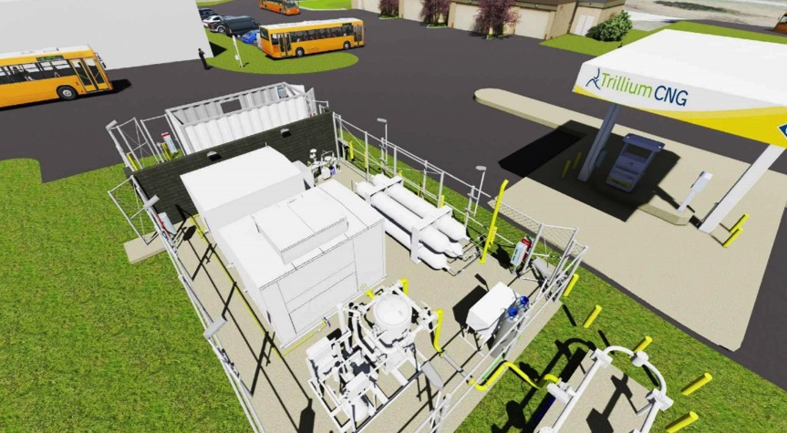
Contact Information
Any Questions regarding the CNG P3 Project, please contact either:
Scott Zeevaart
(717) 877-2644
szeevaart@gfnet.com
Bob Sharp
(717) 783-9461
rosharp@pa.gov
Notes:
Scott

