Slide 1
Human Trafficking:
The Legal Perspective
Presented by Shea Rhodes, Esq.
Director and Co-Founder
The Institute to Address Commercial Sexual Exploitation
Villanova University Charles Widger School of Law

Slide 2
Human Trafficking
The illegal trade of human beings for the purpose of sexual exploitation or forced labor

Slide 3

The Cost of Human Trafficking:
Human Trafficking is a $32 Billion World-Wide Industry
Polaris Project – For A World Without Slavery
Courtesy of Wikimedia Commons
Notes:
SALE OF HUMANS IN THIRD WORLD COUNTRIES IS FOR ORGANIZED CRIME – RIGHT AFTER DRUGS AND WEAPONS

Slide 4
PROSTITUTE

Slide 5
Commercial Sexual Exploitation
What does it look like?
Is prostitution a victimless crime?
Is prostitution the oldest profession?
Why? Does prostitution exist?
Why does sex trafficking exist?
Who are the victims?

Slide 6
Who are the Victims?

Slide 7
Portrait of Exploitation

Slide 8
Portrait of Exploitation

Slide 9
Portrait of Exploitation

Slide 10
Portrait of Exploitation

Slide 11
Portrait of Exploitation

Slide 12
Portrait of Exploitation

Slide 13
Portrait of Exploitation

Slide 14
Portrait of Exploitation

Slide 15
Portrait of Exploitation

Slide 16
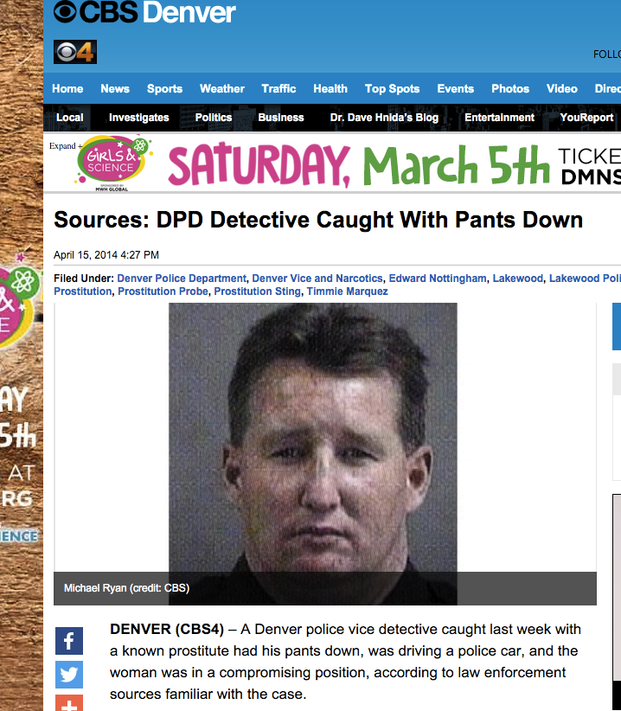
Detective Arrested in Denver
“With Pants Down”

Slide 17
Who Are the Victims?
Anyone who has a vulnerability and can be exploited

Slide 18
Do you know the signs?
Victims rarely self identify as victims
Traffickers use of control causes can make victims reluctant to escape due to fear and dependency

Slide 19
Characteristics of Potential Victims:
Broken Homes
Abused
Unpopular
Substance Abusers
Runaways
Dreamers
Developmentally Disabled
No English or ESL Skills

Slide 20
Youth Risk Factors for CSE
Runs away three or more times
Lack of family stability or no “father figure”
Prior involvement with DHS or Children and Youth, possibly an open case
Prior sexual abuse
Hyper sexualized behavior, unhealthy relationships
Addicted to or using drugs

Slide 21
Conditioning a Victim
Starvation
Confinement
Isolation
Physical abuse
Torture
Rape
Threats of violence to victim’s family members
Denial of medical care or medications
Perceived inability to escape
Forced to give up custody of her children
Forced to participate in acts of violence against other victims
Humiliation

Slide 22
Effects of Victimization
The American Journal of Epidemiology found that the leading causes of death among one cohort of prostituted women in America were:
  Homicide
  Drug Use
“To our knowledge, no population of women studies previously has had a crude mortality rate, standardized mortality ratio, or percentage of deaths due to murder even approximating [prostituted persons]”.

Slide 23
Do you know the signs?
Ask
LABOR OR SERVICE INDICATORS
Was the person recruited for one purpose and forced to engage in some other job?
Is the person’s salary being garnished to pay off alleged debts?
Was the person forced to do sexual acts?
Does the person work excessively long or unusual hours?
Is the person inadequately dressed for the situation or work they do?

Slide 24
Do you know the signs?
Ask
CONTROL INDICATORS
Is the person in possession of her identification and travel documents? If not, who is?
Does the person appear to be coached on what to say?
Does someone appear to be controlling the person’s situation?
Has the person, or their family, been threatened with harm?
Is the person fearful, timid or submissive?
Has the person been threatened with deportation or law enforcement action?
Is the person confused, afraid, or do they show signs of physical or mental abuse?
Can the person contact family and friends freely?
Is the person allowed to freely socialize or attend religious services?

Slide 25
Do you know the signs?
Ask
MEDICAL INDICATORS
Does the person have scars, burns, mutilations, or infections?
Is the person being prevented from or limited in providing her medical history?

Slide 26
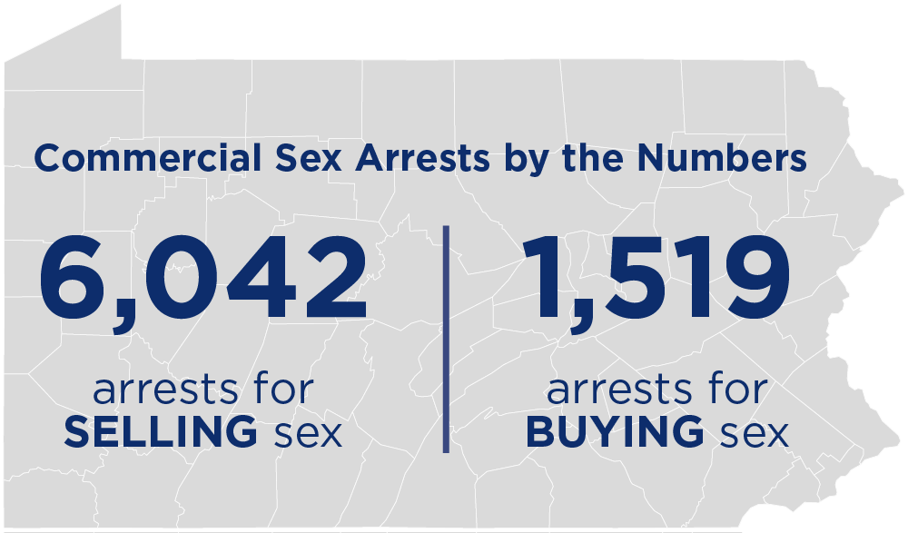
APOC 2014-2015

Slide 27
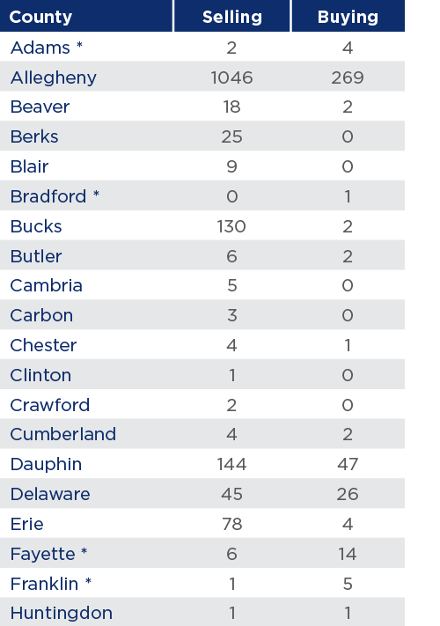
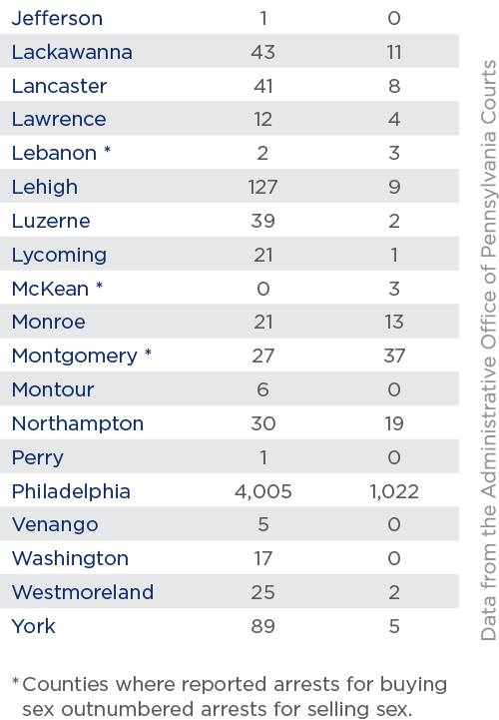
APOC 2014-2015

Slide 28
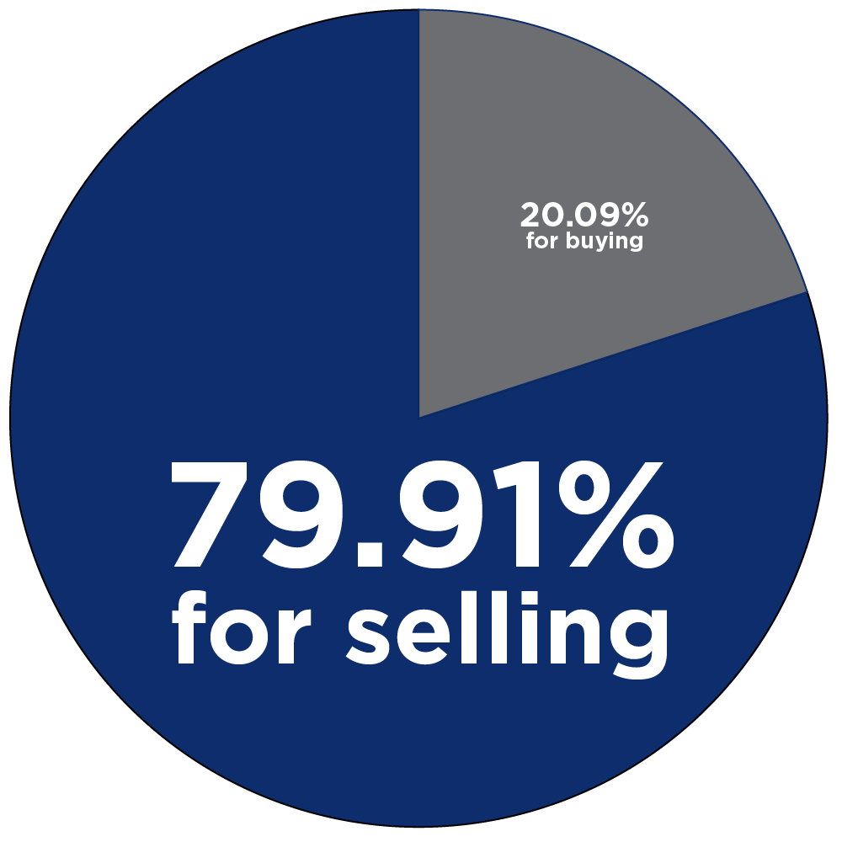
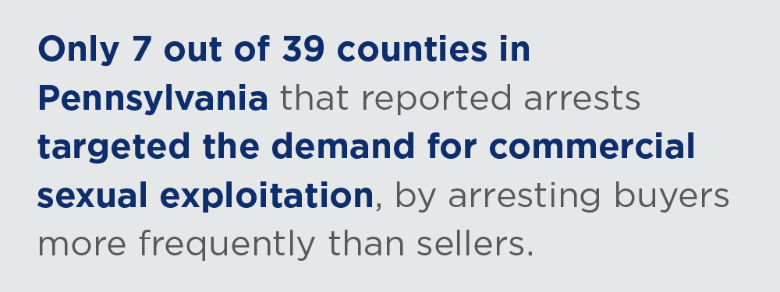
Criminalizing Victims of Commercial Sexual Exploitation
APOC 2014-2015

Slide 29
Federal Law: 18 U.S. Code § 1591
Sex Trafficking of children or by force, fraud, or coercion
The government must prove three elements:
    Act - recruits, entices, harbors, transports, provides, obtains, advertises, maintains, patronizes, solicits OR knowingly benefits from participation in such acts
    Means – by force, threat of force, fraud, or coercion OR if the victim has not yet attained 18 years of age (Sex Trafficking of Children or by Force Fraud or Coercion- 18 U.S.C. § 1591)
    Purpose – a commercial sex act OR to subject the victim to involuntary servitude, peonage, debt bondage, or slavery

Slide 30
Act
Recruits, entices, solicits, harbors, transports, provides, obtains, maintains, advertises, or patronizes
Knowingly financially benefits or receives anything of value
Means
Force, fraud, or coercion
Threats, physical abuse, kidnapping, extortion, use of drugs, duress, controlling property, withholding food, etc.
Purpose
Commercial sex act
Involuntary servitude, debt bondage

Slide 31
Force, Fraud, and Coercion
Aligned with federal law, Pennsylvania does not require proof of force, fraud, or coercion in a case where the victim is a minor.
United States v. Jungers, 702 F. 3d 1066 (8th Cir. 2013)
  “Obtains” is broad enough to apply to both pimps (suppliers) and purchasers of sex (John’s or the Demand)
United States v. Bell, 761 F.3d 900, 908 (8th Cir. 2014)
  “Boyfriend behavior” = fraud. The use of deception about marital status and his “pattern of convincing [the] women that he loved them and would take care of them at the exclusion of all others” and that “they would be financially secure, emotionally secure, and loved” rose to the level of deception – which constituted fraud.
Notes:
U.S. v. Jungers – “obtains” = 18 U.S.C. § 1591 makes no distinction between suppliers and purchasers, “obtains” is broad enough to apply to both.
U.S. v. Bell – “boyfriend behavior” = fraud:
The Eight Circuit found that the trafficker’s use of deception about his marital status and his “pattern of convincing [the] women that he loved them and would take care of them at the exclusion of all others” and that “they would be financially secure, emotionally secure, and loved” rose to the level of procuring the victims’ commercial sexual services through deception, which constituted fraud.

Slide 32
What is Act 105?
(2014)
Act 105 addresses three primary areas:
  Prosecution of human trafficking;
  Prevention of human trafficking; and
  Protection for victims/survivors
  18 Pa. C.S.A. §§3001 et. seq.

Slide 33
Act 105: Act, Means, Purpose
ACT: § 3011 Trafficking in Individuals
MEANS: § 3012(b) Involuntary Servitude
PURPOSE: subjecting an individual to labor servitude or sexual servitude (18 Pa. C.S.A. § 3012(a))
Labor servitude and sexual servitude defined in § 3001
Notes:
Act 105 also breaks down sex and labor trafficking into an act, means, and purpose.

Slide 34
§ 3001 Definitions
“Human trafficking.” Any activity in violation of section 3011 (relating to Trafficking in Individuals) either alone or in conjunction with an activity in violation of section 3012 (relating to Involuntary Servitude).

Slide 35
§ 3001 Definitions
“Involuntary servitude.” Labor servitude or sexual servitude.
“Labor servitude.” Labor which is performed or provided by another individual and is induced or obtained by any of the means set forth in section 3012(b) (relating to involuntary servitude).

Slide 36
§ 3001 Definitions
Pennsylvania now has a clear definition sex trafficking.
“Sexual Servitude” Any sex act or performance involving a sex act for which anything of value is directly or indirectly given, promised to or received by any individual or which is performed or provided by any individual, and is induced or obtained from
(1) a minor
(2) Any other individual by any of the means set forth in section 3012(b)(relating to involuntary servitude).
“Minor” An individual who is less than 18 years of age.

Slide 37
§ 3011
Trafficking in Individuals (“Act”)
(a) Offense defined.—A person commits a felony of the second degree if the person:
(1) recruits, entices, solicits, harbors, transports, provides, obtains or maintains an individual if the person knows or recklessly disregards that the individual will be subject to involuntary servitude; or
(2) knowingly benefits financially or receives anything of value from any act that facilitates any activity described in paragraph (1).
Notes:
Section 2 potentially imposes criminal liability on hotels.

Slide 38
§ 3011 Trafficking in Minors (“Act”)
(b) A person commits a felony of the first degree if the person engages in any activity listed in subsection (a) that results in a minor’s being subjected to sexual servitude.
*Now also a Megan’s Law Offense!
(§ 9799.14 Sexual offenses and tier system)

Slide 39
§ 3012 Involuntary Servitude (“Purpose”)
(a) Offense defined.—A person commits a felony of the first degree if the person knowingly, through any of the means described in subsection (b), subjects an individual to labor servitude or sexual servitude, except where the conduct is permissible under Federal or State law other than this chapter.

Slide 40
§ 3012
Involuntary Servitude (“Means”)
(b) Means of subjecting an individual to involuntary servitude.—A person may subject an individual to involuntary servitude through any of the following means: (This is FORCE FRAUD OR COERCION)
FORCE:
(1) Causing or threatening to cause serious harm to any individual.
(2) Physically restraining or threatening to physically restrain another individual.
(3) Kidnapping or attempting to kidnap any individual.
FRAUD:
(8) Fraud.
Notes:
Examples of fraud:
False promises
Deceitful enticing and affectionate behavior
Lying about working conditions
Lying about the promise of a better life, “selling a dream”

Slide 41
§ 3012(b)
Involuntary Servitude (“Means”)
COERCION:
(4) Abusing or threatening to abuse the legal process.
(5) Taking or retaining the individual’s personal property or real property as a means of coercion.
(6) Engaging in unlawful conduct with respect to documents, as defined in section 3014 (relating to unlawful conduct regarding documents).
(7) Extortion.

Slide 42
§ 3012(b)
Involuntary Servitude (“Means”)
COERCION:
(10) Duress, through the use of or threat to use unlawful force against the person or another.
(11) Debt coercion.
(12) Facilitating or controlling the individual’s access to a controlled substance.
(13) Using any scheme, plan or pattern intended to cause the individual to believe that, if the individual does not perform the labor, services, acts or performances, that individual or another individual will suffer serious harm or physical restraint.

Slide 43
§ 3012(b)
Involuntary Servitude (“Means”)
COERCION:
(9) Criminal coercion, as defined in section 2906 (relating to criminal coercion)
18 Pa. C.S.A. § 2906
Offense defined.--A person is guilty of criminal coercion, if, with intent unlawfully to restrict freedom of action of another to the detriment of the other, he threatens to:
(1) commit any criminal offense;
(2) accuse anyone of a criminal offense;
(3) expose any secret tending to subject any person to hatred, contempt or ridicule; or
(4) take or withhold action as an official, or cause an official to take or withhold action.

Slide 44
Protections for Victims
Vacatur §3019(d)
Civil Causes of Action § 3051
“Rape shield” § 3121 and Mistake of Age § 3018
Crime Victims Compensation
Restitution/Asset Forfeiture

Slide 45
Prostitution Based Offenses
18 Pa. Cons. Stat. § 5902 (2012).

Slide 46
18 Pa CS § 5902(a)
Prostitution
“A person is guilty of prostitution if he or she:
(1) is an inmate of a house of prostitution or otherwise engages in sexual activity as a business; or
(2) loiters in or within view of any public place for the purpose of being hired to engage in sexual activity.”

Slide 47
18 Pa CS § 5902(b)
Promoting Prostitution
“A person who knowingly promotes prostitution of another commits a misdemeanor or felony as provided in subsection (c) of this section. The following acts shall, without limitation of the foregoing, constitute promoting prostitution:
(1) owning, controlling, managing, supervising or otherwise keeping, alone or in association with others, a house of prostitution or a prostitution business;
(2) procuring an inmate for a house of prostitution or a place in a house of prostitution for one who would be an inmate;
(3) encouraging, inducing, or otherwise intentionally causing another to become or remain a prostitute;
(4) soliciting a person to patronize a prostitute;
(5) procuring a prostitute for a patron;
(6) transporting a person into or within this Commonwealth with intent to promote the engaging in prostitution by that person, or procuring or paying for transportation with that intent;
(7) leasing or otherwise permitting a place controlled by the actor, alone or in association with others, to be regularly used for prostitution or the promotion of prostitution, or failure to make reasonable effort to abate such use by ejecting the tenant, notifying law enforcement authorities, or other legally available means; or
(8) soliciting, receiving, or agreeing to receive any benefit for doing or agreeing to do anything forbidden by this subsection.”

Slide 48
§ 5902(b.1) Promoting Prostitution of a Minor
“A person who knowingly promotes prostitution of a minor commits a felony of the third degree. The following acts shall, without limitation of the foregoing, constitute promoting prostitution of a minor:
(1) owning, controlling, managing, supervising or otherwise keeping, alone or in association with others, a house of prostitution or a prostitution business in which a victim is a minor;
(2) procuring an inmate who is a minor for a house of prostitution or a place in a house of prostitution where a minor would be an inmate;
(3) encouraging, inducing or otherwise intentionally causing a minor to become or remain a prostitute;
(4) soliciting a minor to patronize a prostitute;
(5) procuring a prostitute who is a minor for a patron;
(6) transporting a minor into or within this Commonwealth with intent to promote the engaging in prostitution by that minor, or procuring or paying for transportation with that intent;
(7) leasing or otherwise permitting a place controlled by the actor, alone or in association with others, to be regularly used for prostitution of a minor or the promotion of prostitution of a minor, or failure to make reasonable effort to abate such use by ejecting the tenant, notifying law enforcement authorities or other legally available means; or
(8) soliciting, receiving or agreeing to receive any benefit for doing or agreeing to do anything forbidden by this subsection.”

Slide 49
18 Pa CS § 5902(d)
Living off Prostitutes
“A person, other than the prostitute or the prostitute's minor child or other legal dependent incapable of self-support, who is knowingly supported in whole or substantial part by the proceeds of prostitution is promoting prostitution in violation of subsection (b) of this section.”

Slide 50
18 Pa CS § 5902(e)
Patronizing Prostitutes
“A person commits the offense of patronizing prostitutes if that person hires a prostitute or any other person to engage in sexual activity with him or her or if that person enters or remains in a house of prostitution for the purpose of engaging in sexual activity.”

Slide 51
Targeting ALL Perpetrators
Victim
Traffickers
Facilitators
Buyers

Slide 52
“Safe Harbor” Legislation
Being Reintroduced this Session
*PROTECT AND NOT PROSECUTE CHILD VICTIMS
Safe Harbor requires minors (anyone under 18) be granted immunity from prosecution for the crime of prostitution and prostitution-related offenses including:
(1) criminal trespass,
(2) disorderly conduct,
(3) loitering and prowling at night,
(4) obstructing highways or public passages,
(5) false identifications to law enforcement, and
(6) simple possession of controlled substances as a result of being a victim of human trafficking.
Empower state agencies to support child victims
Train police to identify and help child victims
Establish a fund for victim services and awareness
Notes:
Immunity 3/9: Connecticut, New Hampshire, Vermont
Diversion 2/9: Mass, New Jersey
Hybrid 1/3: New York (under 16 presumed victim: immune, 16-17 diversion)
None 3/9: Maine, Pennsylvania, Rhode Island

Slide 53
Needs of Victims
Safe long-term housing
Access to education
Employment/life-skills training
Trauma therapy
Counseling & mental health services
Treatment for drug or alcohol dependency
Medical & dental care
Clothes & personal items
Senate Bill 851

Slide 54
National Human
Trafficking Hotline
Required Posting 43 P.S. §1493
*
(b) Posting.--Establishments shall post at least one sign in a conspicuous manner clearly visible to the public and employees of the establishment.
“Establishment.” Includes:
(5) An airport, train station or bus station.
(6) A welcome center or rest area operated by the Department of Transportation or the Pennsylvania Turnpike Commission. (definitions § 1492)

Slide 55
National Human
Trafficking Hotline
Required Posting 43 P.S. §1493
*
1-888-3737-888

Slide 56
Truckers Against Trafficking
Trucking industry in a unique position to combat trafficking through their time spent observing activity on the highways
Truckers have made countless reports of criminal activity that has helped lead to the arrest of traffickers
TAT’s “programs work to create entry points to train drivers and truck stop employees so that more calls will be made, and more victims recovered.”
Goals: “Saturate trucking and related industries with TAT materials, partner with law enforcement and government agencies to facilitate the investigation of human trafficking, [and] marshal the resources of our partners to combat this crime.”
http://www.truckersagainsttrafficking.org

Slide 57
Statewide Resources
Department of Human Services
(P.O. Box 2675, Harrisburg PA 17105-2675, http://www.dhs.pa.gov)
Friends of Farm Workers
(699 Ranstead Street, Suite 4 Philadelphia, PA 19106, 5450 Second Ave, 2nd Floor Pittsburgh, PA 15207, http://www.friendsfw.org)
Villanova University Charles Widger School of Law Institute to Address Commercial Sexual Exploitation (CSE Institute)
(299 N Spring Mill Rd, Villanova, PA 19085, http://cseinstitute.org)
Pennsylvania Alliance Against Trafficking in Humans (PAATH)
(website coming soon: http://www.educateandadvocate-paath.com)
Pennsylvania Coalition Against Domestic Violence (PCADV)
(3605 Vartan Way, Suite 101, Harrisburg PA 17110, http://www.pcadv.org)
Pennsylvania Coalition Against Rape (PCAR)
(125 North Enola Drive, Enola, PA 17025, http://www.pcar.org)
Pennsylvania Commission on Crime and Delinquency (PCCD)
(3101 N Front St, Harrisburg, PA 17110, http://www.pccd.pa.gov/Victim-Services/Pages/default.aspx#.V1dD62PvHsE)

Slide 58
Villanova Law School Institute to Address Commercial Sexual Exploitation
Shea M. Rhodes, Esquire
Director
Office: 610-519-7183
Email: shea.rhodes@law.villanova.edu
www.cseinstitute.org
Twitter: @cseinstitute and @shmrnrhds

