Slide 1
Transit Benefit 101 How the Transit Benefit Works – and Can Work for Your System
Panelists:
Moderator – Stacy Bartels, DVRPC
David Judd, Edenred USA/Commuter Benefits
Erin Burke, DVRPC/RideECO
Jennifer Scimone, SEPTA/Commuters Choice
Notes:
Introduce self
This session came about b/c of recent Marketing Committee activity and the production of materials for transit agencies to use, promoting the transit benefit to employers. Some members have had very little or no experience with the benefit, so we’re here to tell you what it’s about, what kinds of programs are out there right now, and how you can offer and promote the benefit in your service area.
Introduce each panelist

Slide 2
Quiz Show
Category: Transit Benefits
First person to answer correctly, gets a point
Highest score = prize!
Notes:
Give away “prize” to one who gets the highest score

Slide 3
The Basics
The Commuter Transportation Fringe benefit provides a tax break for commuting via public transportation; permitted through IRS Tax Code 132(f)
Has been around in various forms, at different amounts, since late 1980s – implemented in different ways in different regions
Currently allows employees to take advantage of $255/month ($3060/year) in pre-tax or tax-free dollars – for commuting on transit or vanpools; bicycle benefit also available
Notes:
What’s not covered? (talk only)
Car sharing, Bike sharing, Carpooling, Transportation Network Companies (Uber, Lyft, etc.),Taxis, Tolls, Fuel and maintenance, Business trip costs, Residential parking

Slide 4
How It Works
A Transportation Fringe Benefit (TFB) is similar to, but not the same as, a Flexible Spending Account (FSA)
No formal plan to file (FSAs = Section 125)
Less regulation and paperwork compared to FSAs
No formal enrollment period – employers can implement any time during the year; employees can participate at any time
No “use-it-or-lose-it” provision

Slide 5
There’s a reason it’s called a Benefit
$avings!
When offered as a pre-tax payroll deduction:
For employees:
no Federal Income Taxes and FICA
commuters can realize a savings of more than $900/year
For employers:
reduced FICA match
company can save up to $229 per employee, annually
Notes:
If paid for by employer, the benefit is federal tax-exempt to employee – over and above monetary compensation
Programs can usually be offered at no (or very little) cost to the employer

Slide 6
More Benefits
Allows an easy, additional benefit – can improve employee morale
Helpful in recruiting, retaining quality employees
Promotes company as forward-thinking, environmentally-friendly, a good community partner
Notes:
Recent focus groups substantiate these benefits, reasons for offering the benefit

Slide 7
Setting up a Program
Can be offered by several types of entities:
By a transit agency
By a regional entity (MPO, Chamber, TMA, etc.)
By a third-party administrator (for a system or region)
By the employer directly via reimbursement (if none of the above exists)
Panelists will address these types of implementation
Notes:
We will address these in reverse order:
David – third-party or contractor
Erin – regional entity
Jen – transit agency
Questions at end, please

Slide 8
The Big(ger) Picture

Slide 9
At-a-glance
Edenred Commuter Benefit Solutions is the leading provider of tax-free commuter benefit solutions in the U.S.
Serves over 12,000 employers and 1.9 million eligible employees, including 10% of Fortune 500 companies, 20% of Fortune 100 companies
Partners with over 50 national Third Party Administrators (TPAs), 350+ transit agencies, 5,000+ parking locations and 650+ bicycle shops
Transit, Parking, Vanpooling, Rideshare, Bicycling
Products to work with: all fare media and fare collection systems
Manage commuter programs for MBTA (Boston), RTA (Chicago) and DVRPC (Philadelphia)

Slide 10
What ARE They, Really?
COMMUTER BENEFITS ARE:
Fringe benefits that allow employees to pay for some of their commuting expenses, like public transportation fares, vanpool costs, and parking fees with tax-free money.
QUALIFIED COMMUTER BENEFITS INCLUDE:
Transit / Vanpool - $255/month cap (pre-tax, subsidy or combination)
Parking - $255/month (pre-tax, subsidy or combination)
Bicycle - $20/month cap (subsidy only)

Slide 11
History of the benefit, Part 1
1970s Employer pass programs emerge
1984 Tax Reform Act of 1984 “codifies” use of transit benefits, allowing $15 per month maximum benefit (“cap”); limited to employer subsidy
1992 Energy Policy Act of 1992, permits vanpools and set qualified parking at $155 and included an annual inflation adjustment. (Took effect 1/1/93).
1993 Federal Employees – Clean Air Incentives Act of 1993, allowed Federal agencies to offer commuter benefits to their employees.
1998 TEA-21, Employee-paid pre-tax payroll $65 deduction feature added
2000 Executive Order 13150 mandates transit benefits for Federal employees

Slide 12
History Of the benefit, Part 2
2008 Emergency Economic Stabilization Act adds a bicycle benefit starting in 2009.
2009 February: American Recovery and Reinvestment Act (ARRA) raises cap to $230, matching the cap for tax-free parking (2009 legislation limits the increase through 12/31/10)
2012 Cap reverts to $125 due to expiration of ARRA
2013 American Taxpayer Relief Act of 2012 raises cap to $240, with an inflation adjustment to $245.
2014 January – the cap is reduced to $130, increases to $250 and in December, the Tax Increase Prevention Act retroactively increases the cap to $250 for 2014.
2015 Cap returns to $130.
2015 Consolidated Appropriations Act, 2016 creates permanent parity between Transit and Parking at $255 and retains the annual inflation adjustment effective 1/1/16

Slide 13
Employer Options
Employers can a Commuter Benefit program in one of four ways:
As a pre-tax benefit, where the employee sets aside an amount up to $255/month
As an employer-provided subsidy, where the employer provides it tax-free to the employee
In combination as long as the benefit does not exceed $255/month
For bicycle commuters, as a subsidy, not to exceed $20/month
In all cases, there is a savings to the employer and employee.

Slide 14
Commuter Benefits TOdAY
ARE ALL EMPLOYEES ELIGIBLE?
Included: Employees who receive a W-2
Excluded: Self-employed persons defined as partners, sole proprietors, S-Corp. employees with 2% or more ownership, and independent contractors. However, they can receive a "de minimis fringe" benefit of $21 per month ($252 a year)

Slide 15
Tax SAvings
Employers:
No FICA (7.65%) on either subsidy to employee pre-tax deduction up to monthly cap
Employer can save up to $234 per employee ($255 x 7.65% x 12) per year
Employees:
No FICA (7.65%) on the amount deducted from their paycheck or subsidy provided from employer
Amount subject to Federal and State income tax is reduced – no income tax in AK
On average, employees save up to 40% (depending on state and tax bracket)

Slide 16
How Do Employers Offer the Benefit?
There are many different kinds of products:
Vouchers – transit, parking and bicycle
Prepaid debit cards (anonymous & personalized) – restricted to transit and/or parking facilities
Transit passes and other fare media
Direct loading of smartcards
Direct pay to vanpool operators and parking facilities
Reimbursement for parking expenses

Slide 17
DIFFERENT RELATIONSHIPS FOR DIFFERENT AREAS
Edenred can tailor its services to the needs of a region:
Full Service – handle marketing, sales, fulfillment, customer service
Supplemental service – e.g. provide just fullfillment and customer service (RideECO)
Independent service – provide full program where no program or management interest exists
Consulting – help guide small agencies to initiate a basic program

Slide 18
Program Overview
The Delaware Valley Regional Planning Commission (DVRPC) is the MPO for the Greater Philadelphia Region
Administered by DVRPC since 1991
Second commuter benefit program in the nation (after NYC)
RideECO is a Transportation Fringe Benefit (TFB), not a Flexible Spending Account; has fewer administrative requirements than FSA

Slide 19
Program Overview (continued)
Two program options: RideECO (bulk) and RideECO Select (online)
RideECO is geared toward smaller employers or those with one worksite; administration and distribution handled by employer
RideECO Select is better for larger employers
offers the opportunity of a national commuter benefit;
administration is managed online;
employees can have a role in managing benefit;
products are mailed directly to employees;
more product options
Notes:
Add logo to first slide (and/or do we need an intro slide with brief background?)

Slide 20
Program Overview (continued)
RideECO materials can be used to purchase fare materials – monthly passes, weekly passes, 10-trip tickets, tokens, single ride tickets, loads onto fare cards; + monthly vanpool expenses
RideECO products:
vouchers ranging from $15 - $255 (whole dollar amounts);
direct load to PATCO FREEDOM Cards;
bike benefit

Slide 21
Program Overview (continued)
RideECO Select products:
Stored Value Card (SVC);
Vouchers;
loads to PATCO cards;
SEPTA monthly passes and 10-trip tickets;
bike benefit
RideECO Select’s SVC is branded as a credit card, so it can be used wherever credit cards are accepted (enabling the ability to offer a national benefit); will also be compatible with SEPTA’s planned new fare collection system – SEPTA Key
Notes:
Mention that we can explore loads to SVCs of other systems, too, and/or add fare media for other specific systems to the Select platform

Slide 22
Program Status
Over $289 million in sales since inception
Mix of companies: geographic, industry, size, administration type
Initiating a RideECO program results in 17% new riders; 41% ride more*
* Per research of current RideECO users completed by RideECO
Notes:
Add to footnote: Per research of current users …

Slide 23
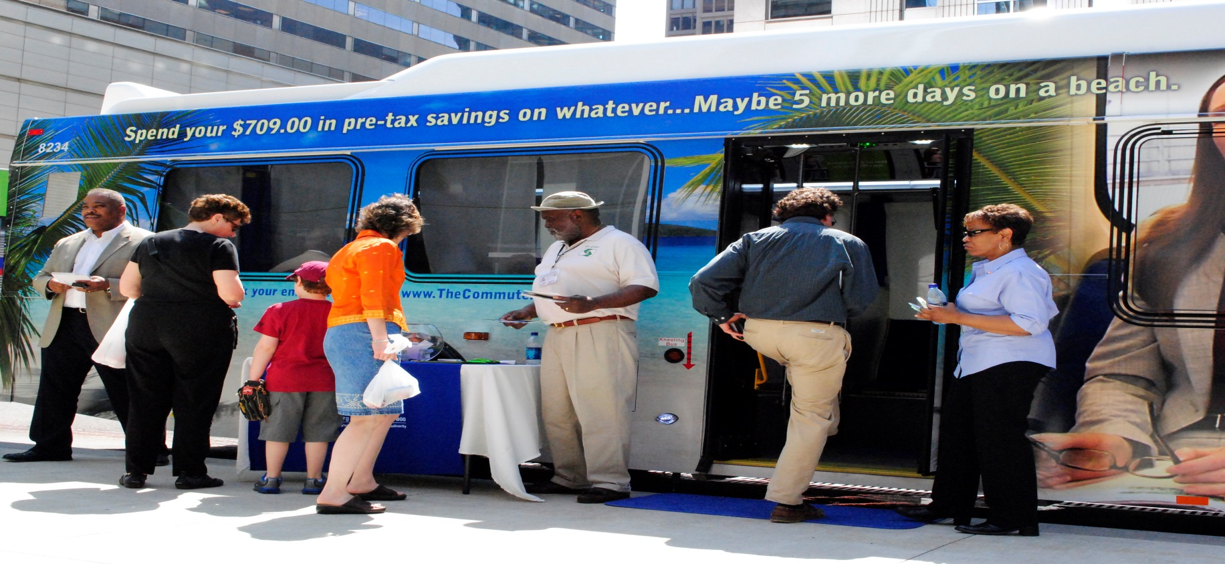
SEPTA’s Commuter’s Choice Program

Slide 24
Commuter’s Choice Overview
The Southeastern Pennsylvania Transportation Authority (SEPTA) is the sixth largest transit authority in the country serving: Bucks, Chester, Delaware, Montgomery and Philadelphia counties.
SEPTA’s transit benefit program, called ComPass, has over 140 area business and 8 college/university participants.
The ComPass program offers a discounted monthly pass. The pass is discounted 5% to participating employers and college/universities. They are required to match the discount and pass on the additional savings to their participants.
SEPTA monthly passes are 100% pretax eligible; highest monthly pass is $191.
Notes:
Mention connections into NJ (Trenton, W. Trenton) and into DE (Wilmington, Newark) via partnership with DART.

Slide 25
Commuter’s Choice Program
Commuter’s Choice includes the ComPass and RideECO Programs.
Participants also include other national third-party benefits administrators.
SEPTA views all these programs as complements to ComPass – not competitors!
Any program that promotes use of public transit is good for SEPTA’s bottom line.
Since ComPass only offers monthly passes, we encourage employers to offer RideECO as well, for employees who want to purchase tokens, tickets or weekly passes, or who ride other systems.

Slide 26
Commuter’s Choice Campaign

Slide 27
Commuter’s Choice Program- Next Steps
SEPTA is gearing up to introduce our contactless card called KEY.
KEY will improve our current transit benefit program by streamlining the ordering process, eliminating the need for monthly pass distribution, and bringing a card with greater security features.
Commuter’s Choice campaign will receive a facelift within the next year to accommodate the new program changes.
Will continue our partnerships with RideECO and third parties.
Look forward to growing the program with area employers and college/universities.

Slide 28
Q&A
Contact Information
David Judd
David.Judd@communterbenefits.com 908-654-0600
Erin Burke
eburke@dvrpc.org 215-238-2855
Jennifer Scimone
jscimone@septa.org 215-580-3566
Stacy Bartels
sbartels@dvrpc.org 215-238-2861
Notes:
THANK YOU!!!
See us afterward

