Slide 1
Best Practices for Design and Construction of Intermodal Transportation Facilities
PPTA 2016 Spring Conference
April 20, 2016

Slide 2
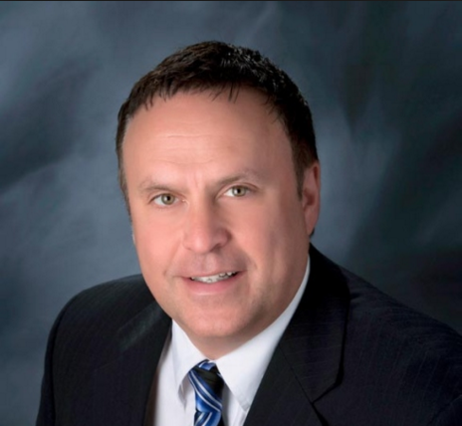
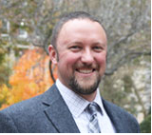
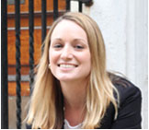
Presenters
Robert Fiume – Executive Director
County of Lackawanna Transit Systems (COLTS)
Richard Sullivan, RA, LEED AP, GGP – Director of Design,
Sowinski Sullivan Architects
Michael Hartley, P.E., PMP, CCM – Vice President, Principal Engineer
Sowinski Sullivan Architects
Kelly Freeman, RA, LEED AP – Vice President, Principal Architect
Sowinski Sullivan Architects

Slide 3
Success Indicators
Process Management
Results Driven Ideas
Planning
Construction
Design

Slide 4
Planning Overview
Planning
Project History
Site Selection
Operational & Facility Needs
Lessons Learned
Construction
Design

Slide 5
Design Overview
Planning
Design Considerations
Stakeholder Coordination
Lessons Learned
Construction
Design

Slide 6
Construction Overview
Planning
Bid Phase
Construction
Stakeholder Coordination
Lessons Learned
Construction
Design

Slide 7
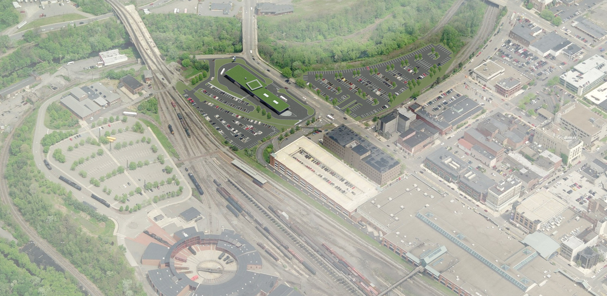
Best Practices in Project Planning

Slide 8
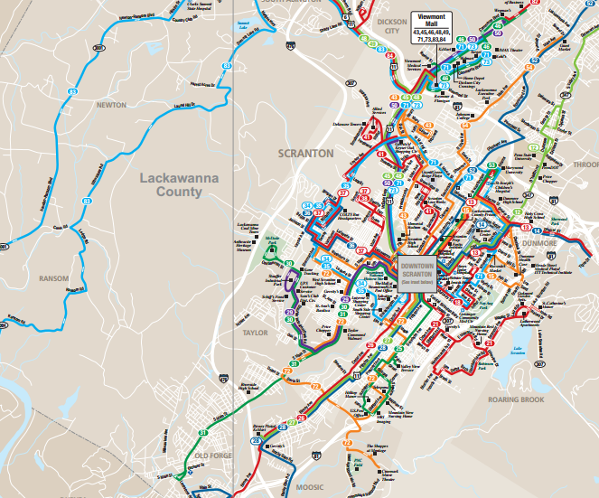
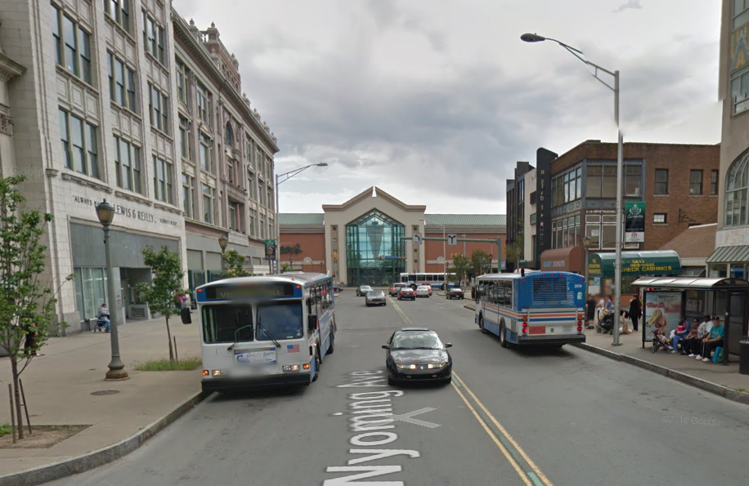
Project History
COLTS Service Area and Operations
Need for Intermodal Center
Property Selection Study
Funding
Wyoming Ave Stop
COLTS Downtown
System Map

Slide 9
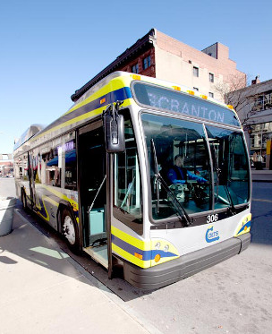
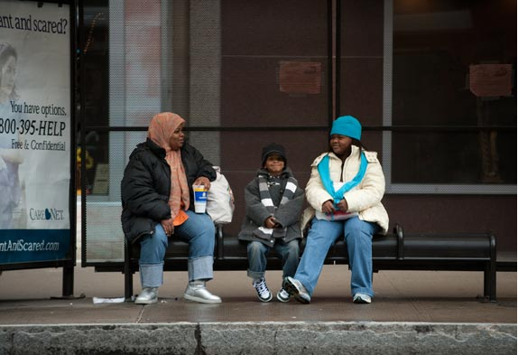
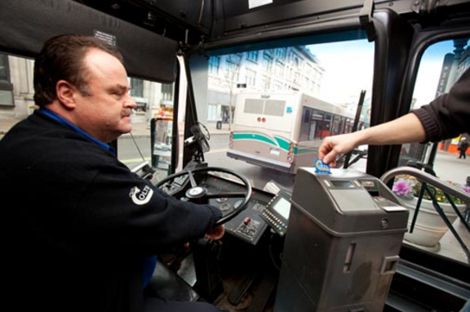
Operational Needs
What are our goals for this project?
Centralized Transit Hub
Multimodal and a True Intermodal
Improved Staff Facilities

Slide 10
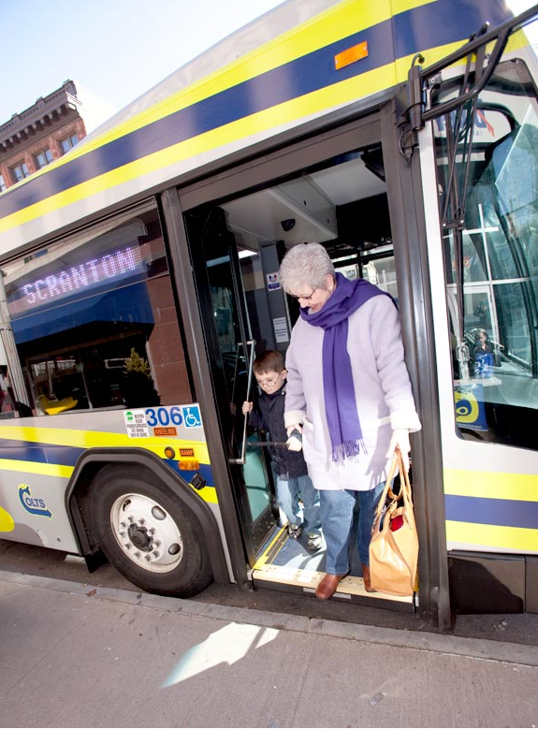
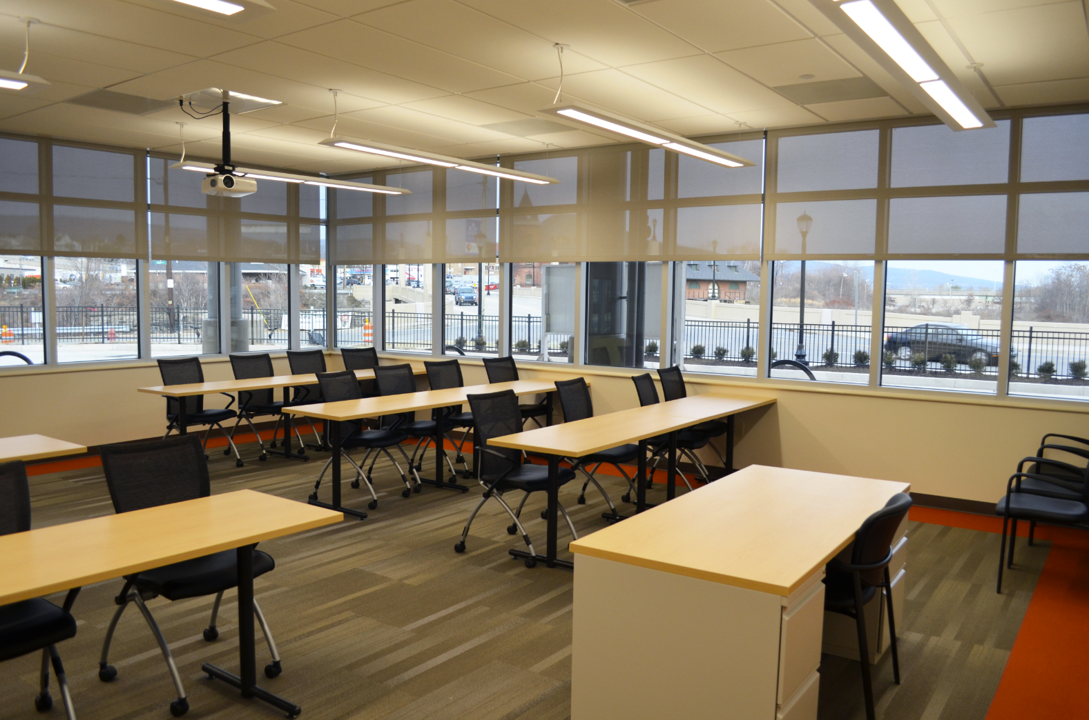
Facility Needs
What does the facility need to satisfy the goals?
Sheltered Public Waiting Space
Safe pedestrian access
Bus Circulation & Layover
Operational Space / Administration
Support Space for Driver Staff

Slide 11
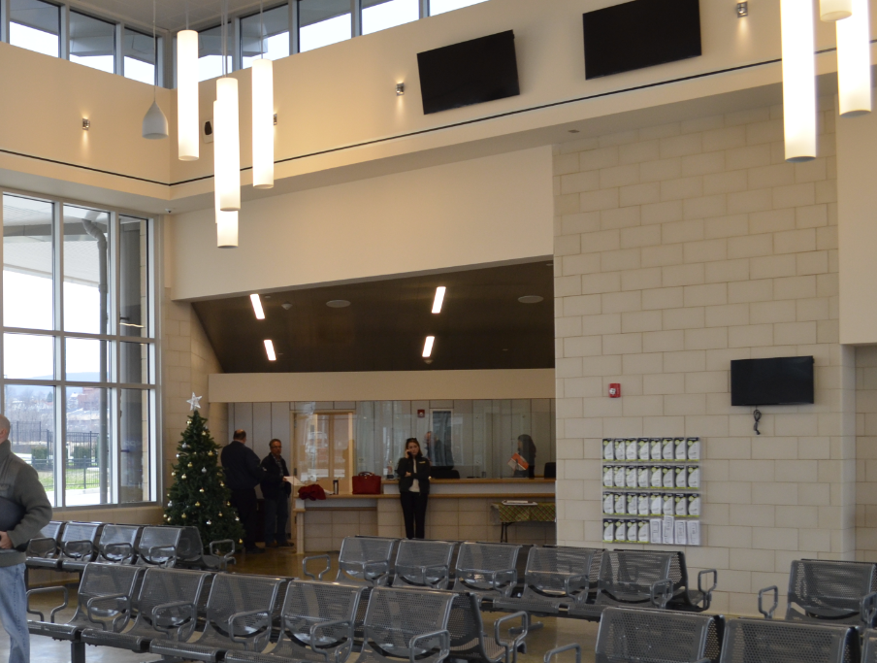
Facility Needs
Result:
Development of overarching goals and objectives that will guide the overall project through completion
A Right Sized Facility

Slide 12
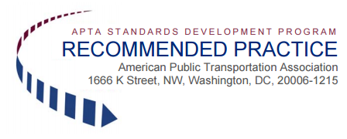
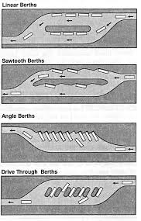
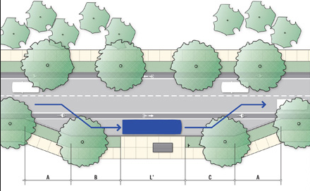
Site Selection
Source
APTA Architectural & Engineering Design for a Transit Operating and Maintenance Facility, Appendix B: Site Selection Criteria
APTA-BTS-BMF-RP-001-10
http://www.apta.com/resources/standards/Documents/APTA-BTS-BMF-RP-001-11.pdf
Shape & Size
Facility Needs
Multimodal Circulation Needs
Layover Needs

Slide 13
Site Selection (Cont’d)
Expansion
On-Site
Off-Site
Locality
Service Area
Dead Heads
Regional Access
Arterials / Highways
Service Area
Local Access
Ingress / Egress
Emergency Services
Zoning / Land Development Ordinances

Slide 14
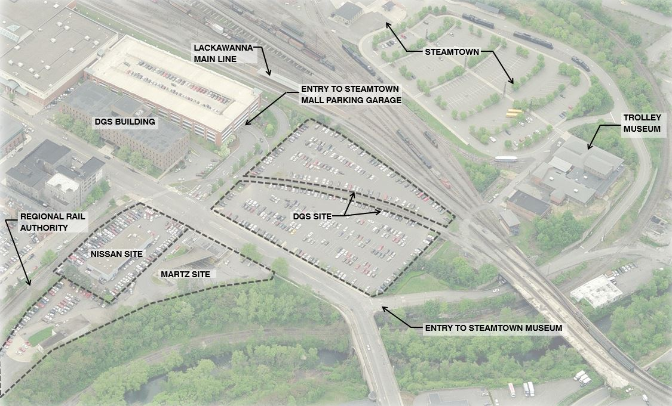
Site Selection (Cont’d)
Surrounding Neighborhoods
Displacements
Special Restrictions
Easements
Geotechnical
Environmental Considerations
National Environmental Policy Act (NEPA)
Wetlands / Riparian Areas / Flood Zones
Hazmat / Contamination
Keep community in mind!
Anchor a Neighborhood
Landmarking

Slide 15
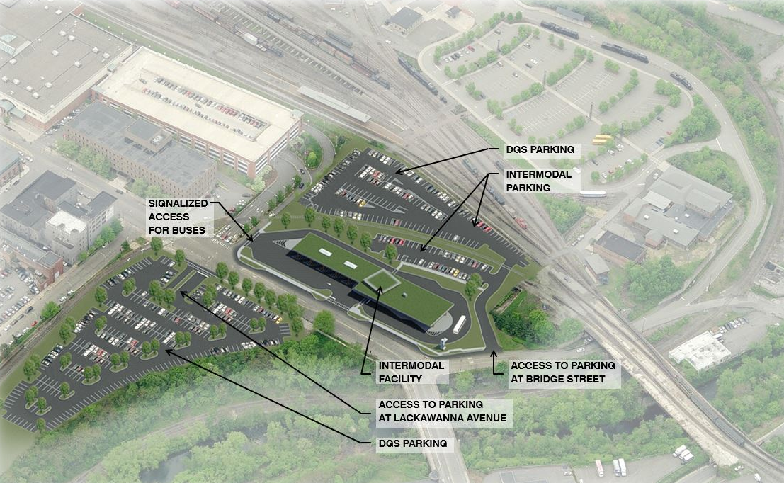
Lessons Learned in Project Planning
Patience & Persistence!!!
Choose Your Site Carefully
Develop a Process and Stick to It

Slide 16
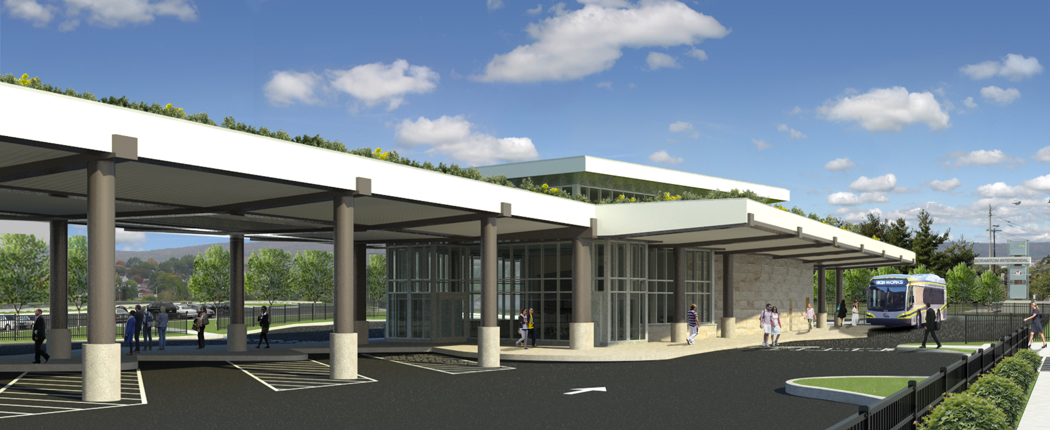
Best Practices in Project Design

Slide 17
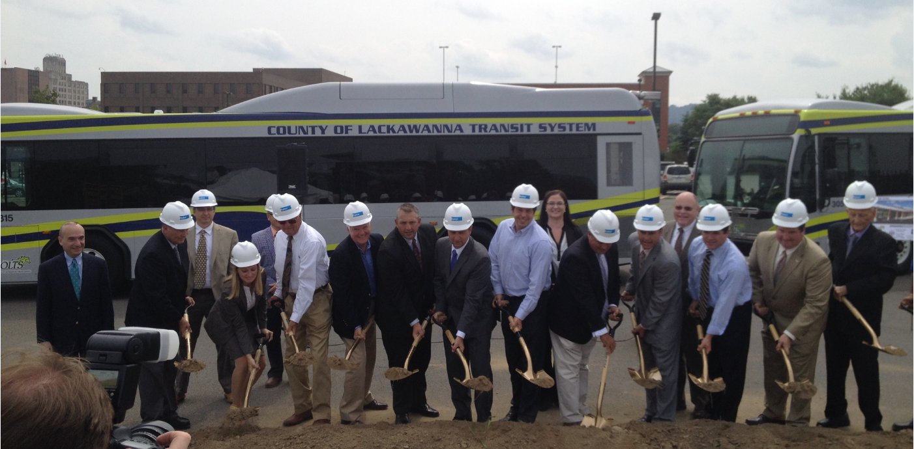
COLTS LTC Stakeholder Coordination
FTA / PennDOT BPT / Lackawanna County
PA DGS
Scranton Sewer Authority
Martz Trailways
City of Scranton, Penn DOT, Other Approval Agencies

Slide 18
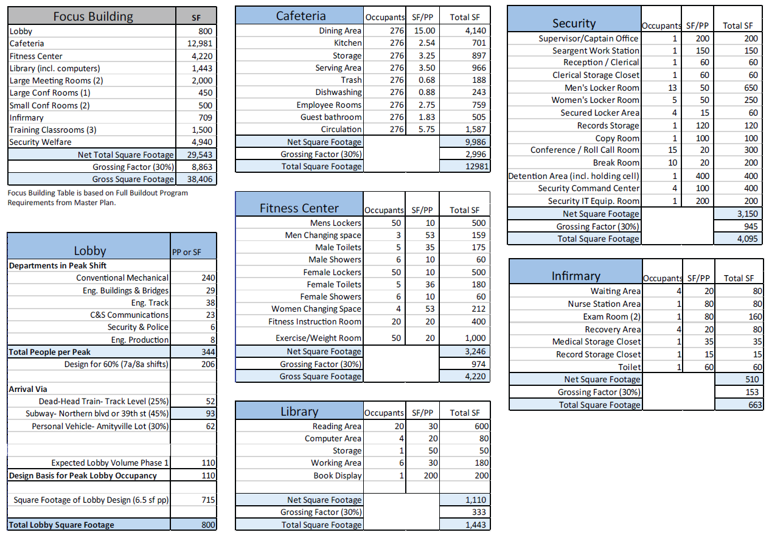
Programming
Delineating a Plan to Meet Planning Phase Goals
Multiple Occupants & Functions
Include Room to Grow

Slide 19
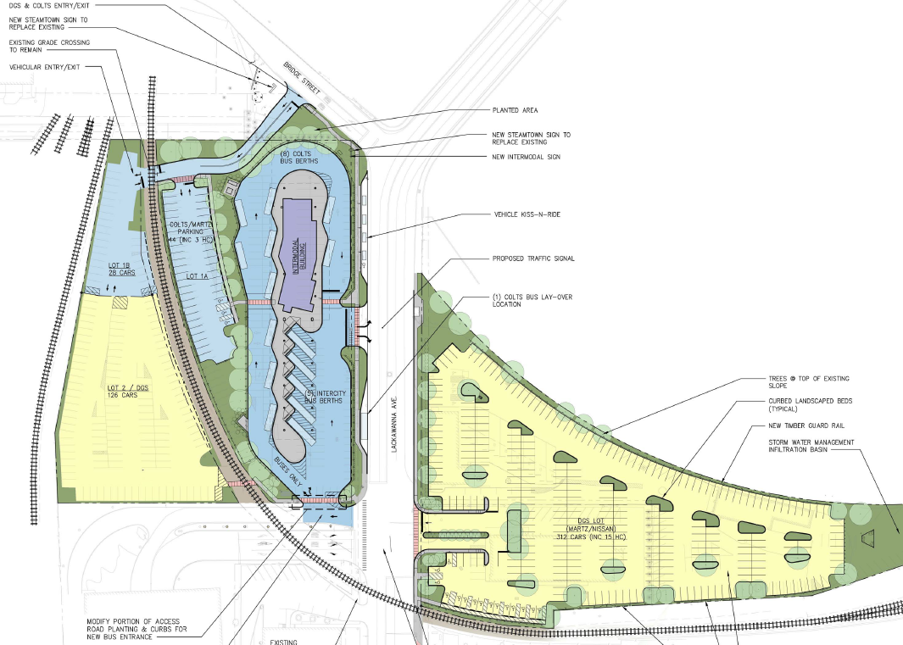
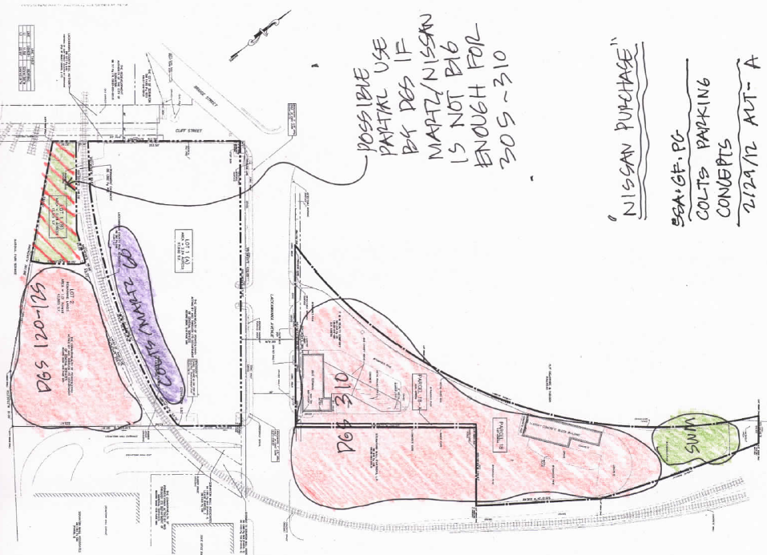
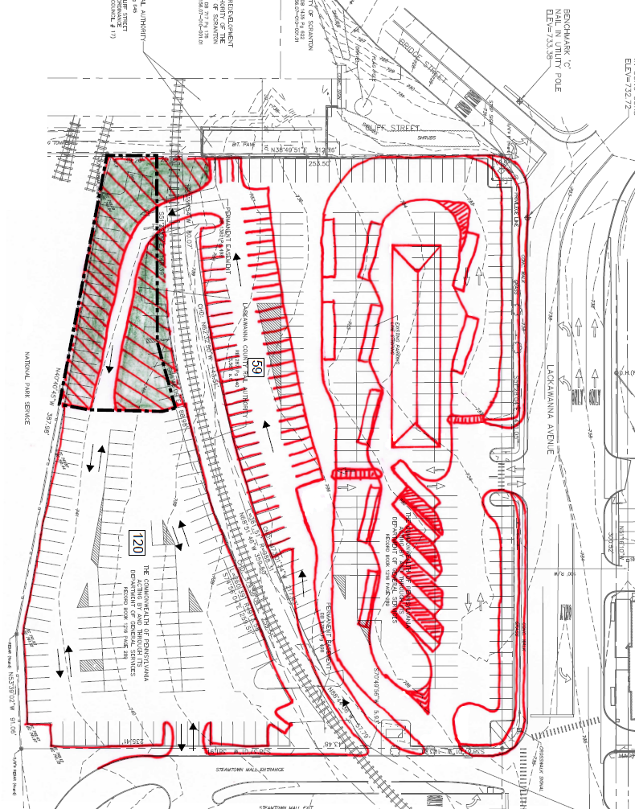
Programming
Test fit a variety of solutions

Slide 20
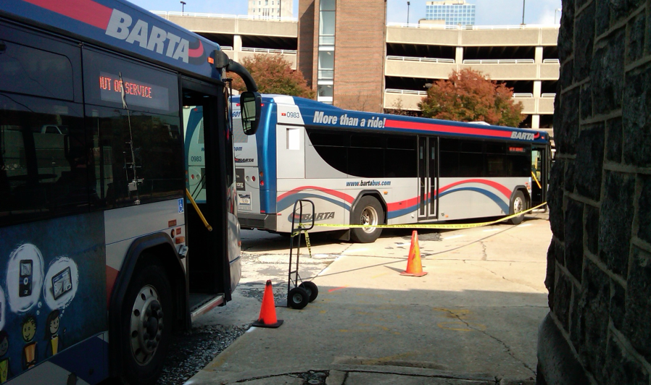
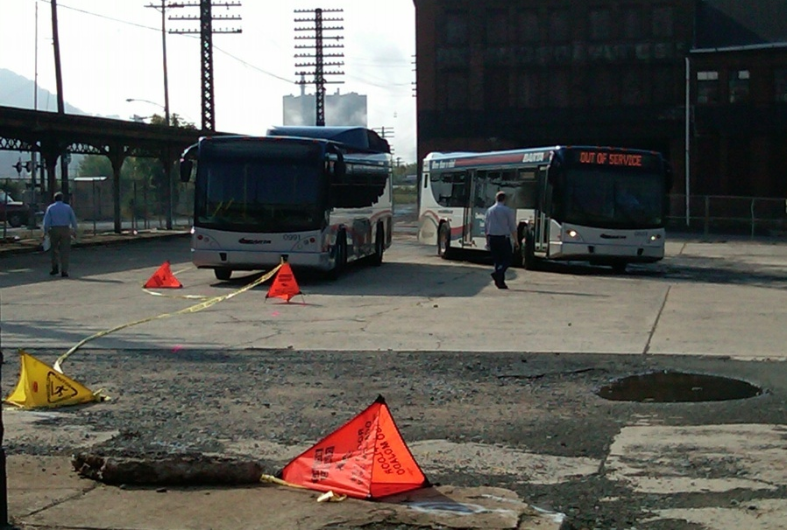
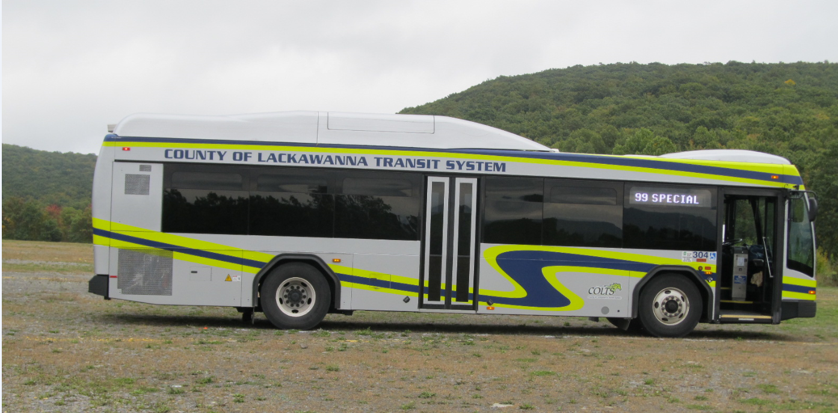
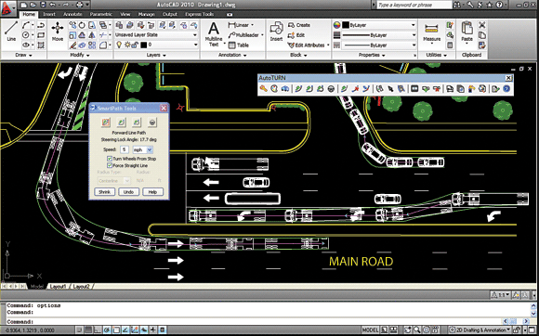
Smart Design
BARTA Bus Test
Operational Considerations for Vehicle Traffic
Multiple Modes
Vehicle Circulation
COLTS Bus Test

Slide 21
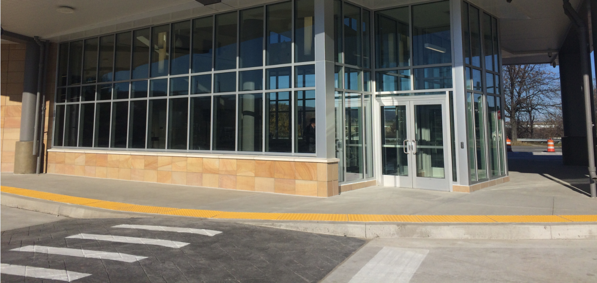
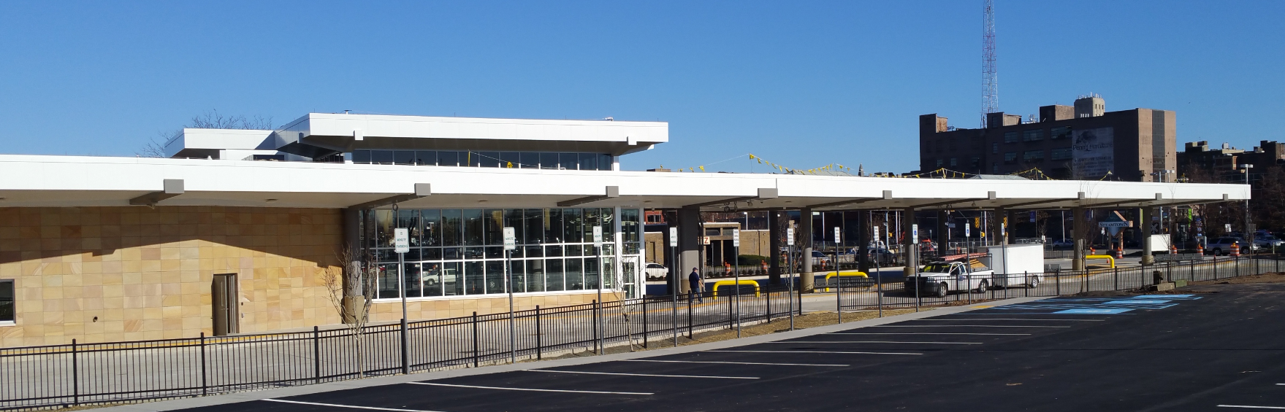
Smart Design
Separation of Passengers and Pedestrians from Vehicle Traffic
Accessibility & Level of Service

Slide 22
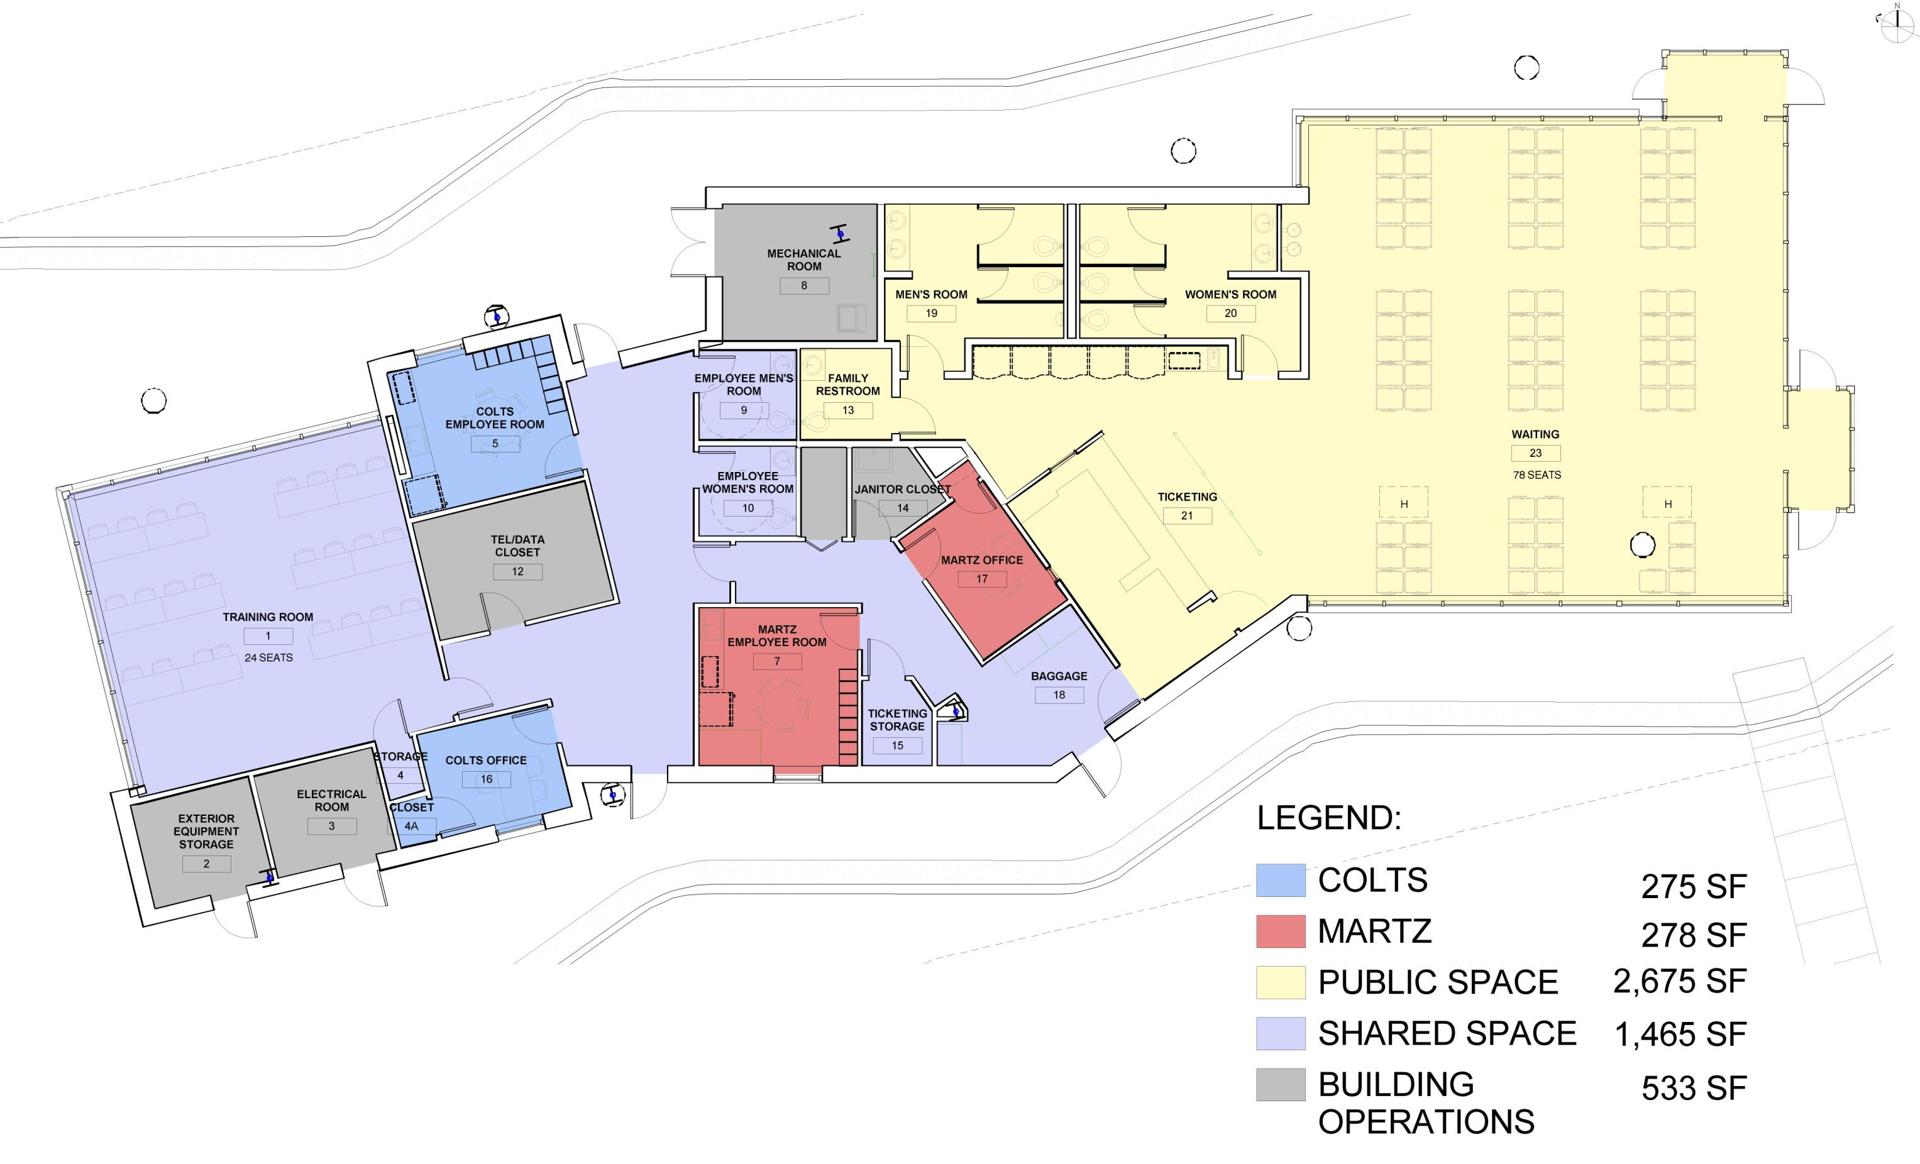
Smart Design
Administrative and “Back of House” Support Spaces
Restrooms, Breakrooms, and Lockers for Drivers
Breakroom for Ticketing Agents
Offices
Storage
Training Room

Slide 23
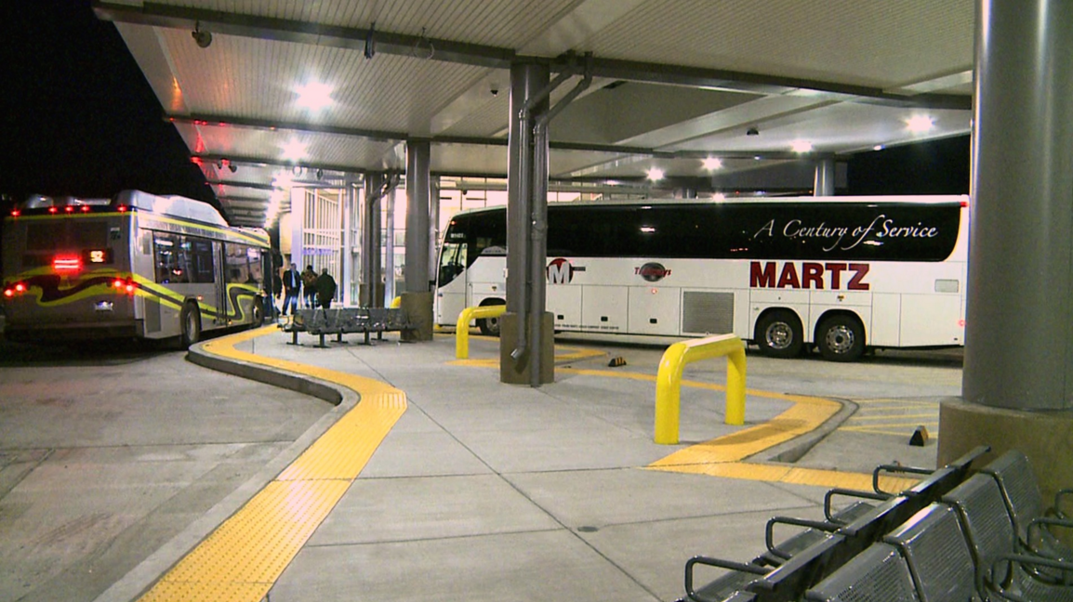
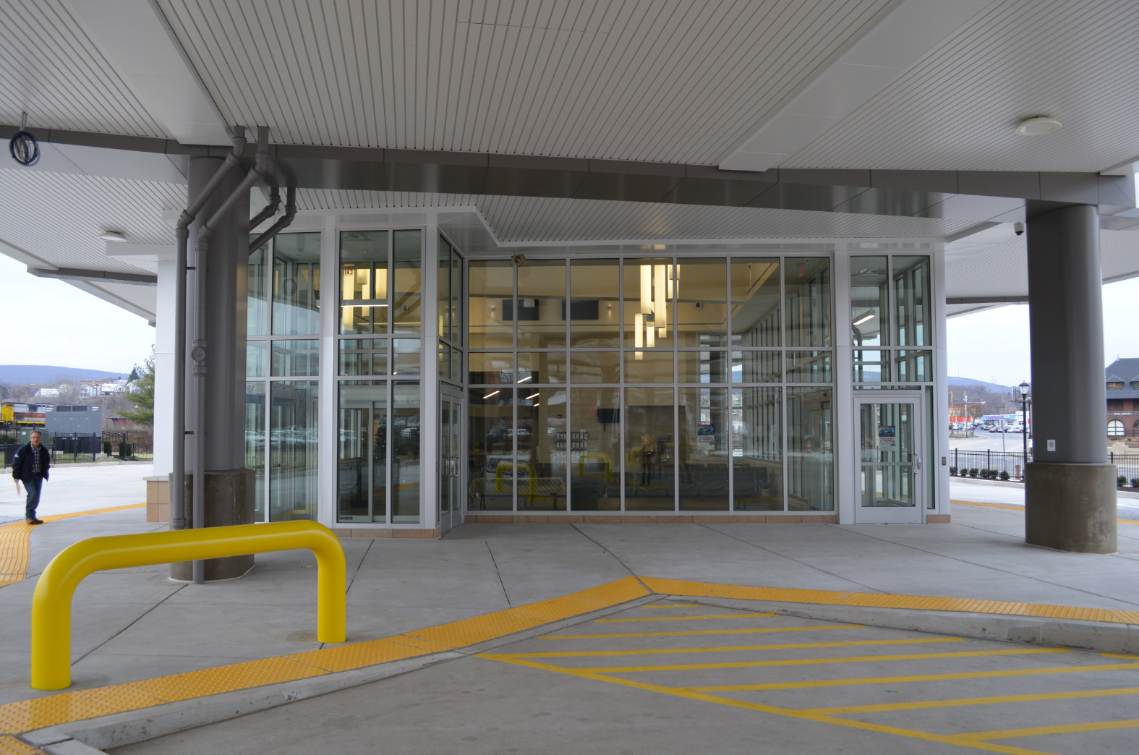
Smart Design
Safety and Security
Well-Lit Spaces
Maximize Direct, Clear Sightlines
Eliminate any potential hiding spaces or niches
Implied surveillance
Active and Passive

Slide 24
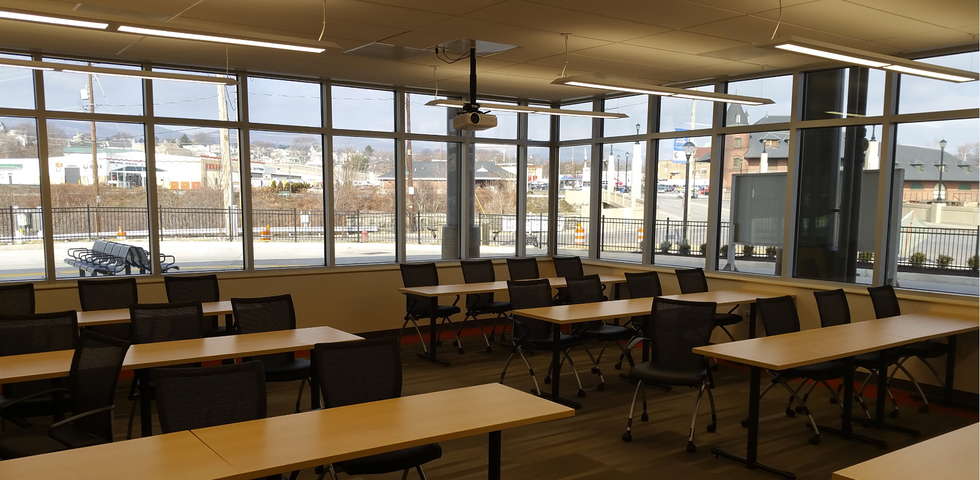
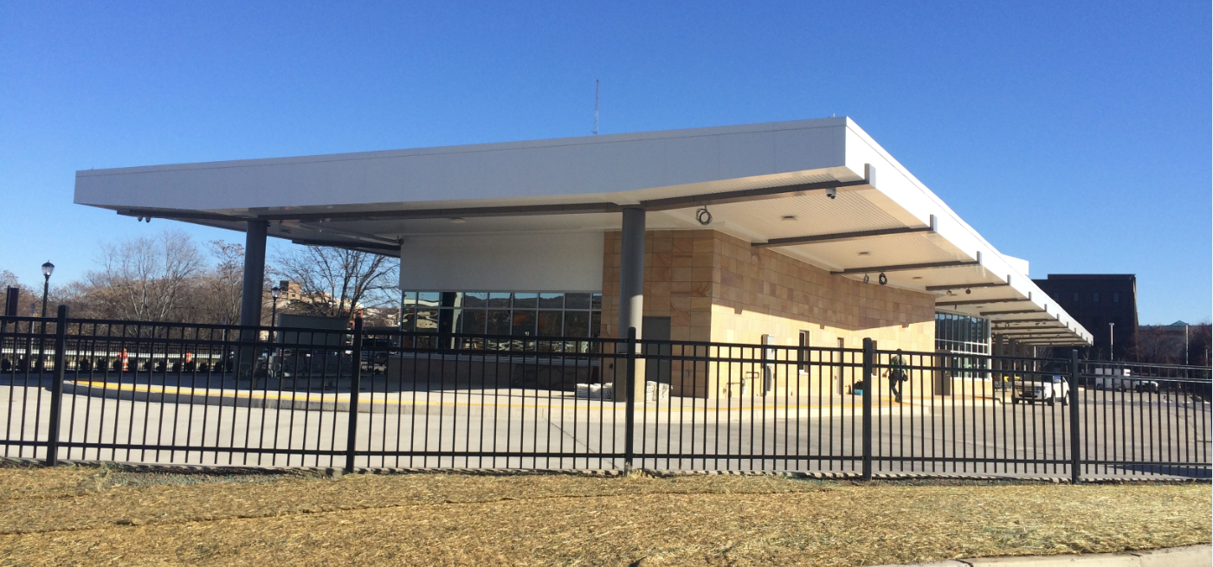
Smart Design
Safety and Security
Well-Lit Spaces
Maximize Direct, Clear Sightlines
Eliminate any potential hiding spaces or niches
Implied surveillance
Active and Passive

Slide 25
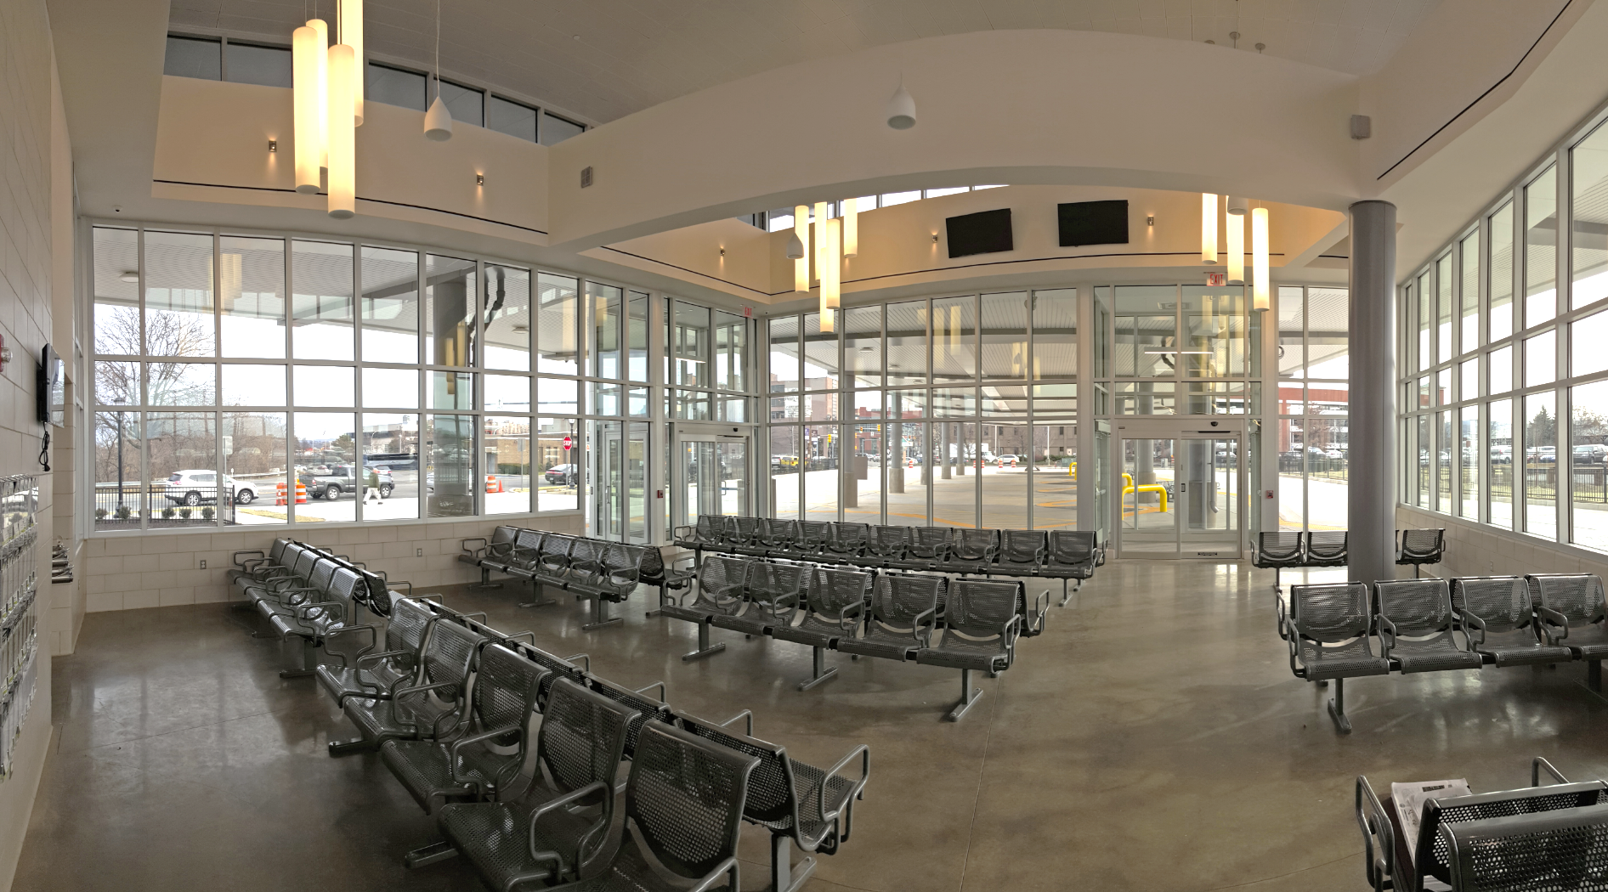
Smart Design
Passenger Amenities
Adequate Seating
Covered Bicycle Parking
Schedules
Arrival and Departure Information
Sufficient Restroom Quantity
Vending; Bottle Filling
Baggage and Freight Handling

Slide 26
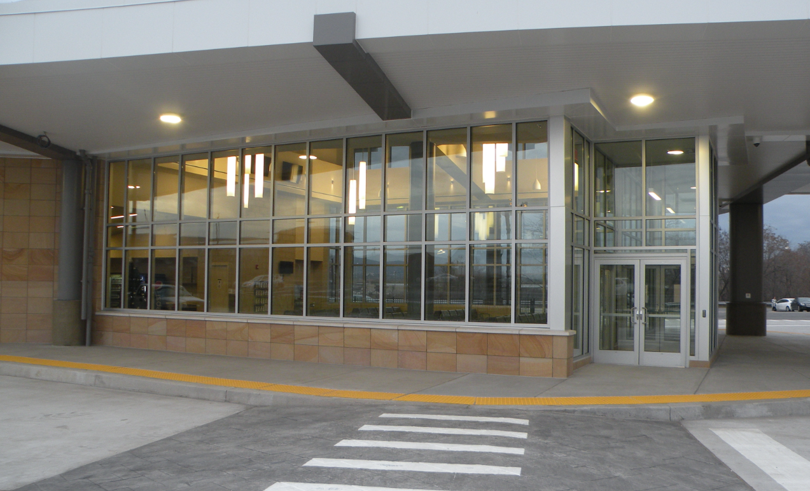
Smart Design
Material Selection
Durable Materials
Materials with Long Service Life
Resistance to Vandalism such as scratching, tagging, and impact
Vandalism Breeds Vandalism

Slide 27
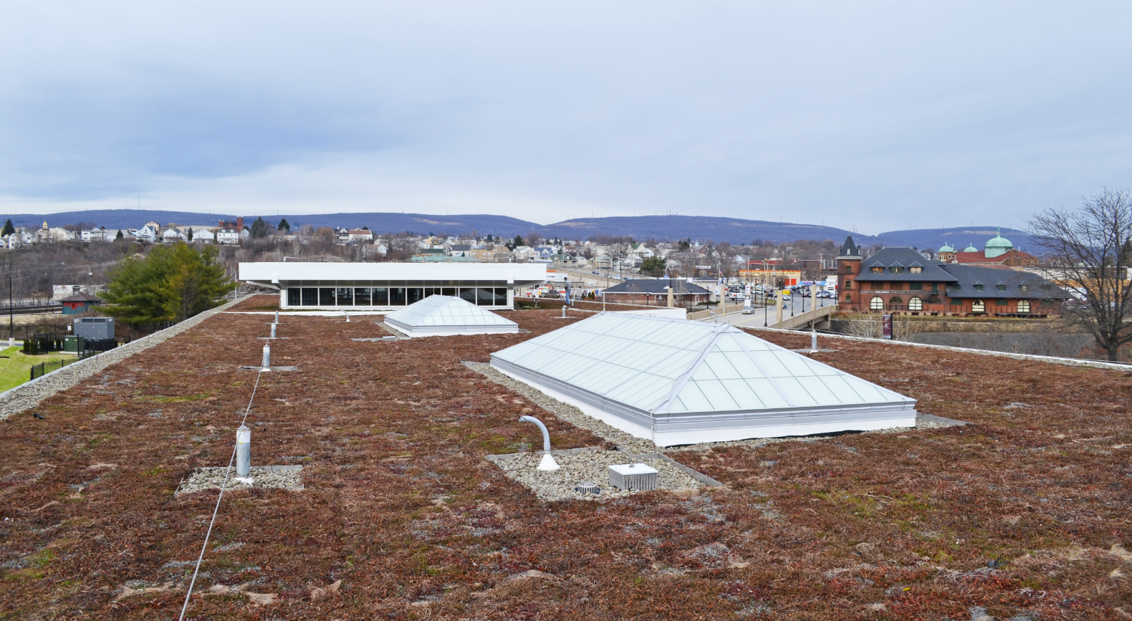
Environmental Footprint
Green Roof System
Retains 1.3 gallons of water per foot
Helps meet tough stormwater retention regulations – 25% improvement
Extends service life of roofing membrane by 2 – 3 x
Reduces heat island effect and cooling load

Slide 28
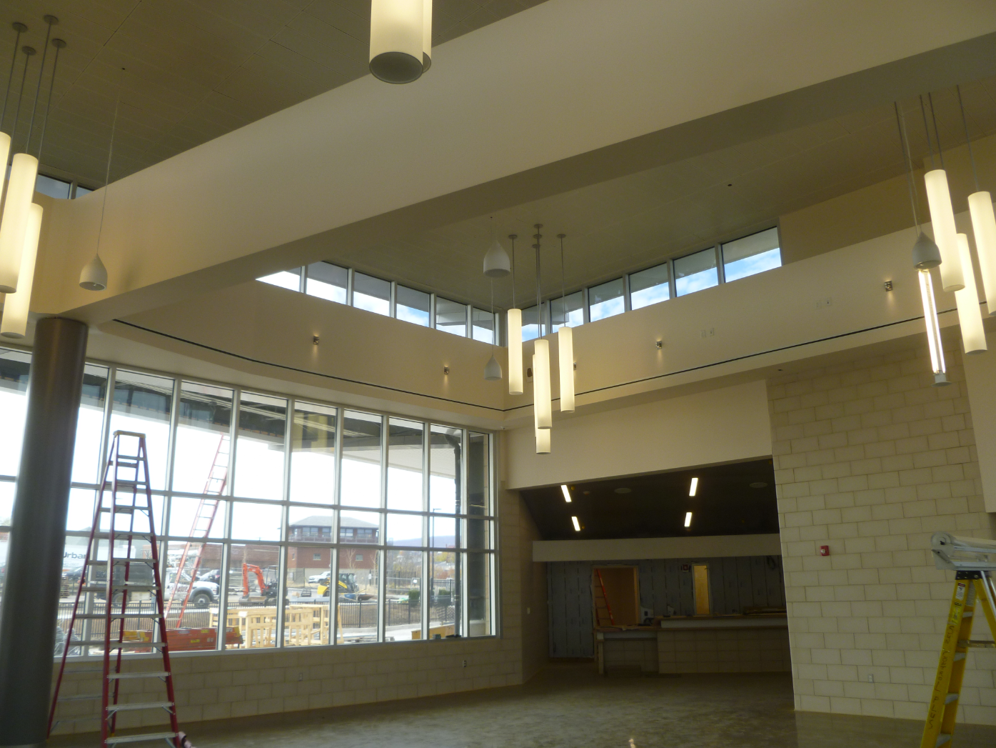
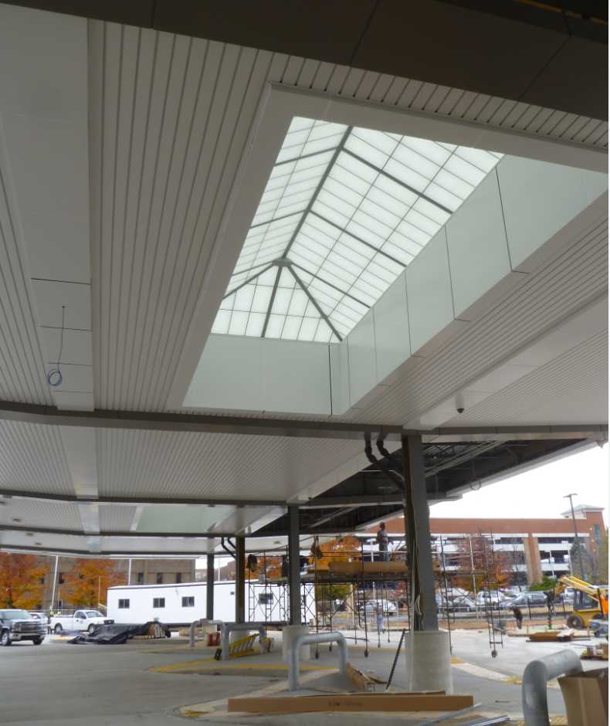
Environmental Footprint
Building Automation
Daylighting and Dimming
Occupancy Sensors
Energy Use Data
Variety of Benefits:
Human Capital
Operating Costs: 25%+ energy savings
Preventative Maintenance

Slide 29
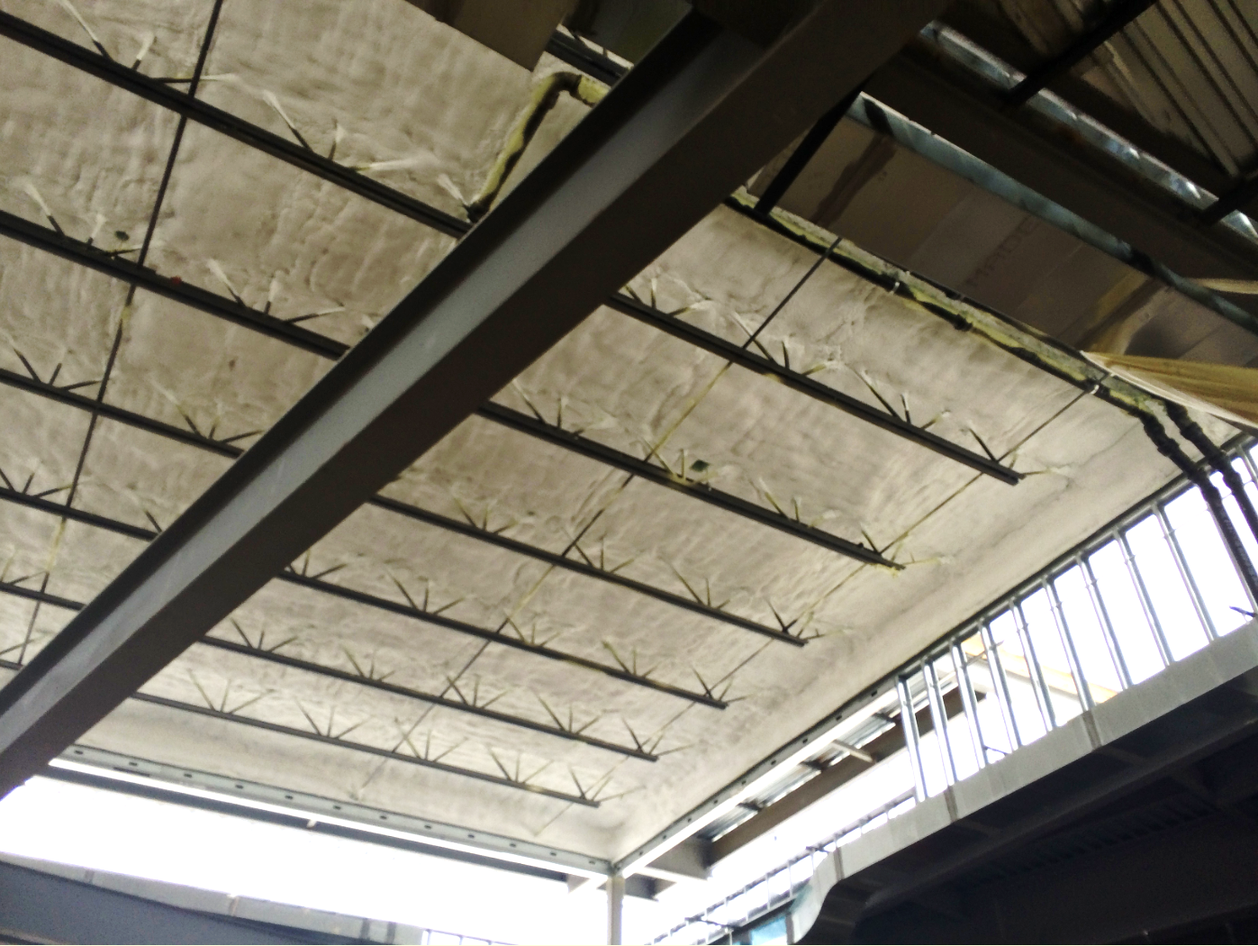
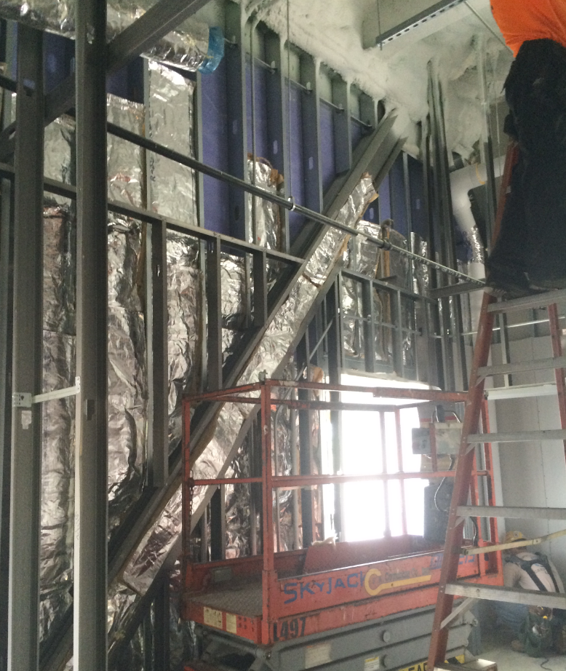
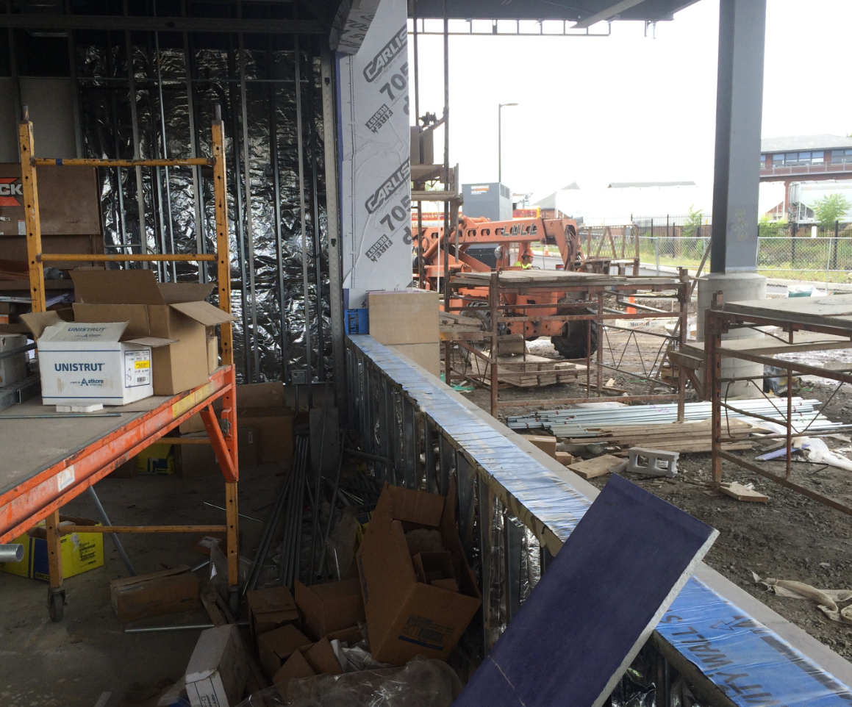
Environmental Footprint
High Performance and Insulation Value
Complete Building Envelope

Slide 30
Lessons Learned in Project Design
Be Proactive
Anticipate Vandalism
Anticipate Security Concerns
Design for Durability
Balance Construction Costs vs. Operational and Maintenance Costs

Slide 31
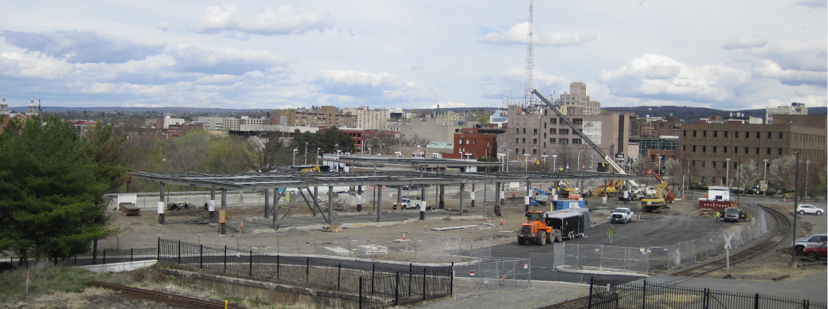
Best Practices in Project Construction

Slide 32
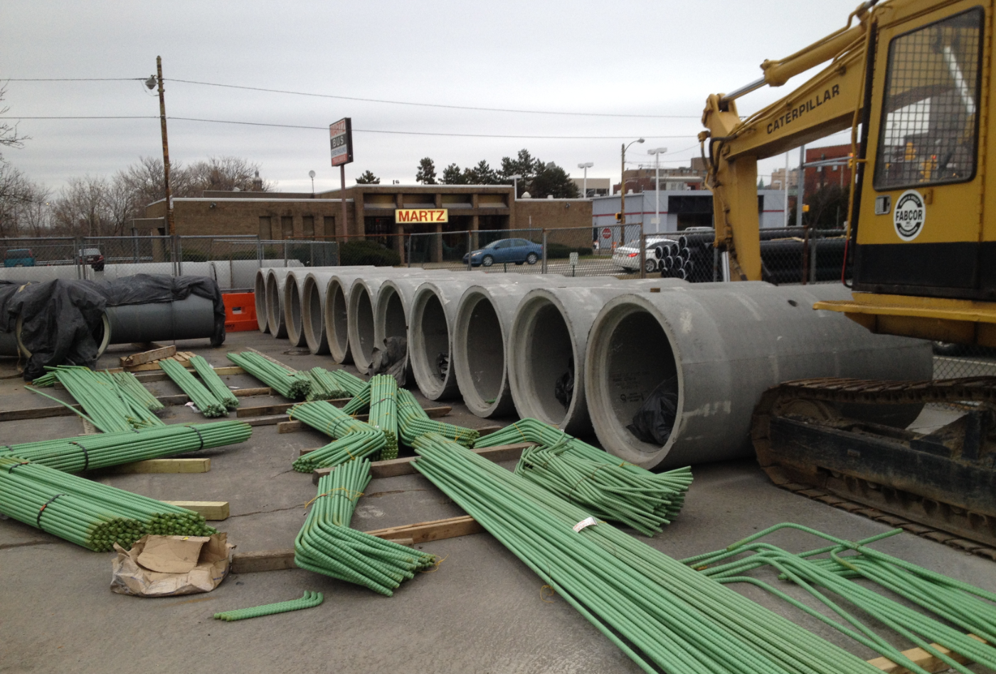
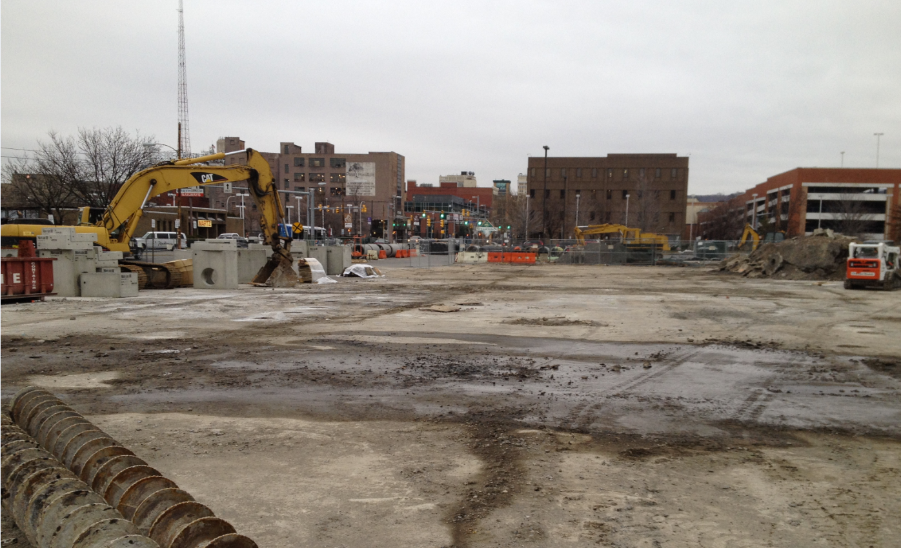
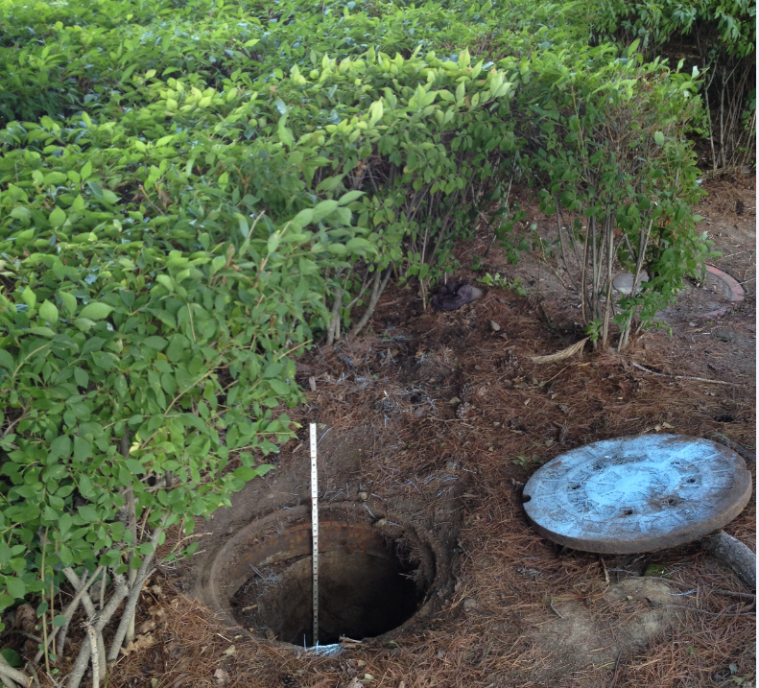
Preparing for Construction
Funding Sources
Project Staffing
Permits and Testing
Insurance

Slide 33
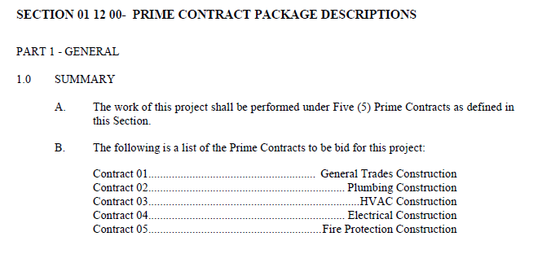
Bid Phase
FTA Requirements
Competitive Bidding
Multiple Prime Construction

Slide 34
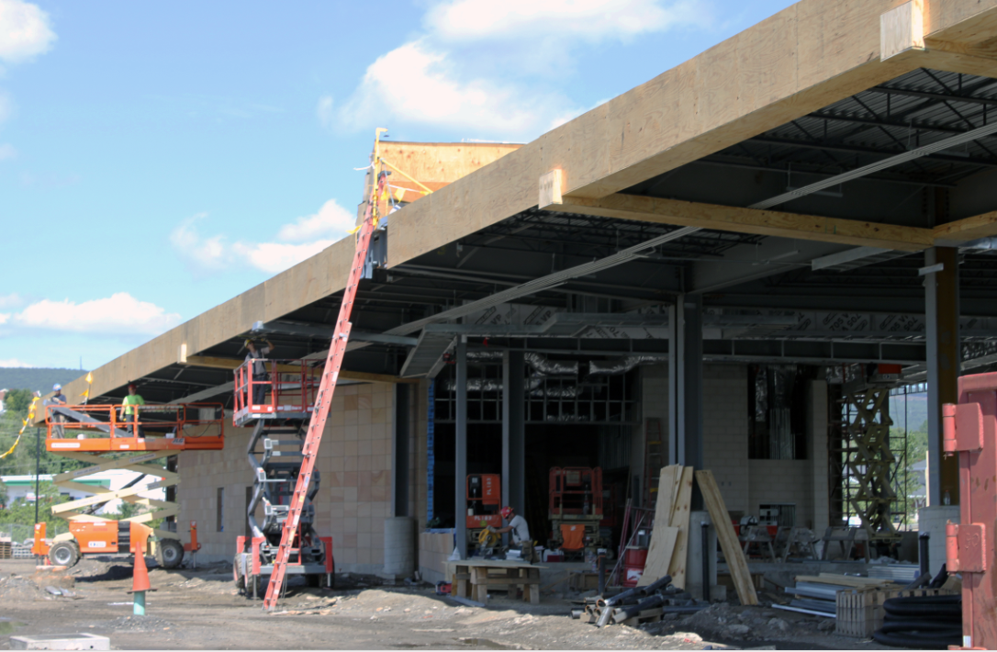
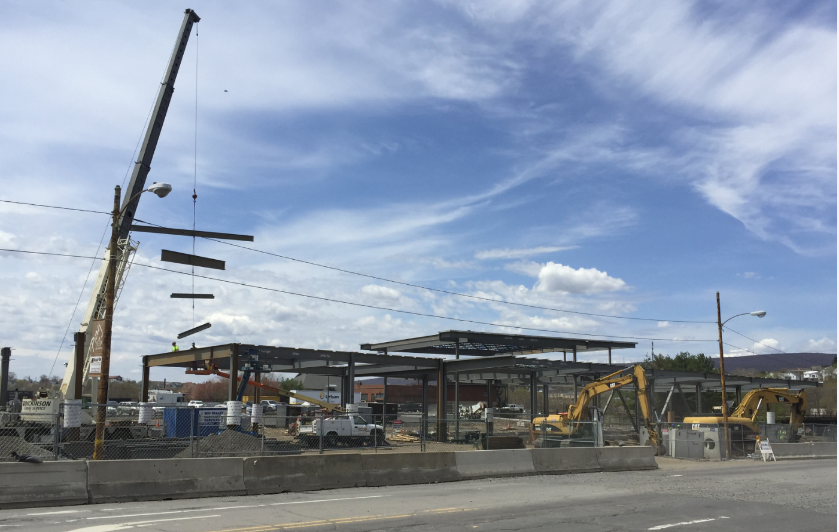
Construction Considerations
Sustainable Construction Practices
Quality Control
Durability
Scope, Schedule, and Budget

Slide 35
COLTS LTC Stakeholder Coordination
FTA / PennDOT BPT / Lackawanna County
PA DGS
Scranton Sewer Authority
Martz Trailways
City of Scranton, Penn DOT, Other Approval Agencies

Slide 36
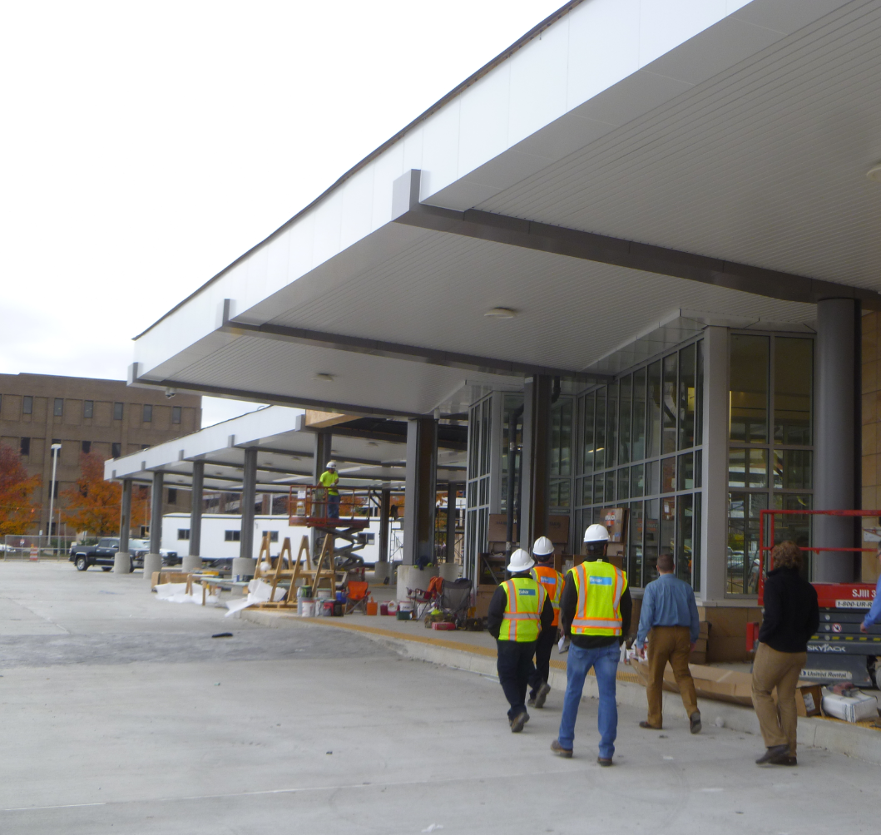
Construction Close-out
Substantial Completion
Final Testing & Commissioning
Contract Close-out
Warranties

Slide 37
Owner Occupancy
Lease Agreements
Maintenance Agreements
Insurance
Staff & Equipment Moving & Set-up

Slide 38
Lessons Learned in Project Construction
Quality Management is Critical to Durability
Make a Plan and Stay Flexible
Continuously Manage Scope, Schedule, and Budget

Slide 39
Planning
Design
Construction
Process Management
Success Indicators
Results Driven Ideas

Slide 40
Contact Information
Robert Fiume
Executive Director
County of Lackawanna Transit System
Richard Sullivan, RA, LEED AP, GGP – Director of Design
rsullivan@sowinskisullivan.com
Michael Hartley, P.E., PMP, CCM – Vice President, Principal Engineer
mhartley@sowinskisullivan.com
Kelly Freeman, RA, LEED AP – Vice President, Principal Architect
kfreeman@sowinskisullivan.com
sparta, nj
philadelphia, pa
harrisburg, pa

