Slide 1
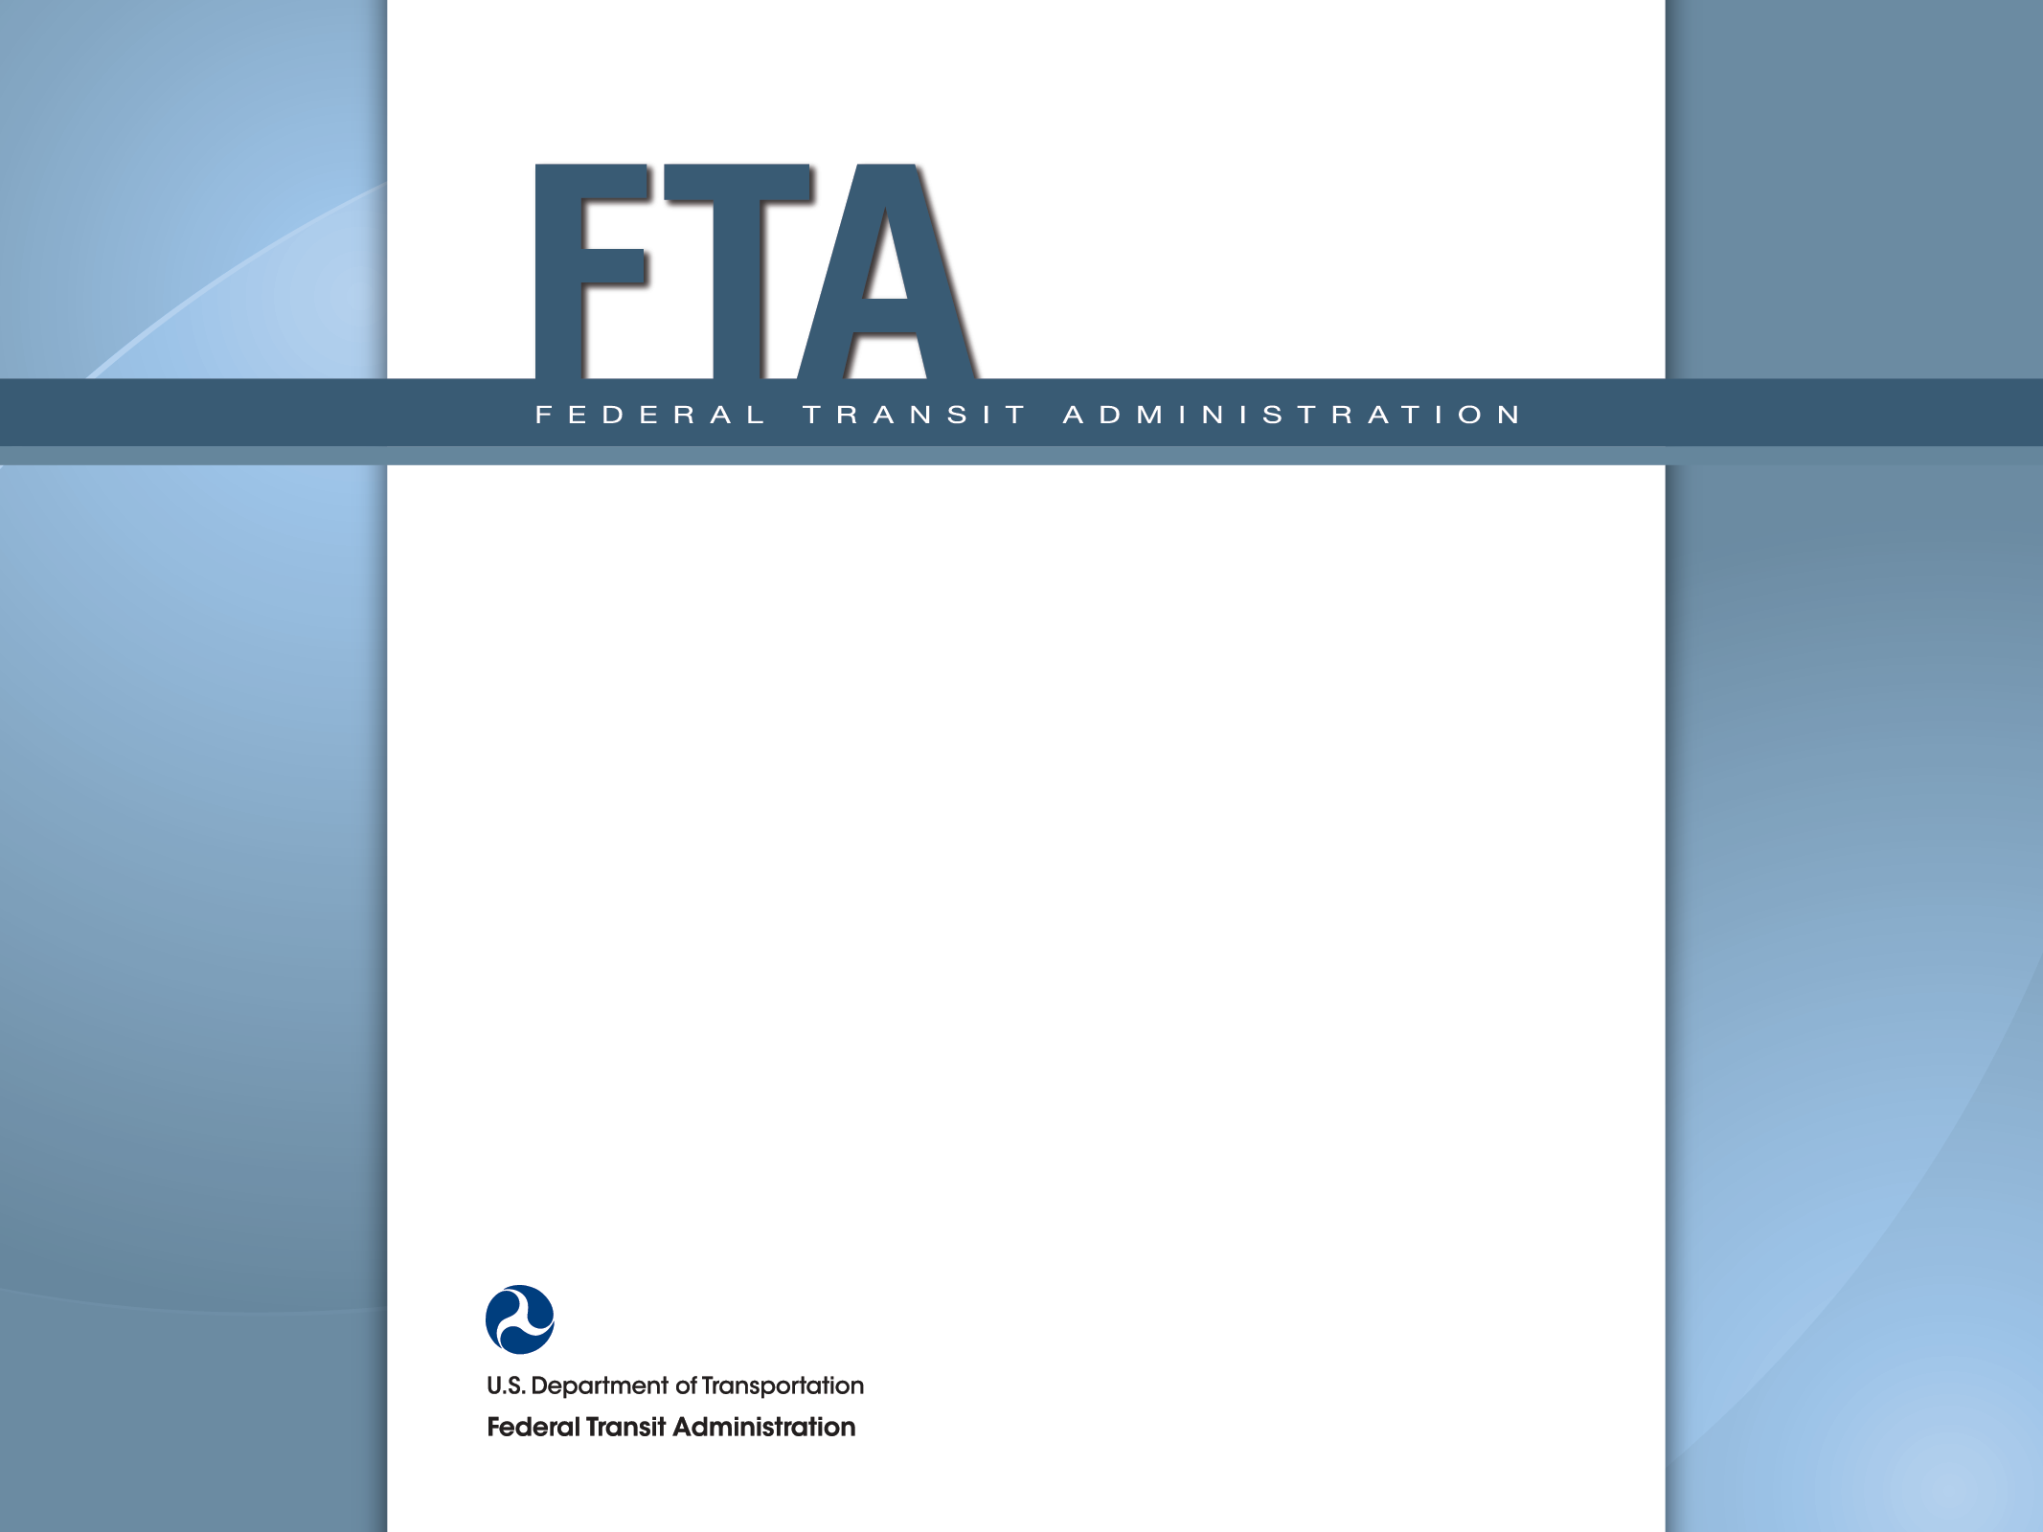
2016 PPTA Annual Conference
Federal Transit
Administration Updates
April 20, 2016
11am – 12 noon
Terry Garcia Crews
Regional Administrator
FTA Region III

Slide 2
Presentation Overview
FAST Act – Terry Garcia Crews
Safety – Terry Garcia Crews
TrAMS – Vida Morkunas
Triennial Review Trends – Tony Cho
Buy America – Jay Fox
Draft Circular 5010.1E – Jay Fox & Sheila Byrne

Slide 3
Fixing America’s Surface Transportation (FAST Act)
Terry Garcia Crews
Regional Administrator
FTA Region III

Slide 4
Fixing America’s Surface Transportation (FAST Act)
Authorizes Transit Programs for Five Years (FY16-FY20) through Sept 30, 2020
Signed into Law by President Obama on Dec 4, 2015
Effective Date of Oct 1, 2015
  Applies New Program Rules to ALL funds Not Obligated

Slide 5
Fixing America’s Surface Transportation (FAST Act)
Provides Steady and Predictable Funding for Five Years
With a Funding Increase of ~$1B Per Year
Re-establishes a Discretionary Bus Program
Introduces Positive Improvements to the Workforce Development Program
  Targets Funding Increases for the State of Good Repair and Bus & Bus Facilities Program

Slide 6
FAST Act Authorized Funding
FY16 (FAST Act): $11,789 Billion

Slide 7
Bus and Bus Facilities (5339)
New
Two New Discretionary Components:
1) Low or No Emissions Bus Deployment Program
2) Funding Distribution Based on Age/Condition of Assets
States/Localities that Operate Fixed Route Systems and Eligible for 5307 Funds May Now be Direct Recipients of 5339 Funds
Up to 0.5% of Allocation for Workforce Development
Authorized Funding (FY 2016): $427.8 M – National $16.6 M – Pennsylvania

Slide 8
Urbanized Area Formula Program (5307)
Modified
‘100 Bus Rule’ is Modified to Include Non-ADA General Population Demand Response Transit Service
Eliminates Requirement to Spend 1% on Associated Transit Improvements
Allows up to 0.5% for Workforce Development
Allows 20% (was 10%) of Allocation Used for ADA Ops
Authorized Funding (FY 2016): $4.53 B – National $240 M – Pennsylvania

Slide 9
Enhanced Mobility of Seniors & Individuals with Disabilities (5310)
Modified
Allows States / Localities that Provide Transit Service and are 5307 Direct Recipients - to also be 5310 Direct Recipients
Requires FTA to Collect & Disseminate Best Practices
Authorized Funding (FY 2016): $263 M – National $13.3 M – Pennsylvania

Slide 10
Formula Grants for Rural Areas (5311)
Modified
Allows Revenue from Advertisements + Concessions to be Used as Local Match
Recipients May Now Use up to 20% of Their Allocation for Paratransit Service Operations
Authorized Funding (FY 2016): $620 M – National
$27.0 M – Pennsylvania
Notes:
Bruce

Slide 11
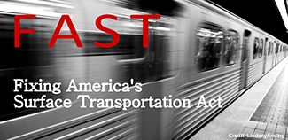
FTA FAST Act Website
www.fta.dot.gov/fastact
Notes:
FTA’s Web Site is the best place to look for more information
We will continue to post information there
Look for Program Fact Sheets with more detail
FTA will post and update FAQs
Sign up for Gov Delivery to get email notification of new postings on the Web Site

Slide 12
Public Transportation
Safety Program
Terry Garcia Crews
Regional Administrator
FTA Region III

Slide 13
Public Transportation Safety Program
With Passage of FAST Act, FTA’s Oversight Strengthened through its New Authority to Assume the Role of a Non-compliant State Safety Oversight Agency (SSOA)
FTA Can Withhold Financial Assistance
FTA Can Direct the Use of Federal Funding for Safety Initiatives Only

Slide 14
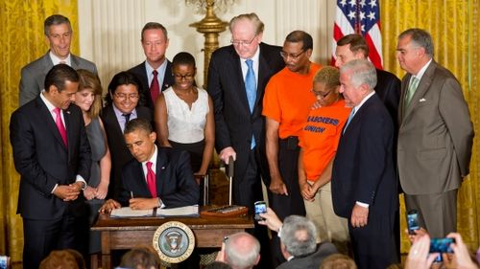
Public Transportation Agency Safety Plan
MAP-21 and FAST Act Require Each “Operator of a Public Transportation System” (receiving FTA funds) to Develop and Implement a Public Transportation Agency Safety Plan. (49 U.S.C. 5329(d)).

Slide 15
Public Transportation Agency Safety Plan
Would Apply to…
Each “operator of a public transportation system” that receives Federal financial assistance under 49 U.S.C. Chapter 53, including recipients and sub-recipients
Would Not Apply to…
A transportation operator that only provides service closed to the general public and only available for a particular clientele
Commuter rail service regulated by the Federal Railroad Administration
Passenger ferry service regulated by the U.S. Coast Guard

Slide 16
Public Transportation Safety Program Notice of Proposed Rulemaking
Published in Federal Register on Aug 14, 2015
Adopts SMS as Basis for FTA’s New Public Transportation Safety Program
Establishes the Framework for the FTA Administrator’s Authority to Monitor, Oversee, and Enforce Safety
Outlines Proposed Content for the National Public Transportation Safety Plan

Slide 17
Public Transportation Safety Program Notice of Proposed Rulemaking:
Where are we in the Process?
MAP-21 Passed (7/2012)
ANPRM Open for Comment (10/2013)
NPRM/ Proposed Plan
Open for Comment (2/516)
Comment Review
Final
Rule/Plan
Issued
Final Rule/Plan Effective
Comment Deadline was April 5, 2016

Slide 18
TrAMS:
Getting Started,
7 Tips to Success, and Lessons Learned
Vida Morkunas
Director, Planning & Program Development
FTA Region III

Slide 19
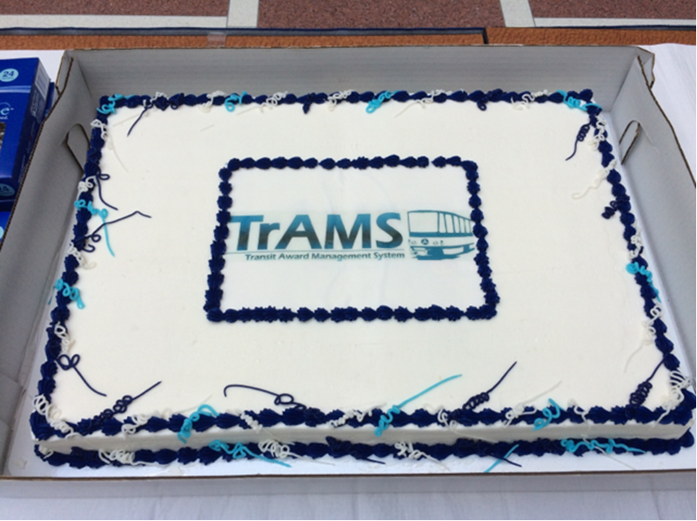

Slide 20
Getting Started
Understanding New Terms & Roles
Grantee:
Recipient User Manager - Grantee staff person empowered to manage grantee staff access in TrAMS
FTA:
Local Security Manager (LSM) – has authority to add users roles to the TrAMS user’s profile
Grant Manager (in TEAM) = Pre-award Manager (in TrAMS)
OPM Manager (in TEAM) = Post-award Manager (in TrAMS)

Slide 21
Getting Started
Registering in SAM.gov
Recipient information in TrAMS is obtained from the System of Award Management (SAM)
TrAMS performs a nightly update and syncs org information with SAM
Access your agency’s SAM.gov account to ensure that your account is active

Slide 22
Getting Started
Setting Up & Managing PIN Numbers
User PINs do not carry over from TEAM
TrAMS Users can use their TEAM PIN by adding it to their TrAMS User Profile
New PIN Users will set up their PIN after the User Manager has assigned the appropriate role
Notes:
Discuss YATA – Ductless A/C

Slide 23
7 Tips to Success: TIP #1
TEAM vs TrAMS: A Core Difference
TEAM grants were structured simply by Scope(s) and ALIs
TrAMS applications can be organized by discrete Projects, and then by Scope(s) and ALIs
Notes:
Discuss YATA – Ductless A/C

Slide 24
TIP #2
Selecting Environmental Findings
Grantee can select Environmental Findings in 1 of 2 methods:
Separate Project Method – NEPA Finding is selected for the entire Project
2) Program of Projects Method – NEPA Finding is selected at the ALI level (as in TEAM)

Slide 25
TIP #3
Using Standard Language in Executive Summary
Award’s Period of Performance
Designated and Direct Recipients
Application does (does not) include funds for Research and/or Development Activities
Application does (does not) include Indirect Costs

Slide 26
TIP #4
Milestone Guidelines
FTA Region III is changing the type of information required under Milestones in TrAMS
Look for a Dear Colleague letter from FTA soon!

Slide 27
TIP #5
Transmitting Grants in TrAMS
TrAMS introduces new function – transmit
Grantee transmits application to FTA when Application is ready
Once transmitted – grantee is locked out from making changes
Suggestion – work with your FTA pre-award manager to complete review before transmitting

Slide 28
TIP #6
Applying Flex Funds in TrAMS
Major Steps:
MPO programs Flex Funds in TIP
Grantee develops new Application in TrAMS
NOTE: Grantee provides FTA with TrAMS-generated Temporary Number (via e-mail)
3) Grantee requests PennDOT to initiate Flex transfer
4) FTA assesses eligibility of Project

Slide 29
TIP #7
Amending TEAM Awards
Team Awards can be amended IF:
Grantee was not able to obligate all of their FY15 funds – may add their final FY15 portion in TEAM
4 Types of TEAM Amendments in TrAMS:
“Zero dollar’ Amendments
De-obligation of Funds
Close-out Amendments
Obligation of Funds (in limited cases)
Notes:
Amendments to active TEAM grants migrated into TrAMS will be limited to close out amendments, administrative amendments, zero dollar amendments, and amendments to add funds in limited circumstances, such as, existing Full Funding Grant Agreements. Please review the TrAMS FAQs for additional guidance or contact your FTA representative before taking action in TrAMS.
There are four cases where amendments may be considered:
Recipients can create a “zero dollar” amendment to TEAM awards to move funds between existing scope codes, including adding new ALIs to existing scope codes, provided it does not increase the scope of work that requires a new DOL certification. The amendment may include zeroing out funds from existing scope codes as long as no additional funds (local or federal) increase the overall award budget and the matching requirement does not change.
Recipients can create amendments to deobligate funds from TEAM grants.
Recipients can create close-out amendments.
In limited cases, recipients can create amendments to obligate additional funds (see below questions).
Recipients, except in several limited cases outlined below, must initiate new grants in TrAMS rather than amending TEAM grants to add additional funding. When in doubt as to whether an amendment to an award meets the limitations below, please contact your FTA point of contact for additional direction. FTA limits amendments to add funds to TEAM awards as follows:
Recipients can create amendments to TEAM awards to add funds associated with existing Full Funding Grant Agreements or larger capital investments covered under a similar Project Construction Grant Agreement. Funds may include prior year and FY 2016 and beyond funding necessary to satisfy the agreement.
For recipients that were only able to obligate a portion of their FY 2015 funding in TEAM, they may create amendments to those TEAM awards to complete the activity by adding their final portion of FY 2015 funding. These actions must use existing scope codes and existing ALIs. For example, amendments may be used where the activity was previously identified as a non-add scope or other budget activity. No new scope codes and no new ALIs may be added to increase the award budget or scope of work of a TEAM award. FY 2016 funds must be used in a new grant.
With the passage of the Fixing America’s Surface Transportation (FAST) Act, new cross-cutting requirements apply to all funds not obligated by February 16, 2016. (See FTA’s Notice of Transit Program Changes, Authorized Funding Levels and Implementation of Federal Public Transportation Law as Amended by the FAST Act and FTA Fiscal Year 2016 Apportionments, Allocations, Program Information and Interim Guidance, published in the Federal Register February 16, 2016). This restriction therefore ensures FTA and the recipients can appropriately track requirements based on the type of award and prevents combining funds with different requirements.

Slide 30
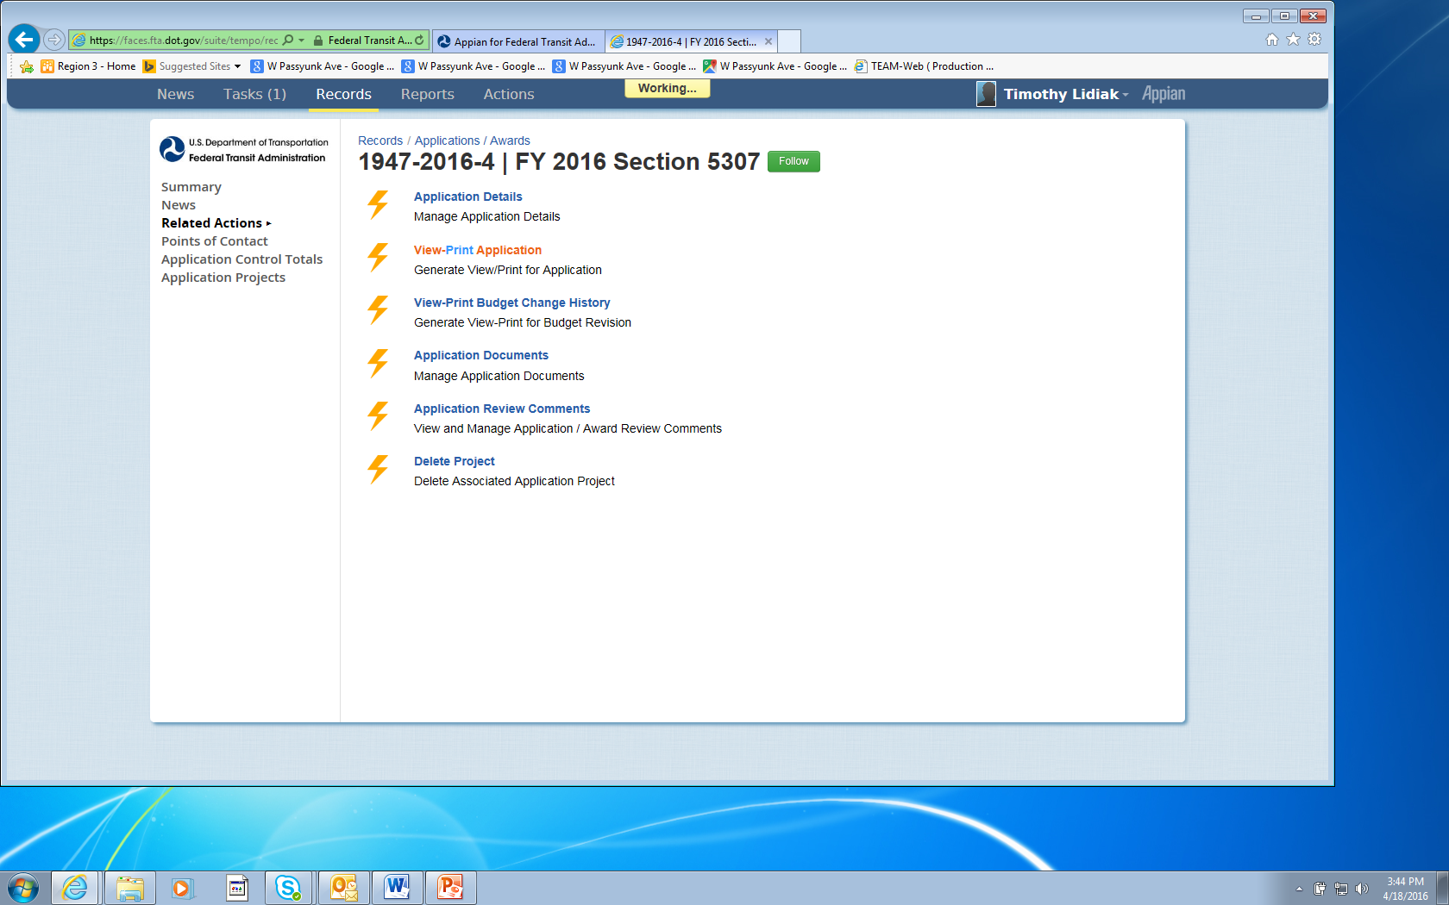
Lessons Learned
Be Patient!
TrAMS is a new technology
Bugs are being worked out
Can be slow at times – when give it time!
Notes:
Discuss YATA – Ductless A/C

Slide 31
Resources
Contact the FTA Region III Office
215.656.7100
Contact TrAMS Help Desk
FTA.TrAMS.Help@dot.gov
877.561.7466
Go to TrAMS Online Information www.fta.dot.gov/TrAMS
Notes:
Discuss YATA – Ductless A/C

Slide 32
Tony Cho
Director, Office of Program Management and Oversight
FTA Region III
Triennial Review Findings
FTA Region 3

Slide 33
Region 3 Triennial Review Finding Trends
2011
2012
2013
2014
2015

Slide 34
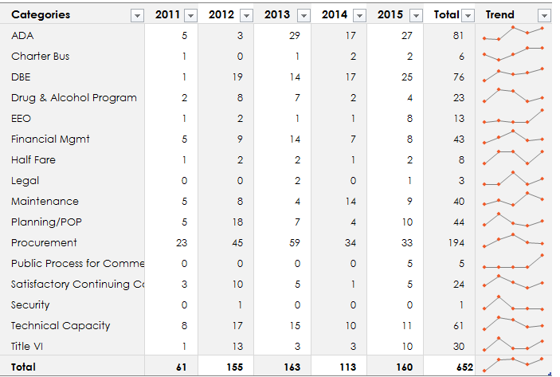
Region 3 Triennial Review Finding Trends

Slide 35
FY 2015 Triennial Review Findings
Procurement
20%
Maintenance
ADA
17%
Title VI
Planning/
POP
6%
DBE
16%
Technical
7%

Slide 36
Procurement – Top Findings
Lacking independent cost estimate
Lacking required cost/price analysis
Procurement policies and procedures not evident
No FTA Clauses

Slide 37
Proactive Procurement
Please ensure that your procurement manual does not refer to the old Third Party Contracting Circular. It should be 4220.1F
Please contact Region 3 if:
  You are a grantee without a separate procurement department and are initiating a major procurement
  You have no response or a single response to an RFP
  You need some example/sample/template documents

Slide 38
Useful Procurement Guidance
4220.1F
https://www.fta.dot.gov/regulations-and-guidance/fta-circulars/third-party-contracting-guidance
Best Practices Procurement Manual
https://www.fta.dot.gov/funding/procurement/third-party-procurement/best-practices-procurement-manual
FTA Procurement Self Assessment Guide
https://www.fta.dot.gov/funding/procurement-system-self-assessment-guide

Slide 39
Annual Update on
Buy America
Jay Fox
Regional Counsel
FTA Region III

Slide 40
First General Point
No Waivers
Notes:
Discuss YATA – Ductless A/C

Slide 41
Statutory Changes – 49 USC 5323(j)
(j)(2)(C) – Rolling stock waiver
  FY16/17 – 60%
  FY 18/19 – 65%
  FY 20+ – 70%
(j)(6) – Certification of Domestic Supply
  Required when Agency denies non-availability waiver
  Agency must certify that a satisfactory item is produced domestically, and identify the manufacturers
(j)(13) – Small purchase waiver is now set at less than $150,000
Notes:
TCC is preparing guidance on the Buy America provisions.
On Rolling Stock Waiver percentage, TCC’s our preliminary conclusion is that for existing contracts executed before enactment of FAST, the new domestic content requirements would not apply even if delivery is in 2018 or later. However, for contracts entered into after enactment of FAST, rolling stock deliveries would need to comply with the domestic content requirements applicable to the year of delivery; otherwise the contract would not be in compliance with current law.

Slide 42
Second General Point
Once an end product, always an end product
Once a component, always a component
Once a subcomponent, always a subcomponent

Slide 43

Third General Point

Slide 44
Draft 5010.1E
Award Management Requirements Circular
Jay Fox & Sheila Byrne
FTA Region III

Slide 45
Where Are We In the Process?
MAP-21 Passed (7/2012)
and
SuperCircular Implemented (12/2014)
5010 Circular Revisions by FTA Staff
(11/2014 – 08/2015)
5010 DRAFT
EMT Review and Concurrence
(9/2015 – 11/2015)
Fixing America’s Transportation System Act passed
(FAST Act)
(12/4/2015)
Federal Register Notice sent for Public Comment
(2/29/2016 – 4/29/2016)
Comment Review and Finalize Document
(5/2016 – 6/2016)
Final 5010 Circular Published and Effective
(7/2016)

Slide 46
Definitions
Overhaul: Systematic replacement or upgrade of systems whose useful life is less than the useful life of the entire vehicle in a programmed manner. Overhaul is performed as a planned or concentrated preventive maintenance activity and is intended to enable the vehicle to perform to the end of the original useful life. Rolling stock must have accumulated at least 40 percent of its useful life before FTA will participate in the costs of its overhaul.
Rebuild: Rebuild means a capital activity associated with rolling stock that occurs at, or near, the end of a unit of rolling stock’s useful life, and that results in an extended useful life for the unit of rolling stock consistent with the extent of the rebuilding.
Remanufactured Vehicles: Remanufactured vehicles means a previously owned/used vehicle that has undergone or requires substantial structural, mechanical, electrical, and/or cosmetic rebuilding, restoration or updating and that is to be acquired or leased by a new party -- must meet all of the requirements for new bus models (e.g., useful life, bus testing, etc.).
Notes:
Remanufactured is a new definition
Buy America guidance required these definition

Slide 47
Definitions
Other Notable Additions/Changes
Associated Transit Improvements
Award
  Scope of Work approved by FTA when agreeing to provide Federal assistance
Project
  Public transportation improvement activities eligible for Federal assistance
Disallowed Costs
Disposition
Federal Interest
Pre-Award Authority
Real Property Inventory
Satisfactory Continuing Control
Notes:
5010.1D – 63 Definitions
5010.1E – 176 Definitions

Slide 48
Significant Policy Changes
Example – Capital Leasing Requirements
  FAST Act eliminates FTA’s regulatory requirement that FTA may only participate in capital leases that are more cost-effective than acquisitions
  FAST Act also requires recipients to provide a report to FTA within 3 years after the date on which the recipient enters into rolling stock or related equipment leases
    An evaluation of the overall costs and benefits of leasing rolling stock
    A comparison of the expected short-term and long-term maintenance costs of leasing versus buying rolling stock

Slide 49
Significant Policy Changes
Other Examples
Force Account Work threshold for justification and plans changed to $1,000,000 (formerly $100,000)
Single Audit threshold changed $750,000 (formerly $500,000)
No Separate Annual Value Engineering Report
  One-time requirement following the completion of a VE study
Useful Life – required only for rolling stock and facilities
Real Property
  Acquisition of contaminated property (additional info in Appendix D)
  Real property inventory reporting
Notes:
Offer Red-Line Version

Slide 50
Changes to Appendices
Appendix D – Guide for Preparing an Appraisal
  Expanded and includes appraisal of contaminated property
Appendix F - Indirect Cost Rate Proposals
  Defines 20 percent change, requiring approval by FTA of a new rate
Appendix G - Cost Allocation Plans
  Also contains information regarding cost principles
Appendix I - Reporting on Real Property (2 CFR 200.329)
  Annual reporting now required
Appendix J - Award Amendments / Budget Revision Guidelines
Notes:
Cost principles in Super Circular – 2 CFR Part 200, Subpart E

Slide 51
Questions?
And don’t forget to visit us at the FTA Chat with Staff outside the Expo Hall right after lunch today!
Notes:
Planners check D - other (Type 13) in team next week and type in the new CE number
We can then use that as an interim measure for the ER CE as well (as well as any future MAP-21 CEs)

Slide 52
Federal Transit Administration
www.fta.dot.gov

