Slide 1
2016 Legal Update
Jill Nagy
Summers Nagy Law Offices

Slide 2
Social Media
Can you control your Employees’ Posts?

Slide 3
Chipotle Changes Everything
Federal court has ruled that regulating employee’s messages on Facebook violates NLRB standards
Claims that it is unlawful to direct employees to delete tweets, to forbid circulating a petition regarding additional breaks and circulated a handbook with unlawful work rules
Employers shall not have rules that “chill” an employee of their “Section 7” rights. You may only take action to curtail Section 7 Activities if the activities are with malice- false and misleading activities are not enough.

Slide 4
What tweets were at issue?
Reponses to customers applauding the restaurant
Complaining about co-workers who received work praise
Compared Chipotle to competitors noting their “free guacamole”
A quality control employee was charged with monitoring social media accounts and after seeing the tweets asked the employee to remove them in accordance with the company’s social media policy.
No discipline was imposed. The employee was just asked to remove the tweets.

Slide 5
Section 7
“protects an employee’s right to engage in concerted activities for the purpose of mutual aid or protection”.
A two prong analysis:
Was the activity “concerted”?
Was the activity for mutual aid or protection?
Since they involved working on snow days and wages they were considered common to more than just the Plaintiff so they were considered “concerted”
Wages and working conditions fall within the second prong

Slide 6
How does this impact you?
While most PPTA members are not private entities, in the case of interpretation often NLRB cases are used when public statutes are silent.
What does your social media policy say with regard to employees’ posts?
Can you regulate posts?
When did you last update your social media policy?

Slide 7
FMLA – CURBING ABUSE
Focus on Intermittent Leave, Policies and Recertification and defining “serious health condition”

Slide 8
What is a serious health condition?
Serious health condition means an illness, injury, impairment or physical or mental condition that involves inpatient care as defined in § 825.114 or continuing treatment by a health care provider as defined in § 825.115. Conditions for which cosmetic treatments are administered (such as most treatments for acne or plastic surgery) are not serious health conditions unless inpatient hospital care is required or unless complications develop. Restorative dental or plastic surgery after an injury or removal of cancerous growths are serious health conditions provided all the other conditions of this regulation are met. Mental illness or allergies may be serious health conditions, but only if all the conditions of § 825.113 are met.

Slide 9
Serious Health Condition Revealed
Inpatient Scenarios
Chronic Conditions
Extends over a Period of Time
For family members- the definition is elevated such that they must show they cannot participate in general daily activities such as work or school

Slide 10
Recertification – how easy is it?
Recertification follows essentially 3 scenarios:
Long term absence- mandates recertification every 6 months with no change in condition
Less than 30 days in the case of “changed circumstances or when the employer doubts the continuing validity of the certification (825.308(c)).
Every thirty days also permitted in the case of any questions.

Slide 11
Is this policy OK?
In order for me to known when to apply FMLA to an absence, a medical note will be required from your provider for that absence. The note will need to indicate you were seen by a provider during the absence and how the absence relates to the FMLA qualifying condition. Without this information, I would be unable to apply FMLA to any specific absence.

Slide 12
Recertification for Intermittent Leave?
The recertification must include the dates of treatment, the medical necessity of treatment, the medical necessity of intermittent leave and the expected duration of the intermittent leave. 29 USC § 2613.
The employer may obtain second and third opinions on the recertification even involving intermittent leave.
The employer may obtain recertification on a “reasonable basis”.

Slide 13
ADA
Wheelchairs, Accommodations and Disruptive Behavior. . . . .

Slide 14
Wheelchairs and Seating - ADA Insight
Most ADA questions involving wheelchair securement involve:
Must the person agree to a lap belt?
What if they refuse?
May I ask another passenger to change seats to accommodate a disabled passenger?
May I force someone to move to a seat?

Slide 15
Reasonable Accommodation?
You need to have a reasonable accommodation policy in place that addresses not only your riders but your employees.

Slide 16
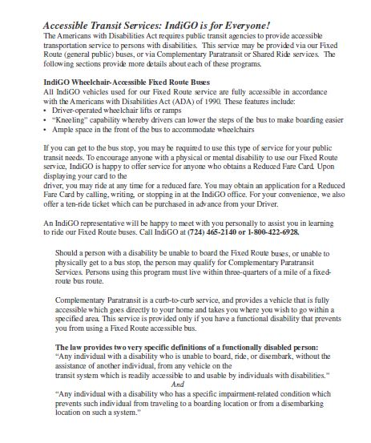
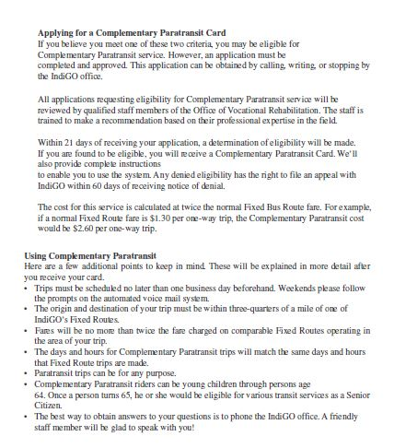

Slide 17
Key Operational Issues
Bus stops
Where do you locate bus stops?
Must you modify bus shelters?
Do you have sufficient control over a location to make that stop ADA Compliant?
Flag stops
Can you prohibit them?
Do you have protection from where such a stop my be? (I.e., you cannot guarantee a flag stop can accommodate an ADA passenger?
Behavioral Policies‘

Slide 18
Behavioral Issues and Enforcement Under ADA
You must have a written process
You must have an appeal process
You must be incremental in your enforcement (i.e., 3 day suspension, month suspension, or similar increments)

Slide 19
Disruptive Behavior
The Company may suspend individual passengers and/or refuse service to an individual with a disability who engages in violent, seriously disruptive, or illegal conduct, using the same standards for exclusion that would apply to any other person who acted in such an inappropriate way.

Slide 20
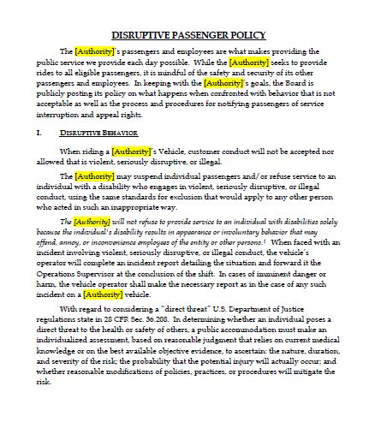
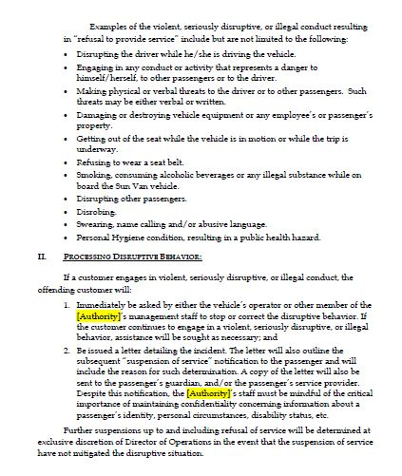

Slide 21
ADA and Substance Abuse
The ADA does not protect persons involved in “illegal” drug activity.
The ADA does look at drug/alcohol abuse as a potential “impairment”.
A positive drug test prior to disclosure is grounds for termination/discipline.
If an employee is being questioned by an MRO regarding prescriptions drugs- an employer may not participate and must abide by the MRO’s decision. See, Benchmark.
Does Medical Marijuana pass muster with DOT?

Slide 22
Contact Information
Jill E. Nagy, Esquire
200 Spring Ridge Drive, Suite 202
Wyomissing, PA 19610
(610) 939-9866
E-mail: jnagy@summersnagy.com
Sean E. Summers, Esquire
35 South Duke Street
York, PA 17401
(717) 812-8100
E-mail: ssummers@summersnagy.com

