Slide 1
PPTA - April 2016
Act 44 Data
Reporting QC Plan Elements, Themes and Opportunities

Slide 2
Agenda
Goals of Act 44 Data Review
Approach
Lessons Learned So Far
Elements of the QC Template
Common Data Issues
Conclusion

Slide 3
PennDOT’s Act 44 Data Review Goals
Verify and Confirm
  Accuracy of data used in Act 44 operating subsidy formula
    Revenue vehicle miles (RVM)
    Revenue vehicle hours (RVH)
    Total passengers
    Senior passengers
  Data reported to dotGrants matches field observations
Evaluate Adequacy
  Act 44 data quality control (QC) plan
  ADA reporting protocols
Suggest Refinements as Warranted

Slide 4
PennDOT’s Act 44 Data Review Approach
Act 44 Data Reporting
  Review current data collection and compilation practices as described by agency management and staff
  Confirm application of current procedures
  Evaluate adequacy of current procedures
  Evaluate accuracy of current procedures
Management Oversight and Quality Control (QC)
  Evaluate adequacy of current procedures
  Confirm application of current procedures
Report Results to PennDOT and Management

Slide 5
Some of the Lessons Learned So Far…
QC Practices Often Defined, Not Always Followed
  Some great practices out there but not fully documented
  Some documented practices are not routinely followed
Interpretation of Data Definitions Varies Among Agencies
Reasonableness Checks Sometimes Lacking
Internal Documentation of Findings & Corrective Actions Often Lacking
“Red Flags” and Adjusting Process to Findings Often Lacking
Feedback to Internal Data Sources Sometimes Lacking
  Drivers
  Operations
  Contractors

Slide 6
Elements of the Model QC Plan
Staff Assignments, Roles & Responsibilities
Initial Data Development & Summaries
Secondary Data Verification
Further Investigation
  Red flags & threshold tests
  Data revisions
QC Program Adherence

Slide 7
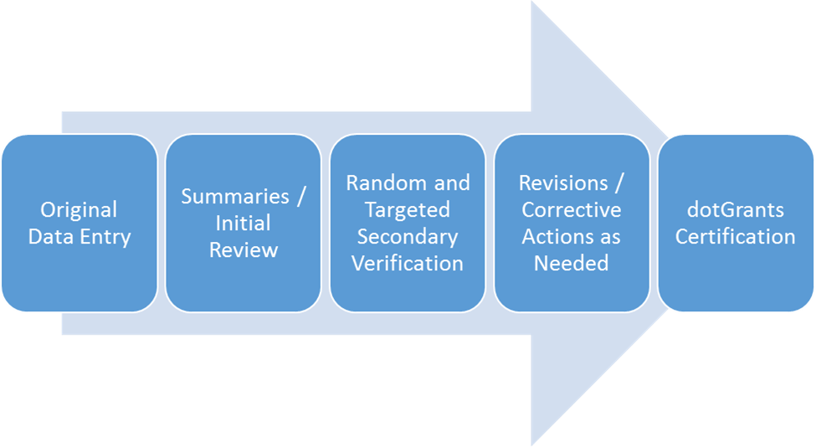
Data Development and QC Flow

Slide 8
Example of Staff Assignment & Responsibilities
Act 44 Data | Original Data Entry | Summaries / Initial Review | Data Verification | Revisions / Follow up | dotGrants Certification
Fixed-Route Statistics
Total Passengers | Vehicle Operator | Operations | Finance | Operations | GM/ED
Senior Passengers | Vehicle Operator | Operations | Finance | Operations | GM/ED
Revenue Vehicle Miles (RVM) | Scheduling | Operations | Maintenance | Operations | GM/ED
Revenue Vehicle Hours (RVH) | Scheduling | Operations | Finance | Operations | GM/ED
ADA & Paratransit Statistics
Total Passengers | Vehicle Operator | Shared-Ride Services | Finance | Shared-Ride Services | GM/ED
Revenue Vehicle Miles (RVM) | Ecolane Calculation | Shared-Ride Services | Maintenance | Shared-Ride Services | GM/ED
Revenue Vehicle Hours (RVH) | Ecolane Calculation | Shared-Ride Services | Finance | Shared-Ride Services | GM/ED

Slide 9
Basic Threshold Tests
Tailor Ranges to Your Verified Experience
Variable | Threshold Range | System (FR/DR) | Verification Frequency
System-wide Total Ridership
Senior Ridership / Total Ridership | 10%-20% | FR | Monthly
Cash Paying Ridership / Total Ridership | 15%-90% | FR | Monthly
Non-Senior Ridership / Total Ridership | 70%-93% | FR | Monthly
ADA Ridership / Total Fixed-Route Ridership | 5% -20% | DR | Monthly
System-wide Transfers
Cash Transfers Sold / Cash Transfers Collected | 60%-95% | FR | Daily
Cash Transfers Collected / Cash Riders | 30%-60% | FR | Daily

Slide 10
Basic Threshold Tests
Tailor Ranges to Your Verified Experience (continued)
Variable | Threshold Range | System (FR/DR) | Verification Frequency
Automatic Passenger Counters
APC Boardings / Farebox Boardings | 95%-105% | FR | Monthly
APC Alightings / APC Boardings | 95%-105% | FR | Monthly
Video Observed Total Ridership
Observed Senior Ridership / Farebox Reported Senior Ridership | 95%-105% | FR | X times /Month
Observed Non-Senior Ridership / Farebox Non-Senior Ridership | 95%-105% | FR | X times /Month
Ride Check Observed Total Ridership
Observed Senior Ridership / Farebox Reported Senior Ridership | 95%-105% | FR | X times /year /Driver
Observed Non-Senior Ridership / Farebox Reported Senior Ridership | 95%-105% | FR | X times /year /Driver

Slide 11
Basic Threshold Tests
Tailor Ranges to Your Verified Experience (continued)
Variable | Threshold Range | System (FR/DR) | Verification Frequency
Fleet Odometer Readings
Reported Total (Actual) Vehicle Miles / Odometer Mileage | 100% | FR/DR | Year End
Revenue Vehicle Miles / Odometer Mileage | 80%- 95% | FR/DR | Year End
Non-Revenue Vehicle Miles/ Odometer Mileage | 5% - 20% | FR/DR | Year End
Scheduled Total Hours
Scheduled Revenue Vehicle Hours/ Reported RVH | 98%-102% | FR | Year End
Non-Revenue Hours / Total Vehicle Hours | 5%-20% | FR/DR | Year End
System-wide Driver Payroll Comparisons
Driver Payroll Hours / Total Vehicle Hours | 100% -130% | FR/DR | Year End
Scheduled Total Miles
Scheduled Revenue Vehicle Miles/ Reported RVM | 98%-102% | FR | Monthly & Year End
Scheduled Non-Revenue Miles / Reported Non-Revenue Miles | 100%-105% | FR | Monthly & Year End

Slide 12
Basic Threshold Tests
Tailor Ranges to Your Verified Experience (continued)
Variable | Threshold Range | System (FR/DR) | Verification Frequency
System-wide Operating Speed Comparisons
Revenue Speed (RVM / RVH) | 11 - 16 mph | FR | Year End
Revenue Speed (RVM / RVH) | 10 - 18 mph | DR | Year End
Non-Revenue Speed (Deadhead miles / Deadhead hours) | > Revenue SPD | FR/DR | Year End
Revenue Comparisons
Boarding Fares Collected / Expected Revenues | 95% - 105% | FR | Monthly
Fare Revenue / Passenger / Full Fare | 65% – 85% | FR | Monthly
Unlimited Ride Pass Ridership /Unlimited-Ride Pass Sales | 15-30 | FR | Monthly

Slide 13
Common Data Issues
More Common
  Poor documentation of current practices
    “Its always been done that way”
    “I don’t know where that came from”
  Skipping simple secondary checks (i.e., previous 5 slides)
  Inadequate tracking and logging of service exceptions
  Reporting ADA live vs. revenue service statistics
  Allocation of shared-ride miles/hours between ADA and all other
  Not tracking or comparing transfers issued vs. collected daily
  Complex and/or ambiguous fare policies
  Differences between NTD and dotGrants on key variables
Less Common
  Erroneous dotGrants data entry
  Counting continue on / interlined passengers
  Not fully testing, maintaining & calibrating new technologies

Slide 14
Conclusion
QC Plan Template
  In testing
  Available by 7/1/16
Be Adaptable to Local Experience / Capabilities but Diligent in QC Responsibilities
Make Your QC Plan Something that Works if:
  You’re out of the office
  “Many of our staff have retired”
Keep Copies of:
  Verifications completed
  Remedial actions taken

Slide 15
Epilogue- NTD Guidance
NTD Definitions (2015 Policy Manual)
  Unlinked Passenger Trips (UPT)
    Fixed-Route- Transit agencies must count passengers each time they board vehicles, no matter how many vehicles they use to travel from their origin to their destination. If a transit vehicle changes routes while passengers are onboard (interlining), transit agencies should not recount the passengers.
    ADA- For demand response (DR) and demand response-taxi (DT) modes, transit agencies must include personal care attendants and companions in UPT counts as long as they are not employees of the transit agency. This includes attendants and companions that ride fare free.

Slide 16
Epilogue- NTD Guidance (continued)
NTD Definitions (2015 Policy Manual)
  Revenue Service (Miles & Hours)
    Fixed-Route- Includes running time, fueling in-route and layover time regardless if passengers can board the vehicle or not (i.e., extended layovers). Excludes deadhead, driver training, maintenance, testing, charter & school bus (pp 75-82).
    ADA- For demand response (DR) modes, mixed messages.
      In narrative, from first passenger pickup to last passenger drop off unless returning to garage (p 76).
      In example, excludes driver lunch break in the middle of shift from revenue service (p 80).
      Demand response-taxi (DT) does not report deadhead.

