Slide 1
Latest Innovations in ITS Technology for Transit

Slide 2
Today’s Presentation
Latest Innovations in ITS Technology for Transit
Highlighting some of the exciting and innovative ITS technologies being utilized in PA today and a look forward at the latest innovations and where ITS technology is going in the near future.

Slide 3
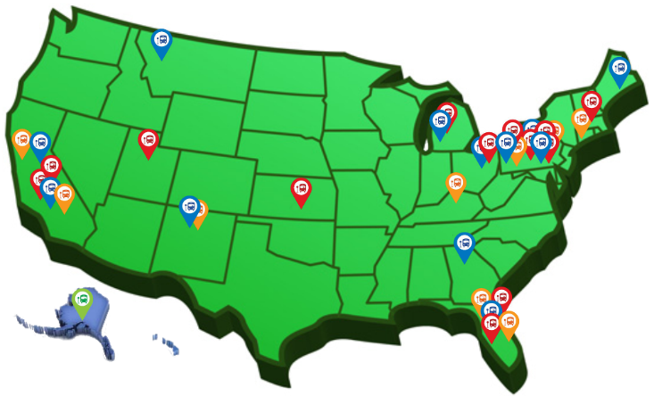
Who is Avail Technologies?
Real people integrating smart, reliable, and convenient ITS solutions
Revolutionizing ITS for public transit with CAD/AVL solutions for more than 18 years
Partnering with our customers to achieve success in transit agencies across the
United States

Slide 4
ITS / Real-Time Passenger Information in PA

Slide 5
Who is Avail Technologies?
CHAD HUFFMAN – Senior Account Manager cah@availtec.com – 814-880-1189
MILO THOMAS, PMP – Program Manager mst@availtec.com – 734-945-7514

Slide 6
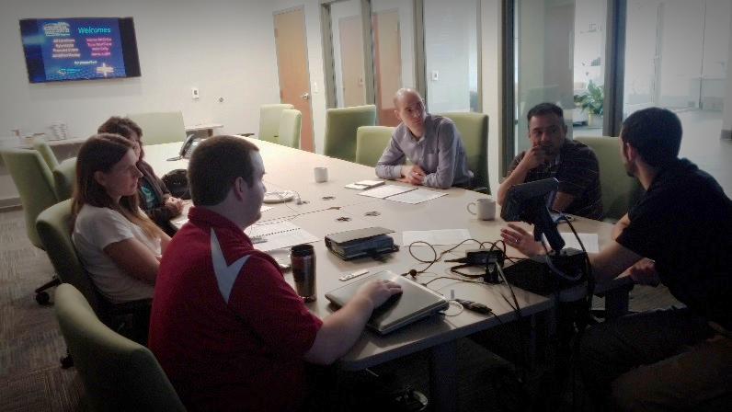
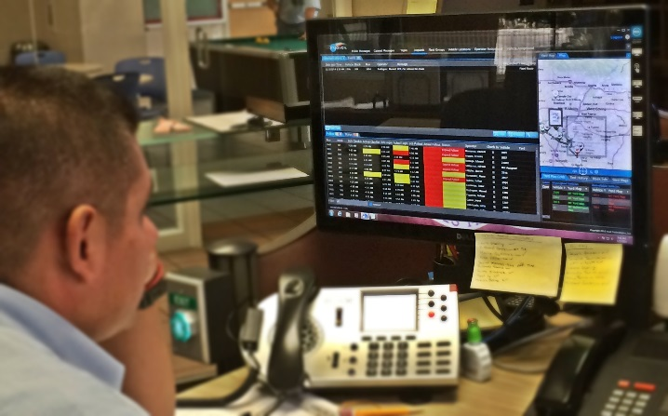
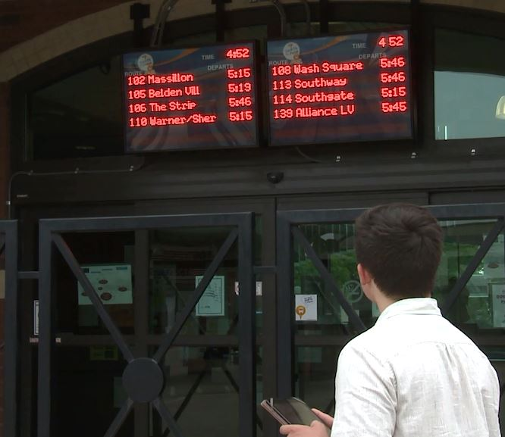
What Does Avail Technologies Do?
Real people integrating smart, reliable, and convenient ITS solutions

Slide 7
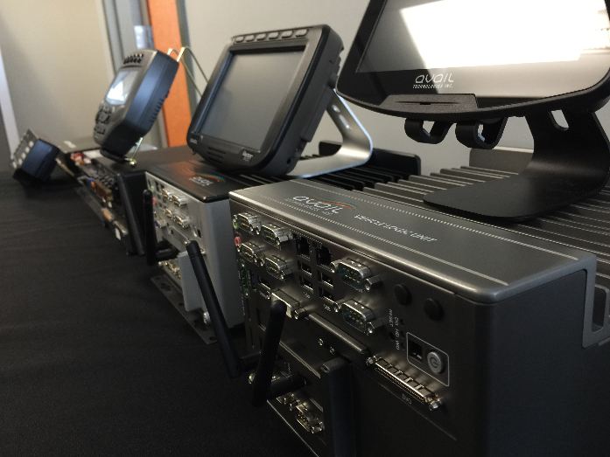
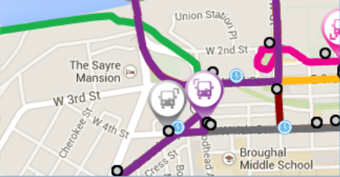
What Does Avail Technologies Do?
Revolutionizing ITS for public transit with CAD/AVL & Fare solutions for more than 16 years

Slide 8
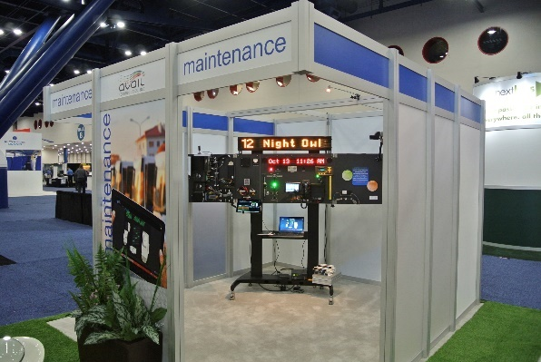
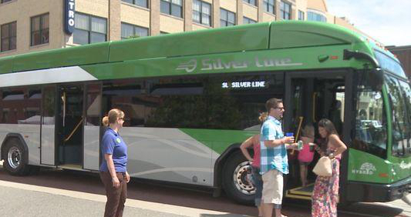
What Does Avail Technologies Do?
Revolutionizing ITS for public transit with APC, VHM, AVA solutions for more than 16 years
Touch here for ADA

Slide 9
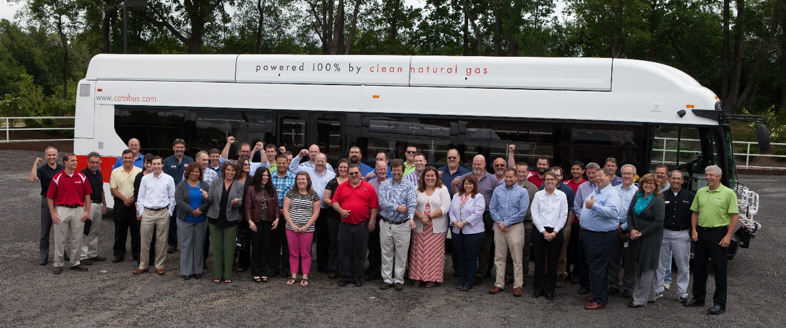
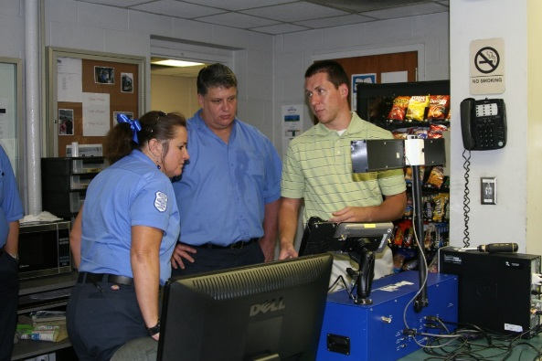
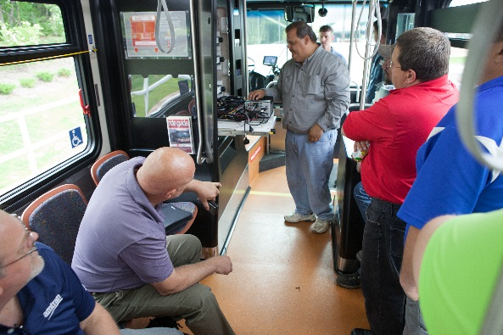
What Does Avail Technologies Do?
Partnering with our customers to achieve success in nearly 50 agencies across the United States

Slide 10
What’s buzzing in APTA…
“All about Mobile Payment Solutions…”
“First and Last Mile…What do Customers Want?”
“ITS and Vehicle-based Real-Time Solutions”
“Connected Vehicle Technologies and Open Data Usage…”
“Security and Cybersecurity…Keeping Pace with Innovation”

Slide 11
What’s out to bid related to ITS…
CDTA, Albany NY – Intelligent Transportation Management System
SMTD, Springfield IL – Intelligent Transportation Systems
SRTA, New Bedford MA – Transit Management Technologies
NORTA, New Orleans LA – CAD/AVL System
CityBus, Culver City CA – SmartBus System Project

Slide 12
ITS Technologies

Slide 13
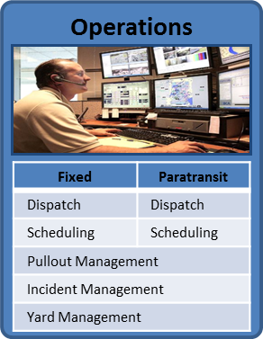
Operations-focused Technologies
Fixed Route Scheduling
Yard Management
Detour Management
Decision Support

Slide 14
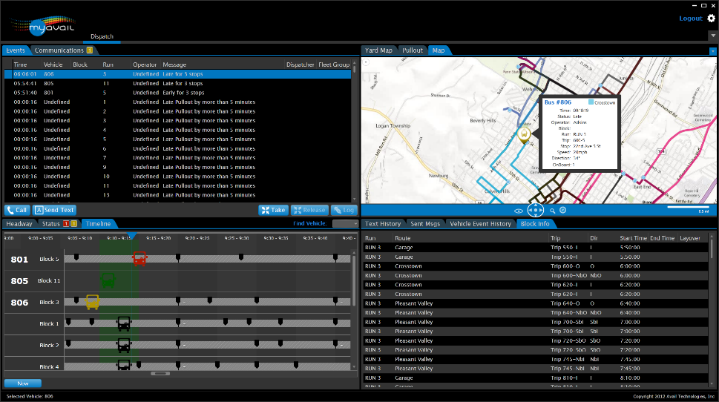
SPOTLIGHT: Decision Support
Imagine you took all the knowledge of your best Dispatcher, and built it into your CAD/AVL system.
System continuously monitors all incoming data and proactively alerts users to potential issues
Recommends actions to ensure consistent and timely handling and resolution

Slide 15
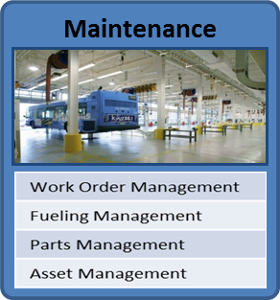
Maintenance-focused Technologies
Electronic Operator Defect Reporting
Vehicle Health Monitoring
Asset Management
Maintenance Management Systems

Slide 16
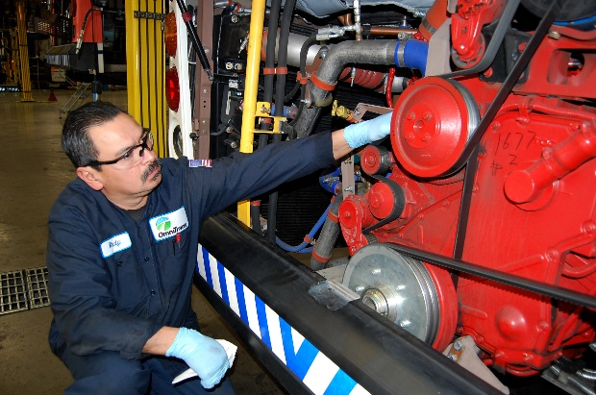
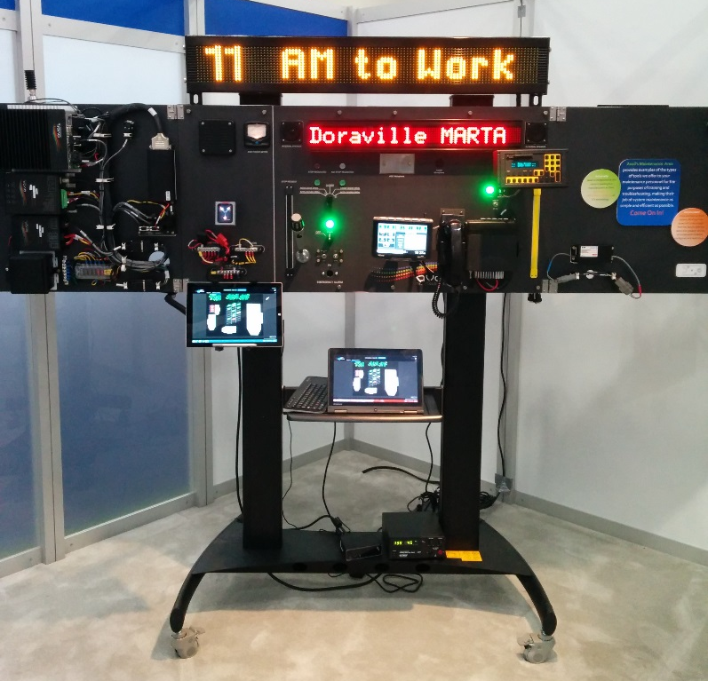
SPOTLIGHT: Maintenance Management
Complete system solution for maintenance staff, think “CAD/AVL” for Maintenance
Electronic Operator Defect Report – streamlines pullout
Yard Management – always know where the bus is in the yard, identify buses out for service
Vehicle Health Monitoring – catch faults in real-time while bus is on the road
More advanced trend analysis

Slide 17
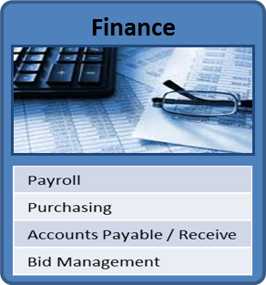
Finance-focused Technologies
Payroll Automation

Slide 18
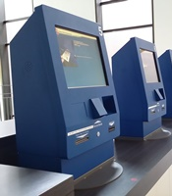
SPOTLIGHT: Payroll Automation
Automating driver payroll by connecting systems
Driver check-in kiosk in dispatch
Fixed Route Scheduling / Rostering system
Base hours / schedule
Dispatch / Pullout Management System
Tracking any exceptions (late, no-show, overtime, time-off)
Finance / Payroll System
Automated import of all data
Less manual effort
More accurate payroll

Slide 19
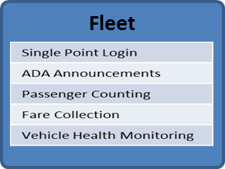
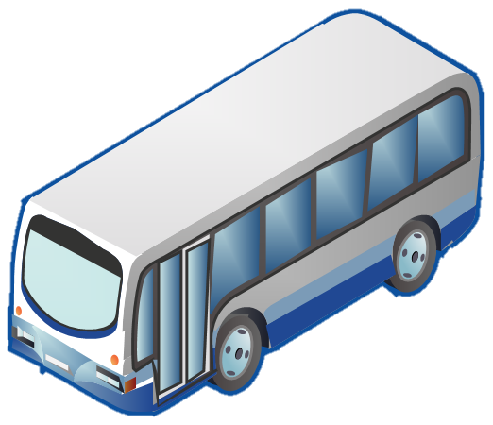
Vehicle Technologies
Mobile Data Routers / Wi-Fi on the bus
VOIP-based Communications

Slide 20
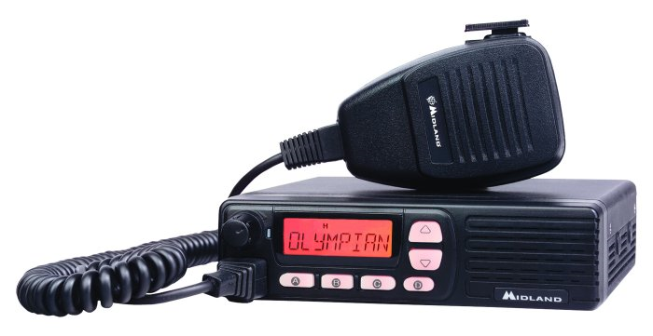
SPOTLIGHT: VOIP-based Communications
Becoming a desirable path with aging two-way radio infrastructures and difficulty obtaining frequencies
Leverages expanding public cellular data networks
Data coverage widespread
Data plans more cost effective
Utilizes LTE router on bus
Expands communication options
Can patch to cell phones, tablets, and office VOIP phones

Slide 21
Rider-focused Technologies
Google Real-Time
Electronic Payment / Mobile Ticketing
Apps! Uber / Lyft?

Slide 22
SPOTLIGHT: Google Real-Time
Builds on GTFS specification for static schedule data
Provides real-time bus information via Google Maps and standard API
Opens up market for even greater diversity of customer-facing solutions:
Apps
Electronic Signs
Kiosks

Slide 23
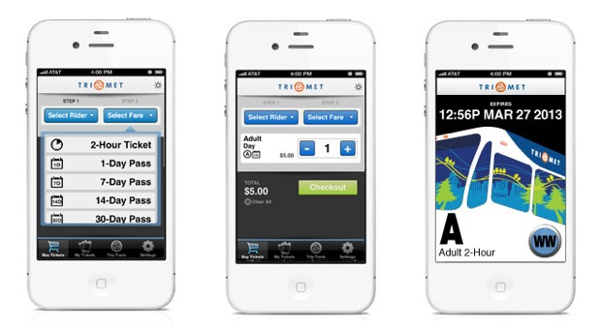
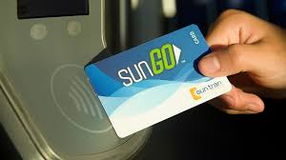
SPOTLIGHT: Electronic Payment
Cash-less payment options expanding as new technologies emerge and are being rolled out across the Country:
Smart Cards
Apple Pay / Google Pay / NFC
Mobile Ticketing
Open Payment
Still in early stages of adoption with solutions ranging from traditional validating farebox solutions to more cost-effective solutions (less infrastructure)

Slide 24
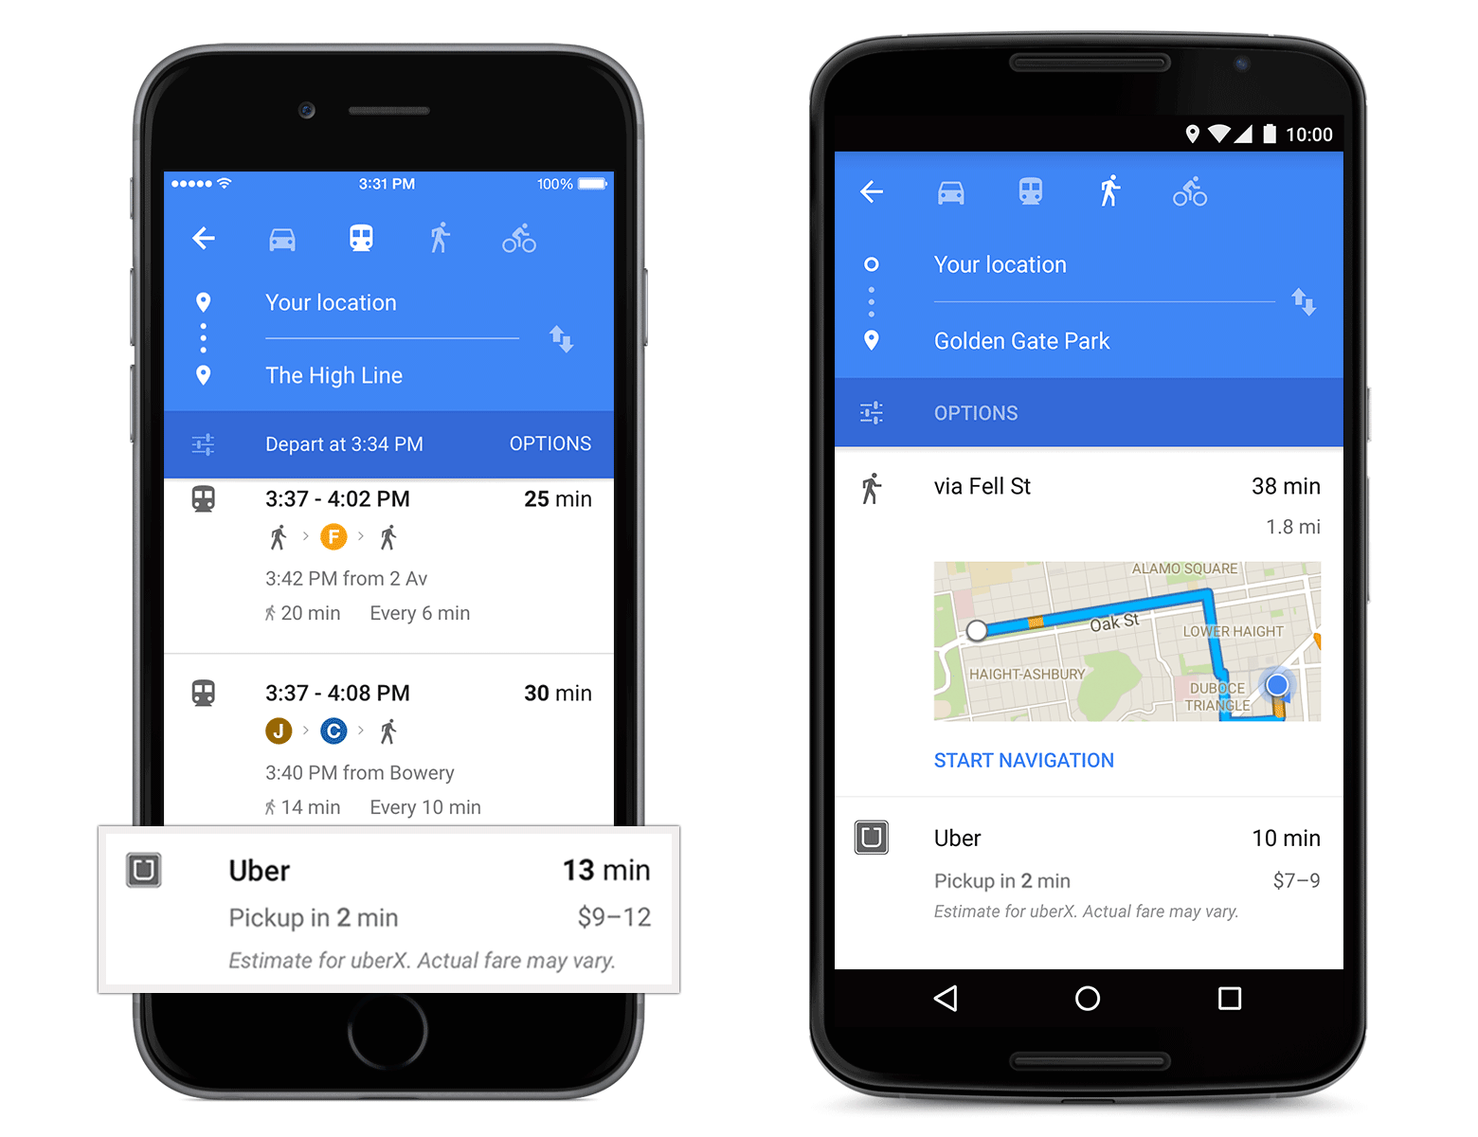
SPOTLIGHT: Apps! Uber / Lyft
Lots of discussion within Transit about Uber and Lift
Are they are threat?
A viable partner?
A potential first/last mile solution?
Transit apps moving towards integrating with Uber
Google Maps rolling out an Uber option (in addition to walking/driving/transit)

Slide 25
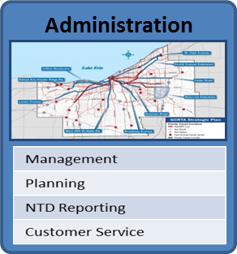
Technologies Tying it All Together
Data Warehousing
Business Intelligence / KPI Dashboards

Slide 26
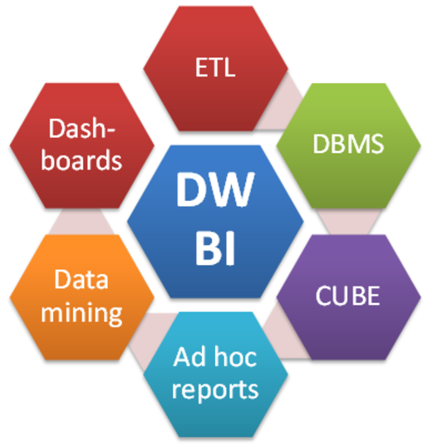
SPOTLIGHT: Business Intelligence
All your ITS systems connected and sharing data via Data Warehouse
Business Intelligence
Mining data warehouse finding trends in data to provide answers, not just data
KPI Dashboards and Reporting
Transit-specific KPI dashboards / Board report
User-defined dashboards
Self-service reporting

Slide 27
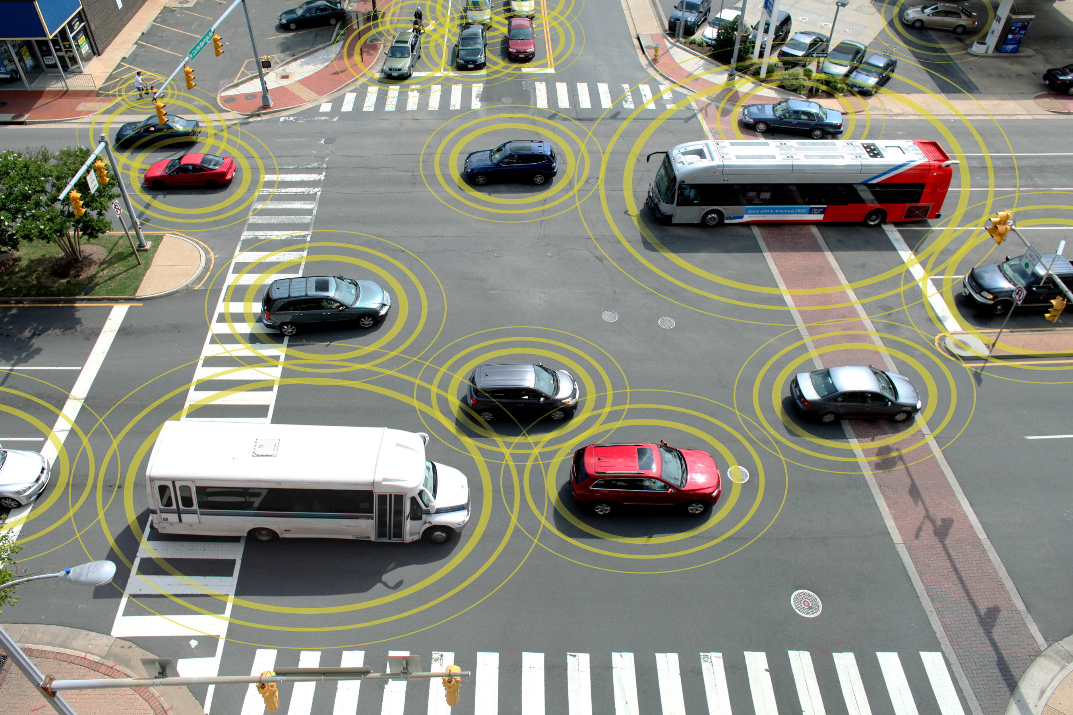
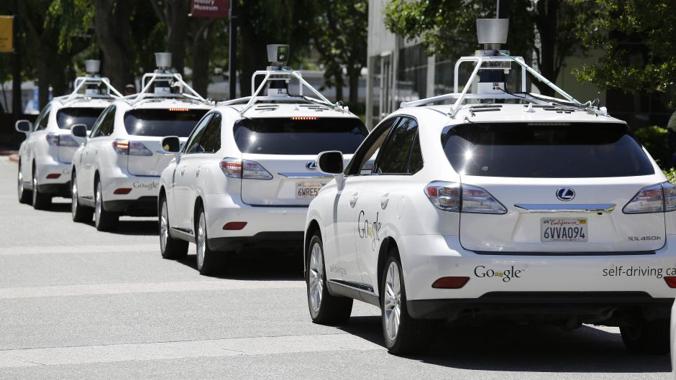
The Future…Coming soon?
Connected Vehicles
Self-driving Buses

Slide 28
Questions?

