Slide 1
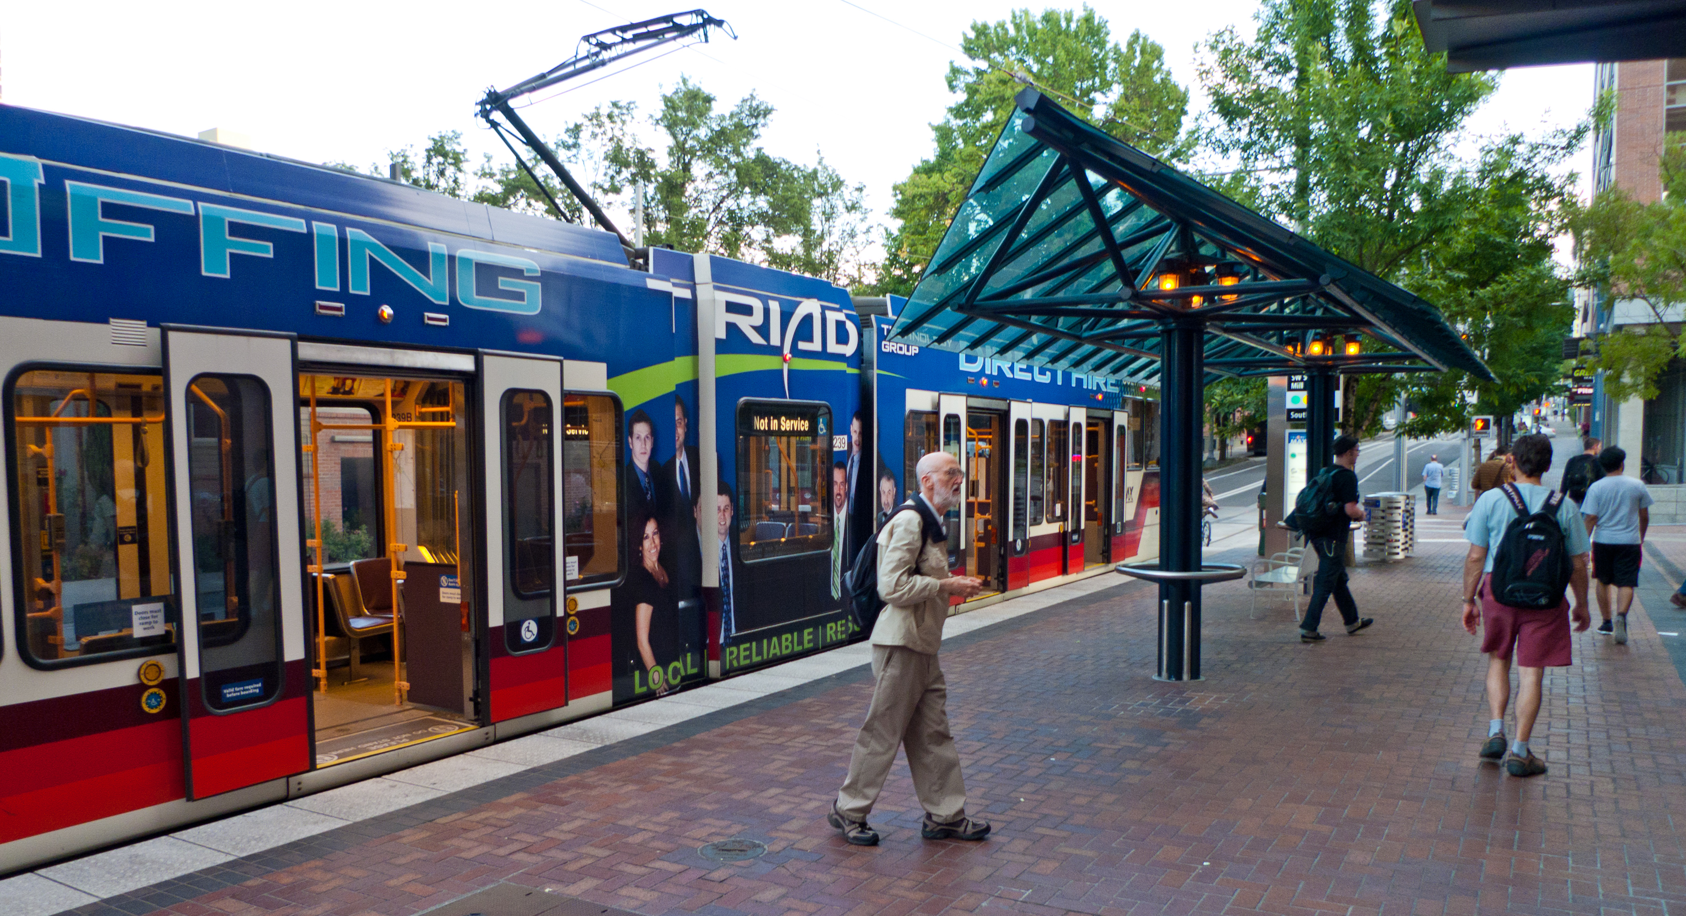
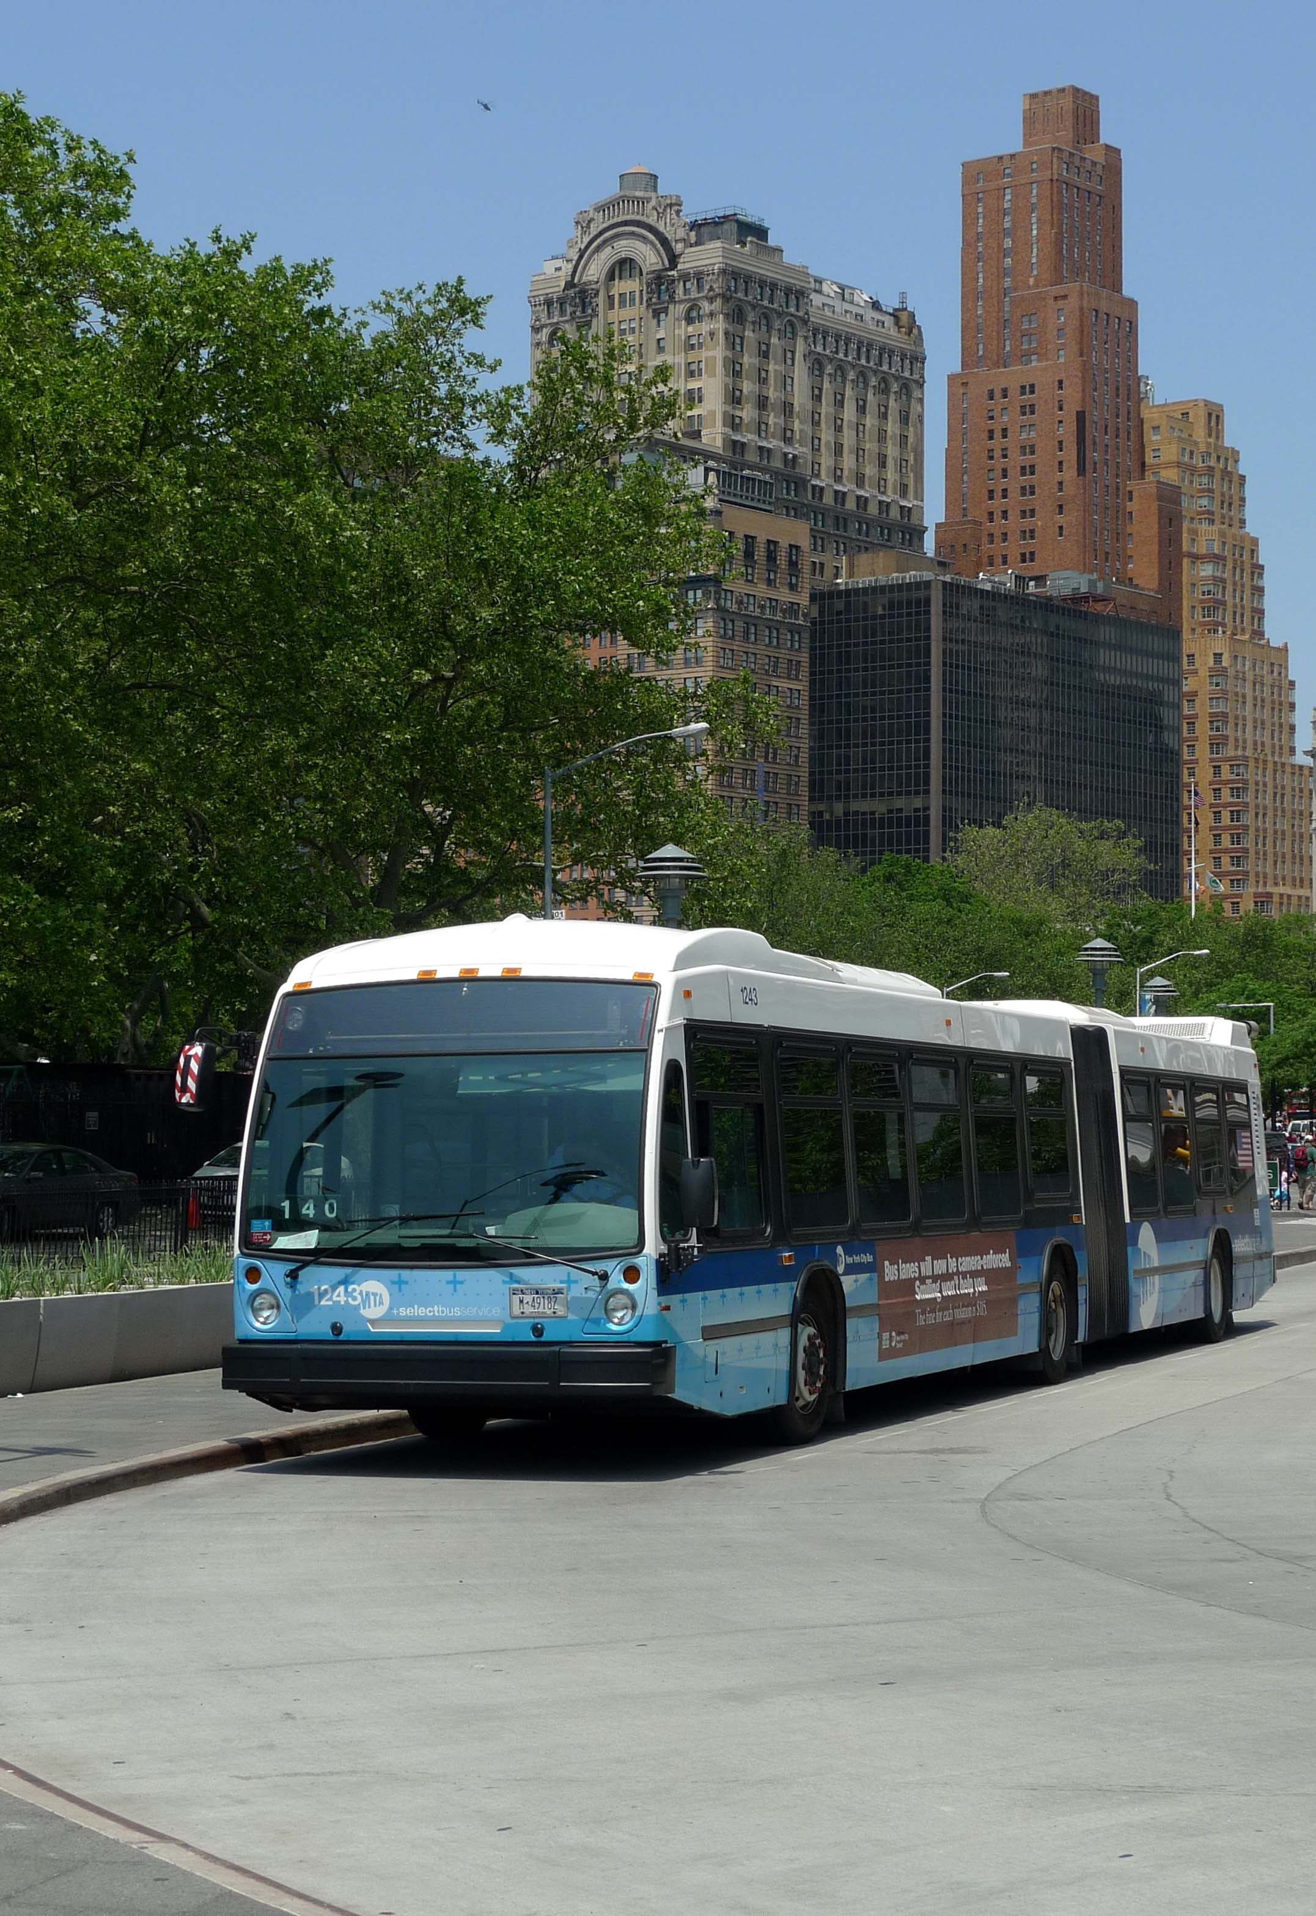
Rides to Wellness
Building
Ladders of Opportunity &
Access to Care through
Public Transit and Healthcare Partnerships
April 21, 2016
Notes:
FTA has a treasured place in our nation’s history with many movements – civil rights, disability rights, tribal rights – access to public transportation is often the great enabler.
-enabling access to jobs
-enabling access to affordable housing
-enabling access to education and training
-connecting suburban, rural and intercity communities.
Now, as the Affordable Care Act and healthcare overall continues to drive historic change in how we help people stay or get well, public transportation can be an important enabler of access to health services – especially in the new directions of greater preventive care, less unnecessary hospital readmissions, and helping reduce health disparities by ensuring that at risk populations can get to the Doctor and to new ACA screenings.
This presentation will outline a new FTA flagship initiative – Access to Healthcare Transportation Ladders of Opportunity Initiative, or RIDES TO WELLNESS!

Slide 2
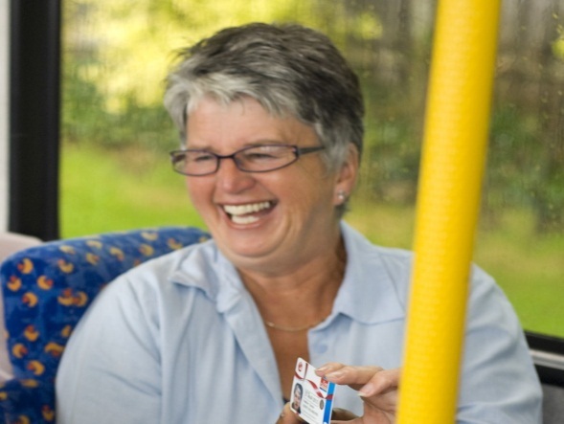
Rides to Wellness
Presentation Outline
What is Rides to Wellness?
Federal Interagency Coordinated Council on Access and Mobility (CCAM)
FAST Act changes
Why should we focus on the intersection between health and transportation?
What are the compelling needs?
How will we accomplish the Rides to Wellness Initiative?
Results so far and next steps
Notes:
Thank you to the thought leaders in this field who have been working on this for a long time. In the next few minutes I’ll describe Rides to Wellness – an initiative FTA developed with our technical assistance center the National Center for Mobility Management (NCMM) who is comprised of the following partners: Easter Seals, the Community Transportation Association of America and the American Public Transportation Association.
I’ll also tell you about the Coordinated Council on Access and Mobility, some changes to FTA’s authorizing legislation, the FAST Act, as it relates to the section 5310 program for enhancement of service for seniors and people with disabilities and discuss some of the questions you see here.

Slide 3
Rides to Wellness Vision and Goals
Through rides people and community health thrive
Improve healthcare access
Leverage public transportation assets and services
Reduce healthcare costs
Notes:
FTA also has the opportunity to develop a return on investment strategy that shows not only how people’s health improve, but also how a strong public transportation network ensures everyone can get to new preventive services and to the doctor or rehabilitation following hospital stays. Access to services is vital to ensuring that individuals have care that can reduce the rate of hospitalization and hospital readmissions.
If access to transportation – a key social determinant of health - provided even just a 1% difference in access to care, reducing health disparities or reduction in unnecessary hospital readmissions, public transportation services could potentially make a significant positive health impact for millions of people and facilitate significant healthcare cost reductions.
The FTA oversees grants to state and local transit providers, and is a unique position to leverage our grant programs and partner with Department of Health and Human Services, the healthcare industry, and transit industry to leverage resources and stimulate investments that address service gaps.
Through Rides, People and Community Health Thrive: FTA can become a recognized partner with the health, wellness, and medical community as a major enabler of a high quality of life for people who live in communities with health disparities by ensuring their access to care.

Slide 4
Coordination Codified under Section 5310 in FAST Act
11 federal agencies, coordinating 80+ funding streams supporting transportation
Joint programs link networks, increase efficiency, build partnerships
Local partners collaborate to serve the public better
Notes:
The Coordinating Council on Access and Mobility (CCAM) is a partnership of federal agencies working to build ladders of opportunity across America by improving the availability, quality and efficient delivery of transportation services to people with disabilities, older adults and people with low incomes. CCAM members continue to promote further the mission of United We Ride, a 10-year initiative to help states and local communities coordinate across the various Federal programs associated with human services transportation.

Slide 5
FAST ACT Section 5310 Changes
New Discretionary Pilot Program ($2-3.5M/yr.) to Expand Access and Mobility
Innovations in coordination including technology solutions
Policies to expand interagency coordination, break down federal barriers, and promote locally developed coordinated planning
Several References to NEMT Service
For more information, visit: https://www.fta.dot.gov/funding/grants/fast-act
Notes:
PILOT PROGRAM:
Financing innovative projects for the transportation disadvantaged that improve the coordination of transportation services and nonemergency medical transportation services, including—
the deployment of coordination technology; projects that create or increase access to community One-Call/One-Click Centers; and such other projects as determined appropriate by the Secretary.
Plan Requirements:
Cost allocation model
Identify and recommend changes to Federal laws
New Strategic plan
STRATEGIC PLAN.—after the date of enactment of this Act, the Council shall publish a strategic plan that outlines the role and responsibilities of each Federal agency with respect to local transportation coordination, including nonemergency medical transportation; identifies a strategy to strengthen interagency collaboration; addresses any outstanding recommendations made by the Council in the 2005
REPORT to the President relating to the implementation of Executive Order No. 13330, including—
a cost-sharing policy endorsed by the Council; and
recommendations to increase participation by recipients of Federal grants in locally developed, coordinated planning processes;
to the extent feasible, addresses recommendations by the Comptroller General concerning local coordination of transportation services;
examines and proposes changes to Federal regulations that will eliminate Federal barriers to local transportation coordination, including non-emergency medical transportation; and recommends to Congress changes to Federal laws, including chapter 7 of title 42, United States Code, that will eliminate Federal barriers to local transportation coordination, including nonemergency medical transportation.

Slide 6
Compelling Need
18% of patients discharged readmitted within 30 days, 1/3 within 90 days. Medicare spends $15B annually for hospital readmissions.
Public Transportation has excess capacity in off-peak hours.
Almost 80% of healthcare costs ($2.1T) associated with chronic conditions.
Missed appointments = lost revenues, wasted staff time, access problems, and worse patient care.
Notes:
- 84% healthcare spending in 2006 for only 50% of population who have one or more chronic condition (Robert Wood Johnson, Chronic Care Study, 2010)
2009 US Healthcare total cost $2.5T (Health Affairs Blog Chris Fleming, 2010), 2.1T of it was for managing chronic conditions.
Screening for chronic conditions can make a difference, and the Affordable Care Act mandates 15 different ones
AARP recent report noted one study showing that 3.6M Americans miss at least one medical trip for lack of transportation (AARP, January 2015)
The people who need the screening the most may not be able to get there due to lack of transportation
Hospitals pay fines for certain types of readmissions
Patients/customers need to access post-operative and rehabilitative services
Getting well at home requires being able to get back to the Dr.
Public transit can help reduce these costs by ensuring a ride is available to all who need one

Slide 7
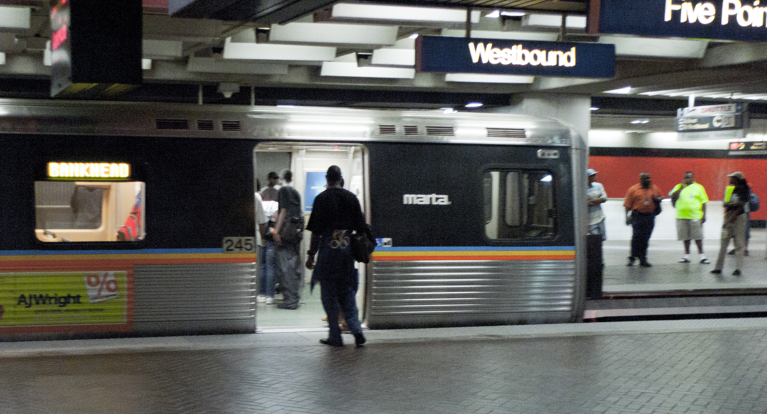
Benefits of a Health and Transportation Initiative: a Win - Win
Health equity resulting from reduced health disparities
Better health access resulting in fewer missed appointments, reduced healthcare costs for providers and improved health for people
New Public Transit riders and partnerships with Healthcare providers and insurers
Notes:
There is a growing awareness in the health sector regarding the importance of ensuring that people can get to the healthcare services that they need. Public Transportation has gained greater recognition as an enabler of health through access to care.
1.) Greater access to care mitigates health disparities: People of color are disproportionately impacted by chronic conditions and there are significant health equity and disparity issues, as an example:
-As of 2005, Native Hawaiians or other Pacific Islanders (15.4%), American Indians/Alaska Natives (13.6%), African Americans (11.3%), Hispanics/Latinos (9.8%) were all significantly more likely to have been diagnosed with diabetes compared to their White counterparts (7%).
2.) Access to Care Supports Better Health for People with Chronic Conditions.
3.) There is a long history of public transit support in non-emergency medical transportation and operational technology changes since the ADA & have resulted in greater on-demand services and infrastructure that could be leveraged in a bigger way with the healthcare industry rather than continuing to set up separate private sector brokerages.

Slide 8
How Will We Accomplish This Initiative?
Notes:
We Have a 3 Prong Strategy for the Initiative
Build commitment:
Identify and build a coalition of major national stakeholders from the transportation, health/wellness, medical and community services, starting with a Health and Transportation Summit on March 11, 2015, and continuing with forums at the national and regional level. The Summit and forums have generated a dialogue aimed at identifying the issues and barriers to healthcare access and potential solutions for how to collectively move forward to address the issues. The main objective is to join the healthcare industry and transportation industry into a partnership around the issue of access to care and garner support to continue to collaborate and invest in solutions.
Drive Change:
Through our Technical assistance centers, create and disseminate materials on best practices, key issues/solutions
Stimulate Investment:
In June 2015 we released $400K in planning grants to sixteen local communities and states to create partnerships with the healthcare and transportation communities. On March 29, 2016 we announced our “phase II” of these grants – the Rides to Wellness Demonstration and Innovative Coordinated Access and Mobility Notice of Funding Opportunity (NOFO) – a competitive process to select promising ideas for implementation in 2016-2017.

Slide 9
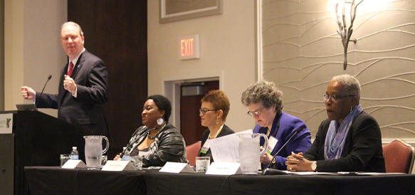
Activities to Date: Forums and meetings
Rides to Wellness (R2W) Executive Summit (March 11, 2015)
Transit CEO Forum (October 3, 2015)
Missouri Get Link'd Health & Transportation Conference (October 13-14, 2015)
R2W Forum, Baltimore MD (March 31,2016)
Notes:
development. The grantee shares “The grant gave us the opportunity to explore the issues patients face regarding transportation to access healthcare, through discussions, focus groups and surveys that were conducted in parallel with the development of the software interface.”
Christian Healthcare Center, Lynden, WA:
The Northwest Adult Day Health Center aims to keep chronically ill and disabled adults living in their homes as long as possible by providing them with care during the day. Transporting program participants to the new center was a problem that several community organizations worked together to solve. A local church offered its lobby as a pick-up and drop-off location for participants, and Whatcom Transit Authority is supplying a bus for trips to and from the new center. Smaller WTA paratransit buses will shuttle participants between the church and their homes.
Whatcom Transit Authority staff, in consultation with Christian Health Care Center and adult day health caregivers, applied for and received the R2W grant to develop the transportation plan. The partner organizations also worked with the NCMM to create a transportation plan to get rural northern Whatcom County residents to and from the center. *(Medicaid is one of the program payers for the Adult Day Center – through the State’s Community Options Program Entry System).

Slide 10
Missouri Statewide R2W Event
Get Link’d 2015
Jefferson City, Missouri
Co-sponsors:
Missouri Rural Health Association
Missouri Public Transit Association
HealthTran
More info: http://morha.org/conference.php
Notes:
This was the first state-wide R2W event, co-sponsored by Rural Health Association and the Public Transit Association in Missouri. Other states and regions can follow this example.
The First Annual Get Link'd Health & Transportation Conference was held in Jefferson City, Missouri on October 13-14, 2015. The event was co-sponsored by the Missouri Rural Health Association and the Missouri Public Transit Association in partnership with HealthTran.
More info: http://morha.org/conference.php

Slide 11
Forum Results: Eight Key Themes
Coordinated Planning
Partnerships
Client-Centric
Technical assistance
ROI
Technology
Outreach and Marketing
Mobility Management
Notes:
Between R2W Kick-Off Summit & CEO Forum we reached 230 people and heard eight major themes:
- Coordinated Planning: There continues to be clear consensus regarding the importance of coordinated planning and the need for more work in this area. Congress agreed, and the FAST Act has a new section in Section 5310 to achieve these goals as part of the Rides to Wellness Initiative.
- Partnerships Work: Early innovators in this area are finding partnerships between health/wellness and transportation providers work and are easier than they thought.
- Client-Centric: We need client-centric approaches; public transportation seems to be evolving in this regard especially with the advent of TNCs like Lyft and Uber.
- Technical assistance: Communities will need help and tools to build partnerships across the health and transportation sector.
- ROI Value: There are many elements of value and ROI gains possible, and we need further exploration to identify where these value propositions lie in both sectors.
- Technology: Information systems and social networking apps. hold strong promise to provide support for information/referral to help clients navigate complex systems such as linking health/wellness appointments to transportation trips.
- Outreach and Marketing: Materials are needed that promote health/wellness and transportation partnerships and assist both industries in understanding each other’s business.
Mobility Management: Fielding mobility managers to assess community needs, inventory resources, identify gaps and fill those gaps, could be a useful complement to care managers or other health sector client support roles.
* In addition, there was a State level R2W event: Missouri’s Rides to Wellness Executive Summit (October 14, 2015). The NCMM is currently developing a toolkit to encourage more State and regional R2W events.

Slide 12
Activities to Date: R2W Healthcare Access Challenge Grants
$400K awarded to 16 communities
Developed Partnerships Among Transportation, Health, and Human Services
Extensive pre-application research to identify challenges (Dialysis, preventive care, readmission, mental health)
Started with two possible solutions
“Design Thinking” planning process lead to one solutions to fully plan
Business Plan
Desirability, Feasibility, Sustainability
Notes:
During the six-month grant period, grantees tested assumptions about their proposed concepts with potential users and modified their solutions to adapt to real-world situations. Here are two examples from the 16 grants:
Worcester Regional Transit Authority, Worcester, MA:
Two parts: 1.) Web-based application to be used by healthcare facilities to schedule appointments better timed with public transit schedule. The application searches for optimum times, considering patient’s address, and provide 3-4 options. 2.) Provides a bus for patients going to healthcare appointments that would travel from 5-6 different regions on different days of the week to coincide with scheduling of hospital appointments for the respective neighborhoods.
The Smart Transit to Healthcare team collaborates with the WRTA, the Central Massachusetts Regional Planning Commission, and other agencies and stakeholders. Led by a recent Clark University Ph.D. graduate, the team is developing and applying a database/application/web-based interface to help health services providers optimize patient-transportation efficiency when scheduling appointments, and give patients clear routing and timing information.
The Family Health Center of Worcester enthusiastically agreed to be the market test site; they are spearheading the software development. The grantee shares “The grant gave us the opportunity to explore the issues patients face regarding transportation to access healthcare, through discussions, focus groups and surveys that were conducted in parallel with the development of the software interface.”
Christian Healthcare Center, Lynden, WA:
The Northwest Adult Day Health Center aims to keep chronically ill and disabled adults living in their homes as long as possible by providing them with care during the day. Transporting program participants to the new center was a problem that several community organizations worked together to solve. A local church offered its lobby as a pick-up and drop-off location for participants, and Whatcom Transit Authority is supplying a bus for trips to and from the new center. Smaller WTA paratransit buses will shuttle participants between the church and their homes.
Whatcom Transit Authority staff, in consultation with Christian Health Care Center and adult day health caregivers, applied for and received the R2W grant to develop the transportation plan. The partner organizations also worked with the NCMM to create a transportation plan to get rural northern Whatcom County residents to and from the center. *(Medicaid is one of the program payers for the Adult Day Center – through the State’s Community Options Program Entry System).

Slide 13
Healthcare Access Challenge Grant: Central Iowa
1.) Develop a “riders’ club” for recently discharged patients who need transportation to follow-up appointments that include an assessment to determine the best mode of transportation for them and linkage to a local mobility coordinator.
2.) Provide transportation to recently discharged patients, identified in consult with discharge planners, through trained volunteers recruited from the hospital’s Volunteer Services Department.
More Info: http://nationalcenterformobilitymanagement.org/challenge/#sthash.a1aK2D7h.dpuf
Notes:
Here is an example of one of the 16 Healthcare Access Challenge Grants – this one from Central Iowa
If you visit the link you see on the screen, you can listen to Healthcare Access Mobility Design Challenge grantees’ business pitches from February 2016. These Shark-Tank-like pitches are 5 mins long and showcase the great work completed by each grantee over a six month period in late 2015. visit: http://nationalcenterformobilitymanagement.org/challenge

Slide 14
Healthcare Access Challenge Grant: Waukesha Co., WI
One call to schedule a ride and receive eligibility screening and application. Technology connects HST providers to central dispatch.
“Navigation” program:
Travel Training with volunteer “Bus Buddies” paired with Sr./PWDs
Trained volunteer “transportation wayfinders” assist individuals to apply for programs and help them (& caregivers) create an individualized transportation plan. http://nationalcenterformobilitymanagement.org/challenge/#sthash.a1aK2D7h.dpuf
Notes:
Again - if you visit the link you see on the screen, you can listen to Healthcare Access Mobility Design Challenge grantees’ business pitches from February 2016. These Shark-Tank-like pitches are 5 mins long and showcase the great work completed by each grantee over a six month period in late 2015. visit: http://nationalcenterformobilitymanagement.org/challenge

Slide 15
Current Efforts: Driving Change
$5.3M Rides to Wellness Demonstration & Innovative Coordinated Access & Mobility Grants
Coordinating Council on Access and Mobility (CCAM) Meeting late 2016
Community Scan (lack of transportation impacts)
IOM/TRB Workshop
2 Research Initiatives:
Rides to Wellness Regional Forums – 5 Regions in 2016 & the remaining in 2017

Slide 16
CCAM Meeting
Later in 2016, the CCAM will meet to devise a strategy to:
Develop a cost sharing policy and a cost allocation model
Update inventory of human services transportation program guidance
Promote coordination across agencies through joint planning and guidance

Slide 17
Rides to Wellness Demonstration Grants
$5.3M Rides to Wellness Demonstration and Innovative Coordinated Access and Mobility Notice of Funding Opportunity (NOFO): https://www.fta.dot.gov/funding/applying/notices-funding/rides-wellness-demonstration-and-innovative-coordinated-access-and.
Posted: 3/29/16
Closes: 11:59 p.m. EST on 5/31/16
SF-424 form supplemental form: https://www.fta.dot.gov/node/43276
Notes:
SF-424 form supplemental form https://www.fta.dot.gov/node/43276 must be completed and attached to any final submission in Grants.gov. The form works best in Internet Explorer.
The funding sources are: Section 3006(b) of the Fixing America’s Surface Transportation Act (FAST), Pub. L. 114-94, which authorizes a pilot program for innovative coordinated access and mobility; and 49 U.S.C. 5312 (Section 5312). Proposals must be submitted electronically through Grants.gov website by midnight Eastern Time on 5/31/2016.

Slide 18
Rides to Wellness Grants, Continued
The goal is to find and test promising, replicable public transportation healthcare access solutions that support the following Rides to Wellness goals: increased access to care, improved health outcomes, and reduced healthcare costs.
Eligible applicants: States, Tribes, and Designated or Direct Recipients for funds under 49 U.S.C. 5307, 5310 or 5311.
Eligible projects: Mobility management; health and transportation provider partnerships; technology; and other actions that drive change. The selected projects will develop innovative and replicable best practices.
Notes:
To support these goals, the R2W Demonstration Grants will: 1. Develop replicable, innovative, sustainable solutions to healthcare access challenges; 2. Foster local partnerships between health, transportation, home and community-based services and other sectors to collaboratively develop and support solutions that increase healthcare access; and 3. Demonstrate the impacts of transportation solutions on improved access to healthcare and health outcomes and reduced costs to the healthcare and transportation sectors.

Slide 19
Community Scan: Key Research Questions
How does lack of transportation impact healthcare costs, including the percent of missed appointments?
What percent of missed appointments are due to transportation issues?
What are the direct costs associated with missed appointments?
What are the indirect costs associated with missed appointments?
Notes:
This is a cooperative agreement with Health Outreach Partners (HOP) that will be awarded in late April 2016. HOP will conduct a literature review to identify existing data related to the following research questions:
How does lack of transportation impact healthcare costs, including the percent of missed appointments?
What percent of missed appointments are due to transportation issues?
What are the direct costs associated with missed appointments?
What are the indirect costs associated with missed appointments?

Slide 20
Community Scan: Survey
Three networks will be surveyed:
The Health Resources and Services Administration’s (HRSA) community health centers
The Department of Veterans Affairs’ (VA) Medical Centers
A National Health Insurer’s healthcare providers
The survey will be administered to staff with access to data related to missed appointments and the ramifications of missed appointments on their costs and productivity
The final report will include a summary of national data as well as profiles of communities with promising solutions
Notes:
Since R2W began in 2015, partners and stakeholders have repeatedly cited missed appointments as a major challenge, representing a huge cost to the medical community and to peoples' health. Transportation is regularly cited as a primary cause of missed appointments. R2W-related research has found a lack of hard data about costs associated with transportation barriers to healthcare. This lack of data has contributed to an absence of broad-based solutions because a clear identification of the problem has not been established. A better understanding of the costs that transportation barriers pose to the healthcare system would generate broad interest in innovative solutions. Thus the R2W Community Scan Project seeks to determine the impact of missed medical appointments due to lack of available transportation on healthcare costs.
Then, HOP will develop a survey to gather community-level data regarding missed appointments due to transportation issues, direct and indirect costs associated with missed appointments, and other healthcare costs associated with lack of transportation. Three networks will be surveyed: the Health Resources and Services Administration’s (HRSA) community health centers, the Department of Veterans Affairs’ (VA) VA Medical Centers, and a National Health Insurer’s private healthcare providers. The survey will be administered to staff with access to data related to missed appointments and the ramifications of missed appointments on their costs and productivity.
The final product will be a report, which will include a summary of national data as well as profiles of communities with promising solutions. Key partners from the following agencies will help guide the project: FTA, Centers for Medicare and Medicaid Services, VA, a National Health Insurer, HRSA, and Administration for Community Living. The period of performance for this project will be April 2016 to March 2017.

Slide 21
Community Scan: Key Partners
Key partners from the following agencies will help guide the project:
FTA
VA
HRSA
A National Health Insurer
Centers for Medicare and Medicaid Services
Administration for Community Living

Slide 22
IOM/TRB Workshop
The National Academies’ Health and Medicine Division (HMD) and Transportation Research Board (TRB) is hosting a workshop: “Exploring Data and Metrics of Value at the Intersection of Health Care and Transportation” at the National Academy of Sciences Building in DC on June 6-7, 2016
Workshop Objectives:
To showcase models of transportation services that facilitate individuals’ access health care providers;
To discuss data sources, information technology obstacles and solutions from (and across) the health care and transportation perspectives; and
To explore opportunities to ascertain the value of transportation services to improving health outcomes (e.g., through performance metrics) to transportation providers, to health systems, to payers.
For more information, visit: http://nationalacademies.org/hmd/activities/publichealth/transitandhealthcare.aspx
Notes:
The Health and Medicine Division and the Transportation Research Board, program divisions of the National Academies of Sciences, Engineering, and Medicine, will jointly conduct a two-day workshop intended to examine community level data relating to building partnerships between health and transportation providers, including identifying data from health care providers, existing measures, and other information relevant to measuring the value of the relationship and partnerships between public transit services and health care and to calculate the return on investment.
This workshop will take place on June 6-7, in Room 125 of the National Academies of Sciences, Engineering and Medicine, located at 2101 Constitution Ave., NW, in Washington, DC.
Objectives for this workshop include:
- Showcase local examples of systems of transportation to health care and other services (including formal and informal partnerships);
- Explore relevant local information systems and data sources relevant to estimating the value of transportation and health care in various settings;
- Examine existing, locally-relevant performance measures pertinent to the relationship between transit/transportation services and health care outcomes (e.g., missed health care appointments, hospital readmissions); and
- Discuss what is needed to calculate the return on investment for public transit (including the Rides to Wellness Initiative) and health care delivery system spending on transportation services.
See more at: http://nationalacademies.org/hmd/activities/publichealth/transitandhealthcare.aspx#sthash.KSZeWjWt.dpuf

Slide 23
Regional Forums
Rides to Wellness Regional Forums: Bring together local metropolitan organizations, the healthcare sector, and public transportation leaders to explore partnerships.
Notes:
Our Technical Assistance Center, the National Center for Mobility Management (NCMM) supports our Rides to Wellness initiative. As a part of their cooperative agreement, NCMM is hosting 10 Rides to Wellness Regional Forums in each of our FTA Regions. There will be 5 Forums in 2016 and the remaining set for 2017. Participating in these peer exchanges are executives of metropolitan organizations, the healthcare sector, and public transportation industry, as well as public and private organization leaders.
At the Rides to Wellness Regional Forums, following the broader discussion on the Ladders of Opportunity initiative, there will be a more focused discussion to share and develop best practices on improving access to healthcare through transportation strategies – this will be the Rides to Wellness Forum – a “peer exchange”. Participating in this Peer Exchange and Forum are executives of metropolitan organizations, the healthcare sector, and public transportation industry, as well as public and private organization leaders.

