Slide 1
Disadvantaged Business Enterprise (DBE) Best Practices
Federal Transit Administration
Office of Civil Rights
April 20, 2016
Notes:
Script Notes

Slide 2
What is DBE?
U.S. Department of Transportation (DOT) Grant Recipients must establish a Disadvantaged Business Enterprise (DBE) program in accordance with regulations of the U.S. DOT, 49 CFR Part 26.
49 CFR 26 applies to:
-Federal Aviation Administration (FAA)
-Federal Highway Administration (FHWA) and
-Federal Transit Administration (FTA)
Notes:
Read slide

Slide 3
Who must have a DBE Program and Set Goals?
FTA recipients that expect to award more than $250,000 in FTA funds in prime contracts (excluding transit vehicle purchases) in a Federal fiscal year are required to set three-year goals for DBE participation for this DOT-assisted work.
49 C.F.R. § 26.45(a)
3
Notes:
Prime contracts in aggregate; not only contracts valued $250,000 or more.
Exclude transit vehicle purchases.
If the threshold is met once, must submit a program.
Once approved, valid until a major change occurs (e.g., new DBE Liaison Officer, CEO, addition of SBE element, etc.)
3

Slide 4
What is DBE?
A DBE Program must be submitted to the Federal Agency administering the grant and updated every time there is a major change
DBE Goal Methodology must be submitted every three (3) years to the DOT agency administering the grant for each Fiscal Year.
Semi-Annual Reporting - Must be Submitted June 1 and December 1 of each Fiscal Year
Notes:
DBE Program –
DBE Goal Methodology
the grantee’s method or process by which it proposes to meet the overall goal
This process should be a “team effort” that includes several divisions of the agency to come up with the goal
To develop the goal may include folks from budgeting, capital construction, planning, etc.
The overall goal established should be a “look ahead” of projects/contracts that the agency foresees in the 3 years ahead

Slide 5
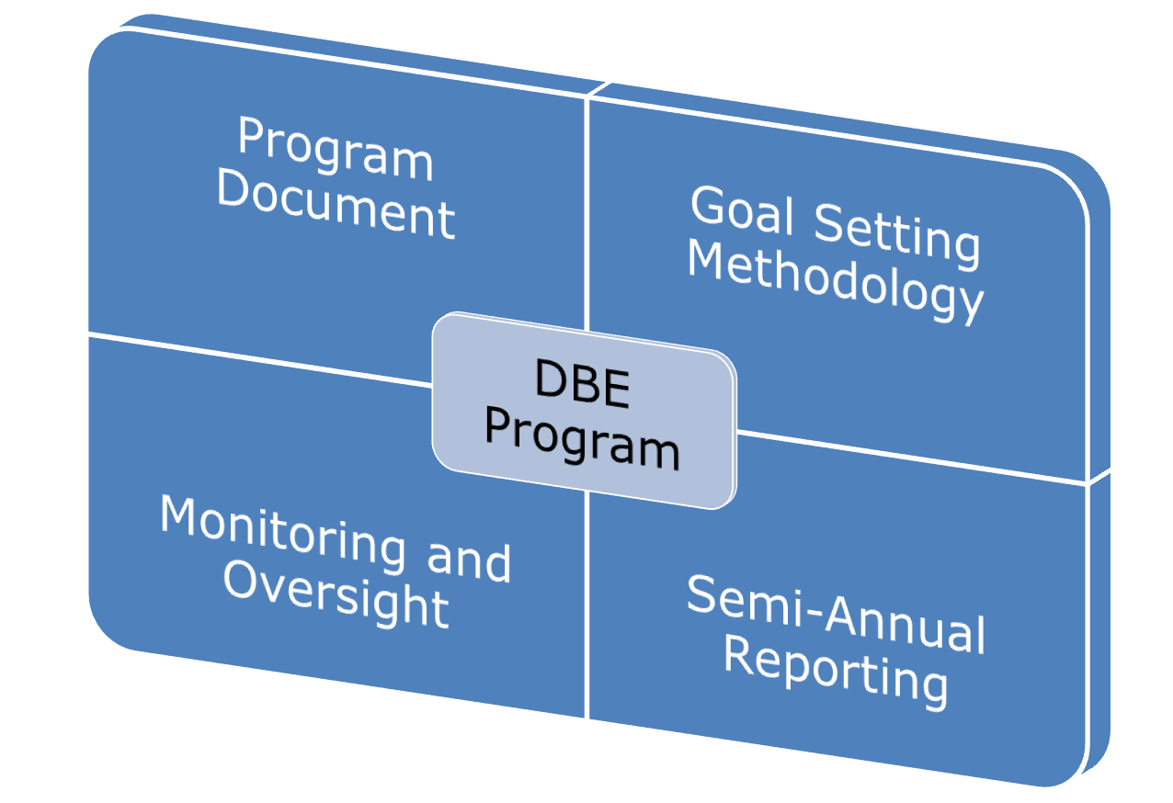
DBE Program: 4 Key Elements
5
Notes:
Note: these are the key programmatic elements of the DBE program.
Program Document
Goal Setting Methodology – how the agency proposes to meet the goal
Monitoring and Oversight – contract monitoring and ensuring the goal is being met
Semi-Annual Reporting – June 1st and Dec 1st reporting of activity to FTA
OTHER IMPORTANT AREA: CERTIFICATION. Not included here because it is in many ways separate from the programmatic requirements.
Certification is the “gate keeper” to the DBE program; first line of defense against fraud, etc. If certifications aren’t done properly, makes it more difficult to manage the rest of the DBE program.
This overview does not cover certification issues; however DOCR does separate trainings on certification generally, and specific certification issues (PNW, retirement assets, ownership/control, etc.)
5

Slide 6
DBE Goal/Methodology Requirement
Triennial submission of goal setting methodology due August 1st
What do you need to submit?
Letter stating overall goal for the three Fiscal Years including the anticipated R/N and R/C split
Copy of the methodology you used to develop the goal
Proposed projects and scopes of work
Clear and thorough explanations
Show the work!
Notes:
What do you need to submit?
Letter stating overall goal for the three Fiscal Years, as well as your anticipated R/N and R/C participation
Copy of the methodology you used to develop the goal
E.g., worksheet, spreadsheet, charts, etc.
Clear explanation of all required elements
Show your work!

Slide 7
DBE Goal/Methodology Requirement (Cont’d)
Copy of the published notice on transit agency’s website (notice should be published for the entire triennial period)
A summary of the public consultation process and activities, including a scheduled, direct, interactive exchange
Notes:
What do you need to submit?
Copy of the published notice on your agency’s website that should remain for the entire triennial period
A summary of your consultation process and activities, including a scheduled, direct, interactive exchange (e.g., a face-to-face meeting, video conference, teleconference);
VERY IMPORTANT: PUBLIC PARTICIPATION IS REQUIRED; good idea to capture the feedback of the exchange

Slide 8
Goal Setting Principles
DBE Goal
Must be based on demonstrable evidence of the availability of ready, willing, and able DBEs relative to all businesses ready, willing, and able to participate on DOT-assisted contracts.
Must reflect the level of DBE participation to be absent the effects of discrimination
Notes:
The goal you develop must be based on demonstrable evidence of the availability of ready, willing, and able DBEs, relative to, all businesses ready, willing, and able to participate on DOT-assisted contracts.
This measure is the relative availability of businesses that are able to compete for the contracts that you let. This process provides a way to quantify the businesses in your surrounding area that are able to compete for the work on your upcoming projects.
The DBE goal must reflect what you would expect the level of DBE participation to be absent the effects of discrimination.
Recipients may not rely on the aspirational 10% national goal—in order to maintain a narrowly tailored program, each grantee must submit a goal tailored to local market circumstances.

Slide 9
Goal Setting Principles (Cont’d)
Recipients may not rely on the aspirational 10% national goal—
In order to maintain a narrowly tailored program, each grantee must submit a goal tailored to local circumstances.
Minimum DBE Goal is not required.
DOT does not approve the goal but….
DOT reviews and concurs on the goal methodology.
Notes:
We’ve stated that your agency’s DBE Goal must reflect what you could expect the level of DBE participation to be, absent, the effects of discrimination. You are precluded from using the aspirational 10% national goal, and must tailor your program to your surrounding area/circumstances.
A minimum goal is not required however, the USDOT does review and concur with your methodology- or the process/procedures used to reach your target percentage.

Slide 10
How do recipients set overall goals?
49 C.F.R. § 26.45
“Tips for Goal-Setting in the Disadvantaged Business Enterprise (DBE) Program”
Notes:
So, what are the steps involved in complying with the regulations; specifically 49 CFR 26 section 26.45?
Well, it’s a 2-step process, reliant on the data available to you. You can gather this data from your agency, your UCP, the Census website, etc.
Again, it is key to involve the various decision makers within your organizations – capital planning, engineers, budgeting dept, etc.

Slide 11
Step One: Considerations
Use all available data
State UCP directory can be considered to set the baseline—(not the sole source of information)
Consider the following: disparity studies, census bureau statistics, bidders’ lists, and/or information from other DOT recipients.
Use most refined data sources whenever possible
Accurately account for all contracting opportunities
Do not:
Automatically use past participation as the base figure
Utilize local preference
Notes:
It is important to gather all the necessary information/data beforehand. This may require you to seek information regarding the DBE directory from your UCP. OR, Census bureau statistics for your area, OR, information from your agency’s bidder’s list.
Next, account for ALL contracting opportunities. This may require a working session with your procurement department of your program managers! Gain increased understanding of upcoming projects and the contracting opportunities that lie ahead.
Weighting: (although not a regulatory requirement) if utilized correctly it will help to increase the accuracy of your overall goal. All weighting does is emphasize your agency’s relative importance of one work category over another (by dollar amount). So, if more of your work is provided in the category of janitorial than construction, then the janitorial segment of the computation will have a higher percent weight than the construction segment of your computation.
Keep this in mind as we move forward through the next slides.
Also a cautionary note: Do Not utilize past participation as your base figure! The calculation of your agency’s overall goal is always based on forthcoming projects!

Slide 12
Step One: Base Figure
Grantee A will be receiving approximately $1M in FTA assistance for FY 16-18, and will be using all of the money to construct a new bus maintenance facility. In the course of its preparation, 15 DBE and 110 non-DBE firms are identified as being ready, able, and willing to perform on the project.
What is Grantee A’s base figure?
15 DBEs / 125 total firms
=
12%
Notes:
Let’s view an example of calculating the base figure.
[Read Slide]
15 DBE firms, divided by the total of 125 firms, yields 0.12 or 12%
Therefore, 12% is your base figure or relative availability

Slide 13
Step Two: Adjust Base Figure
Once a base figure has been calculated, recipients must examine all other evidence available to determine what, if any, adjustment to the base figure is merited. See 49 CFR 26.45(d).
Evidence to consider:
Current capacity of existing DBEs to perform work
Disparity studies (if not used in Step One)
Input from interested parties:
Local chambers of commerce
NAACP
Minority Business Associations
Contracting Associations
Past participation
Notes:
Next step after determining a base figure is to see if adjustments are necessary, per 49 CFR Part 26.45 (d) Evidence to consider are the following;
LIST in SLIDE
This should be more than a desk top exercise and should be coordinated with the public notice period and a Consultation/Outreach Process, which should include minorities, women, and contractor groups.

Slide 14
Step Two: Adjust Base Figure (Cont’d)
Use past participation if contracting opportunities are similar to those in prior years
In such instances, recipients must determine the median past participation, then average that number with the base figure determined in Step One
Past Participation (Historical Median):
FY 2013 14%, FY 2014 3%, FY 2015 7%
(3, 7, 14) = 7% Median
13% + 7% = 20%/2 = 10% Adjusted Base Figure
Notes:
PRESENTER NOTE: “Generally Not Recommended” (removed)
A note about “Past Participation” - SEE SLIDE. Bullet & Example.
Past Participation should not be relied upon if much higher or lower than in the next three years.

Slide 15
Meeting Overall Goals
Two means of meeting overall DBE goals:
Race neutral; and
Race conscious
49 CFR 26.51 says recipients must meet the maximum feasible portion of their overall goal by race neutral means
Race neutral (RN) - DBE wins a contract competitively Recipients must also establish contract goals to meet any portion of overall goal they project will not be met via R/N means
Race conscious (RC) – setting contract goals to achieve DBE participation
Notes:
Two means of meeting overall DBE goals:
Race neutral; and
Race conscious
Recipients must meet the maximum feasible portion of their overall goal by race neutral means
Race-neutral participation occurs when a DBE wins a contract competitively; that is, there was no contract goal and/or the firm’s DBE status was not considered in making the award
Recipients must also establish contract goals to meet any portion of the overall goal they project will not be met via race-neutral means.
Contract goals = race-conscious means of achieving DBE participation
Ask these questions:
Of the overall goal, how much can be achieved via race neutral means?
Are the available contracts attainable by small firms?
Contract goals = race-conscious means of achieving DBE participation

Slide 16
Facilitating Race Neutral Means of Achieving DBE Participation
Utilize DBE prime contractors
Make RFPs/solicitations attractive to DBEs
Unbundling of contracts
Simplify or reduce bonding requirements
Distribute DBE directories to prime contractors
Outreach to/for DBEs
Notes:
The listed items are way your agency can facilitate Race Neutral Means of Achieving DBE Participation.
An example of effective outreach to make DBEs aware of contracting opportunities
(An established MPO working with the transit provider and/or Airport concessionaires to facilitate discussions, identify contracting opportunities).
*ECAT – Small Business Workshop – (Example – 1. To Discuss opportunities in transportation for DBEs and 2. Explain benefits of becoming a DBE [FDOT – Practitioners]).
*HRTPO Example - Working with COMTO and Airport concessionaire committee)

Slide 17
Race Conscious Means of DBE Participation: Contract Goals
Permitted only when the projects are not able to meet overall goal by race-neutral means
May be used only on DOT-assisted contracts with subcontracting opportunities - NO set asides (based on race)
Not required on all contracts
Contract goals need not match overall goal
Tailor to approximate relative availability for particular contracts
Adjust contract goals based on DBE achievement
Upward when project falling short of overall goal
Downward when project exceeding overall goal
Notes:
Agency’s discretion to use Contract Goals—unless required by FTA
Tailoring – use discretion to determine the scope of work for various contracts/projects
Adjusting suggests that the agency is monitoring goal achievement during the course of the project

Slide 18
Calculating Race-Neutral and Race-Conscious Splits
Adjust R/C and R/N splits on basis of past achievement, provided similar contracting opportunities exist
Example:
Grantee A’s FY 13-15 overall goal was 10% with 5% projected to be met via race neutral means
Grantee A’s actual DBE participation for FY 13-15: 12%
Grantee A’s FY 16-18 overall goal: 10%
Q: What should Grantee A’s race conscious and race neutral splits be for
FY 16-18?
Notes:
Here’s an example of how to calculate R/N and R/C splits:

Slide 19
Calculating Race-Neutral and Race-Conscious Splits (Cont’d)
FY 13-15 participation-10% Goal:
Past Achievement: 12%
Race neutral: 7% (5% projected plus additional 2% achieved)
58% (7/12 x 100 of total achieved by race neutral means)
Race Conscious: 5%
Given past achievement FY 16-18 split:
Overall goal: 10%
Race neutral: 5.8% (58% of 10% overall goal)
Race conscious: 4.2%
Notes:
Determine the R/N & R/C split based on past recent past achievement.

Slide 20
Consultation and Publication
Consultation is required!
Consultation must include a scheduled, direct, interactive exchange (e.g., a face-to-face meeting, video conference, teleconference) with as many interested stakeholders as possible focused on obtaining information relevant to the goal setting process (must occur before you are required to submit the methodology) 49 CFR Part 26.45
A published notice must be posted on agency’s official website and may be posted in any other sources (e.g., minority-focused media, trade association publications).
Notes:
(g)(1) In establishing an overall goal, you must provide for consultation and publication. This includes:
(i) Consultation with minority, women's and general contractor groups, community organizations, and other officials or organizations which could be expected to have information concerning the availability of disadvantaged and non-disadvantaged businesses, the effects of discrimination on opportunities for DBEs, and your efforts to establish a level playing field for the participation of DBEs. The consultation must include a scheduled, direct, interactive exchange (e.g., a face-to-face meeting, video conference, teleconference) with as many interested stakeholders as possible focused on obtaining information relevant to the goal setting process, and it must occur before you are required to submit your methodology to the operating administration for review pursuant to paragraph (f) of this section. You must document in your goal submission the consultation process you engaged in. Notwithstanding paragraph (f)(4) of this section, you may not implement your proposed goal until you have complied with this requirement.
(ii) A published notice announcing your proposed overall goal before submission to the operating administration on August 1st. The notice must be posted on your official Internet Web site and may be posted in any other sources (e.g., minority-focused media, trade association publications). If the proposed goal changes following review by the operating administration, the revised goal must be posted on your official Internet Web site.
(2) At your discretion, you may inform the public that the proposed overall goal and its rationale are available for inspection during normal business hours at your principal office and for a 30-day comment period. Notice of the comment period must include addresses to which comments may be sent. The public comment period will not extend the August 1st deadline set in paragraph (f) of this section.

Slide 21
Summary
Submit triennial goal to FTA by August 1st
Submit within TrAMS:
Cover letter stating overall goal including RC/RN splits
Copy of methodology/worksheet used to calculate goal
Remember: Show the work!
FTA approves only the methodology, and not the goal itself!
Copy of published notice on the agency’s website
Consultation Process / Outreach Conducted
Notes:
In SUMMARY
Your agency’s DBE goals/methodology is the second element of the 3 prong required DBE documents that you will submit to FTA.
Goals are submitted triennially by August 1 of your submission year.
Your DBE goals/methodology is submitted in TrAMS. The document is composed of 4 components:
A letter from the agency stating the overall goal for the triennial years with the race neutral/race conscious splits
All worksheets/methodology for the calculation of your goal
A copy of the published notice
The consultation process and outreach documentation
REQUIRED: A Consultation Process, with must include a scheduled, direct, interactive exchange (e.g., a face-to-face meeting, video conference, teleconference) with as many interested stakeholders as possible; GO THE EXTRA STEP: Get feedback from the community you serve.
FTA’s focus is on the Methodology. We “Concur” on the Methodology.

Slide 22
What is a Shortfall?
A recipient’s failure to meet its Triennial DBE Goal by the end of the fiscal year

Slide 23
Purpose of a DBE
Shortfall Analysis
To identify the reasons recipients failed to meet their DBE goal in a fiscal year
Help identify means to increase DBE participation to achieve the DBE goal in the next fiscal year
Ensure compliance with the DBE rule
Increase DBE accountability on FTA funded projects and activities
49 C.F.R. 26.47(c)

Slide 24
When is a Shortfall Analysis Required?
If at the end of the fiscal year,
Awards and Commitments
<
Overall DBE Goal
=
Shortfall Analysis and Corrective Action Plan REQUIRED
49 C.F.R. 26.47(c)

Slide 25
Did Your Agency Meet Its DBE Goal?
June 1st (8A) + December 1st (8A) = Total Awards and Commitments
Ex: June 1st ($24,163,859) + December 1st ($49,908,233) = $74,072,092
June 1st (8C + 9C) + December 1st (8C + 9C) = DBE Total Awards and Commitments
Ex: June 1st ($5,117,013) + December 1st ($1,002,387) = $6,119,400
DBE Total Awards and Commitments ÷ Total Awards and Commitments = DBE Participation
Ex: $6,119,400 ÷ $74,072,092 = 0.0826 or 8.26%
DBE Participation 〱 Triennial DBE Goal = Shortfall
Ex: 8.26% less than 10% Triennial DBE Goal = Shortfall

Slide 26
What If…
Your FY 2014-2016 is 10% Goal
FY 2014: Achieved 15% DBE Participation = No Shortfall Submission Required
FY 2015: Achieved 8.7% DBE Participation = Shortfall Submission Required and due on December 29, 2015
FY 2016: Achieved 5.9% DBE Participation = Shortfall Submission Required and due on December 29, 2016

Slide 27
Shortfall Requirements
Timeframe: December 29 of respective year (90 days after the end of the fiscal year)
FTA Approves: In Compliance
FTA May Require: Modifications to overall goal methodology
Changes to RC/RN projections
Additional RC or RN measures

Slide 28
Shortfall Requirements
Top 50 FTA recipients:
must perform a Shortfall Analysis, create a Corrective Action Plan, and submit these documents to FTA by December 29.
Non-Top 50 FTA recipients:
must perform a Shortfall Analysis, create a Corrective Action Plan, and maintain these documents in a file for production upon FTA’s request or during an oversight review.

Slide 29
Elements in Drafting a Shortfall Analysis:
Shortfall Percentage
Race-Conscious/Race-Neutral Breakdown
Race-Neutral Measures
Projects undertaken during the FY
DBE participation on these projects
List DBE attainment on each project
Reasons for the Shortfall
Thoroughly explain

Slide 30
Specific Reasons for Shortfall: Common Error
Lack of Specificity!
Explain why you did not meet the overall goal by evaluating:
Projects with low level of DBE participation
Whether these projects implemented RC or RN measures
What went wrong generally

Slide 31
Elements in Drafting a
Corrective Action Plan:
Describe all Corrective Action Measures
Explain how proposed corrective actions will increase DBE Participation in upcoming fiscal year
Provide timeline for implementation

Slide 32
Specific Steps to Achieve Goal: Effective Practice
Enhanced Race-Neutral Measures
Explain what race-neutral measures can be improved or added to increase DBE participation
Example:

Slide 33
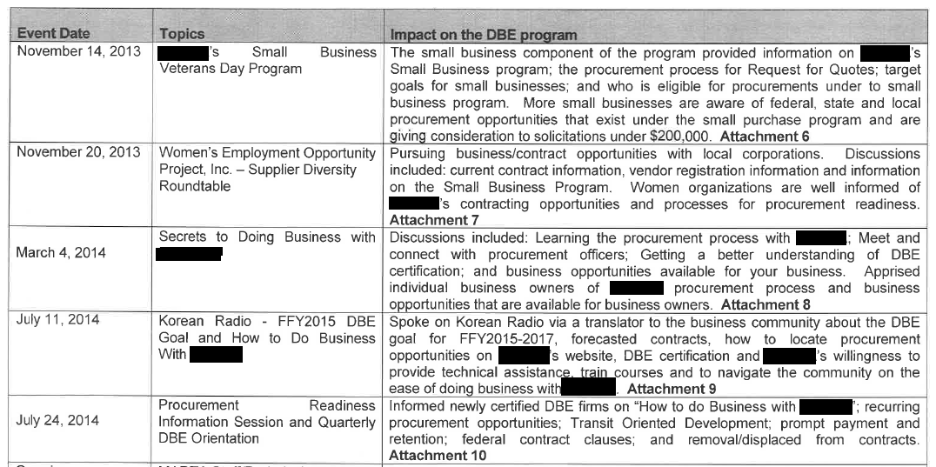
Specific Steps to Achieve Goal: Effective Practice
Include dates and topics for outreach sessions that span throughout the FY
Example:

Slide 34
DBE Contract Monitoring

Slide 35
DBE Best Practices: Contract Monitoring
Review the “cradle to grave” process
Begins at the pre-solicitation stage
Perform an exhaustive review to determine opportunities for DBE participation
Utilize Resources:
DBE UCP Directories; Bidders Lists
Similar procurements previously awarded
Notes:
Review with Capital Planning to determine which projects are ready to commence
Work with this group to determine project estimates and durations
Also - identify prospective opportunities for DBE participation

Slide 36
DBE Best Practices: Contract Monitoring
Pre-Bid Meetings
Project Scope & Requirements
Make Information available via
Agency website, Email blasts
Stakeholders (Contractors’ Associations; Chambers of Commerce)
Networking Opportunity
Notes:
Opportunity to present initial information about the upcoming project
Presentation of :
Contract scope and requirements
DBE requirements
Invitees: Prime contractors AND existing and prospective DBE firms
Opportunity to network

Slide 37
DBE Best Practices: Contract Monitoring
Bid Openings
Preliminary review of bid submission
Inclusion of DBE requirement
DBE participation schedules
Commitment/confirmation letters
Notes:
Formal opening of the bids
Public meeting attended by primes, DBEs
Preliminary review to ensure all bid documents included
Copies of bids along with DBE submissions are made available to DBE Program Office for review to determine if the prime contract has made a good faith estimate to planning to meet the established goal

Slide 38
DBE Best Practices: Contract Monitoring
Awards/Notice to Proceed
Executed subcontract agreements
Notifications of expected DBE participation

Slide 39
DBE Best Practices: Contract Monitoring
Post Award/Contract Monitoring
Tracking system
Project completion
Proof of payments
Cancelled checks; ACH transactions
Follow up with all parties
Change Orders/Amendments?
Notes:
Each FTA recipient has it’s own means of tracking the progress of it’s projects
FTA understands that some have more robust systems than others
Tracking the progress of the project is important. However, tracking DBE goal achievement is of utmost importance as well
Follow up with all parties (capital planning, prime contractors, etc.) is ESSENTIAL
During this phase, grantees will need to pay attention to change orders/amendments that may alter the scope of the projects
Frequency: project reporting

Slide 40
DBE Best Practices: Contract Monitoring
Checkpoints
What is the project’s completion status?
What is the DBE goal achievement status?
Have change orders/amendments been issued that will affect the goal achievement?
Commercially Useful Function (CUF) Reports with site visits
Notes:
At any given time during the course of a project, grantees should be able to answer the following questions?
How complete is this project?
If the project had an established goal (from the pre-solicitation phase), is the goal being met? If not, why not?
What was the schedule for the DBE firms to participate?
Have the DBE firms, which were confirmed to participate on these contracts, been performing the work that they are certified to do?
Have the firms been performing a commercially useful function?

Slide 41
DBE Best Practices: Contract Monitoring
Project Close-out Checklist:
DBE goal met?
Yes
DBE goal not met?
Why not? Keep in mind in case a shortfall analysis is needed
DBE goal exceeded?
Achievement over the DBE goal: Race Neutral
Notes:
Determine if the goal was met?
If not, why not?
Did the project scope change?
Was the DBE unable to perform as intended?
What other issues arose?
This info is necessary in the event a shortfall analysis is required.
These are important to keep in mind in the event a shortfall analysis is required.
Also, projects sometimes exceed the established goal (i.e. DBE firm utilized more than expected; scope increased thus creating additional opportunities for DBE participation, etc.)
Achievement above the the established goal is race neutral

Slide 42
Useful Websites
FTA –Civil Rights Training Materials & Videos
Implementing a successful DBE Program
DBE Uniform Reporting
Preparing an Adequate Shortfall Analysis and Corrective Action Plan
https://www.fta.dot.gov/regulations-and-guidance/civil-rights-ada/dbe-training
DBE Semi-Annual Reporting (49 CFR Part 26 Appendix B)
Uniform Report 11-03-2014.pdf
County Business Patterns (NAICS Codes)
http://www.census.gov/econ/cbp
USDOT Office of Small & Disadvantaged Business Utilization
http://www.dot.gov/osdbu
Notes:
FTA –Civil Rights Training Materials (DBE & Title VI)
http://www.fta.dot.gov/civilrights/12885.html
County Business Patterns (NAICS Codes)
http://www.census.gov/econ/cbp
OSDBU State DOT and DBE Program Sites
http://www.osdbu.dot.gov/DBEProgram/StateDOTDBESites.cfm
USDOT Office of Small & Disadvantaged Business Utilization
http://www.dot.gov/osdbu
DBE Semi-Annual Reporting (49 CFR Part 26 Appendix B)
Uniform Report 11-03-2014.pdf

Slide 43
Other Helpful Resources
FTA DBE Academy
Charlotte, NC (May, 2016)
APTA (June, 2016)
National Transit Institute (NTI)
Website: www.ntionline.com
Attend/Host a training

Slide 44
Notes:
Thank you!

