Slide 1
MBTA Key Bus Route
Improvement Program
Pennsylvania Public Transportation Association
April 7, 2015
Joanne Haracz, AICP
responsive client solutions since 1976

Slide 2
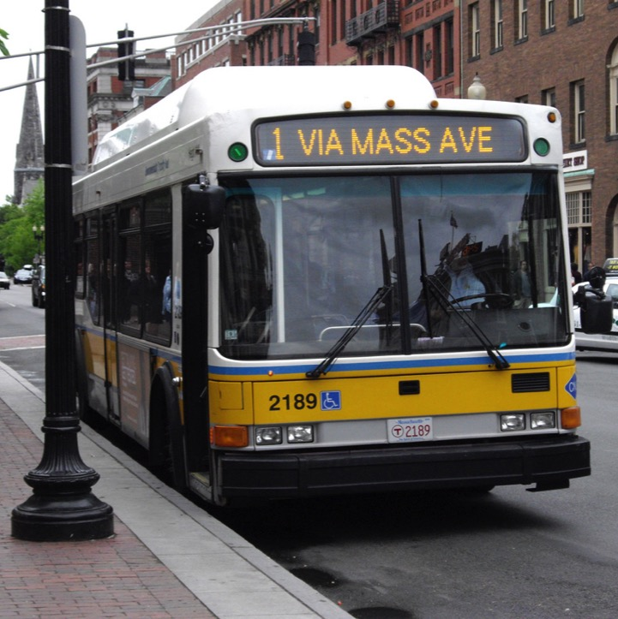
MBTA Key Bus Route Improvement Program
The Project
Planning Process
Bus Stop Design

Slide 3
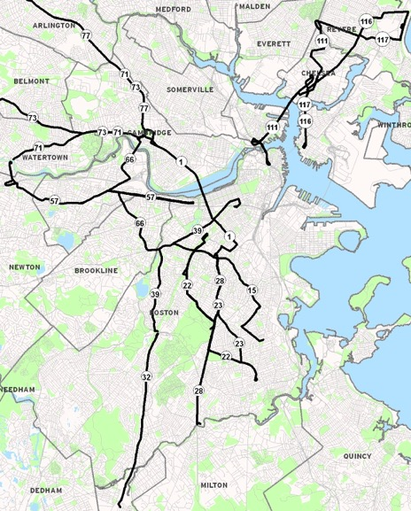
Introduction
15 Key Bus Routes
800 stops
$10 million funding

Slide 4
Key Route Characteristics
Key Point #1
Key Point #2
Key Point #3
Key Point #4
Describe characteristics of key routes
Frequency, span of service
ridership

Slide 5
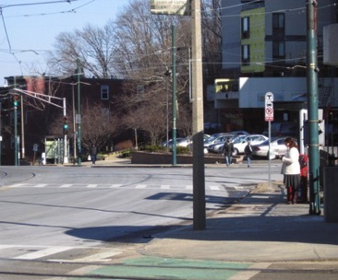
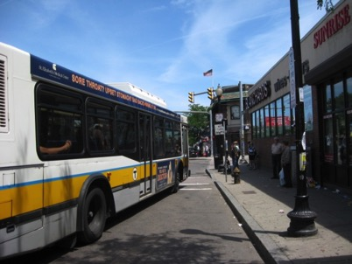
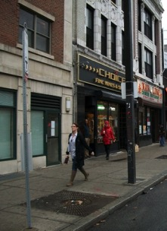
Typical Conditions
Key Point #1
Key Point #2
Key Point #3
Key Point #4
Bus stops too close
Bus stop too short
Poorly located
boarding area

Slide 6
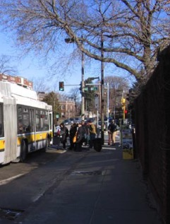
Challenges to Good Transit
Access difficult for seniors and persons with disabilities
Stops blocked by parked cars
Many bus stops without shelters and other amenities
Traffic congestion and double parking
Traffic signals often not optimized or coordinated
Placement and number of bus stops result in longer trip times

Slide 7
Key Bus Route Goals
Greater reliability
less bus bunching, fewer delays
Faster service
fewer stops
Improved accessibility
faster boardings
Passenger amenities
shelters, benches, signage, trash barrels

Slide 8
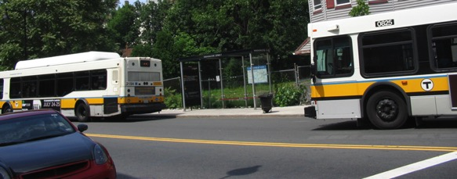
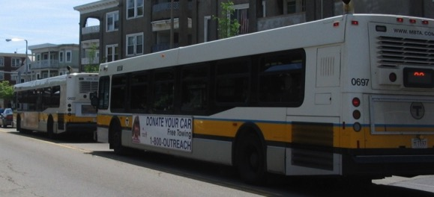
Reliability Issues
BUS
BUNCHING

Slide 9
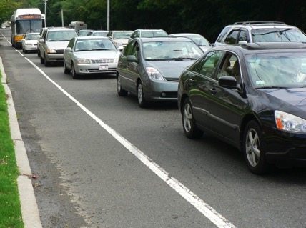
Faster Service
Traffic Signal Improvements
Stop Locations
Fewer Stops
Faster Boarding

Slide 10
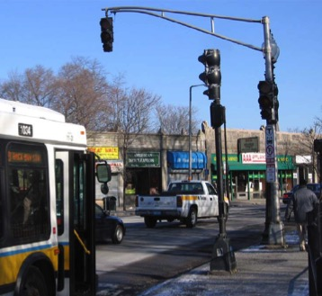
Traffic Signal Improvements
Signal optimization
Timing and phasing changes
Benefit buses and general traffic
Transit signal priority potential
Bus stop locations
Relocated to improve operations
Speed up bus service
Decrease in bus delay at intersections

Slide 11
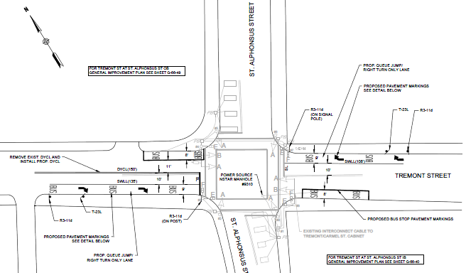
Queue Jump Lanes
Route 66

Slide 12
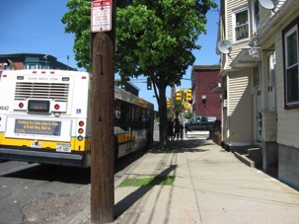
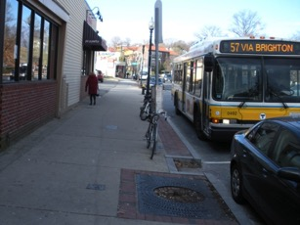
Bus Stop Locations
Sufficient length to allow buses to pull to the curb
Clear boarding/alighting area
Not blocking crosswalks or driveways
Considerate of adjacent traffic
Appropriate distance between stops

Slide 13
Bus Stop Consolidation
Benefits
Shortens bus trip times
Improves service reliability
Minimizes “stop & go” experience
Provides additional parking spaces
Ability to provide better stop amenities

Slide 14
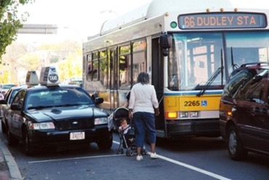
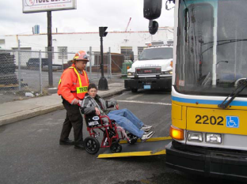
Improved Accessibility
Legal Mandate
All bus doors must open at curb
Deter cars from parking in stops
Providing accessible curb access requires longer bus stops
Bus Stops must meet Current ADA Guidelines

Slide 15
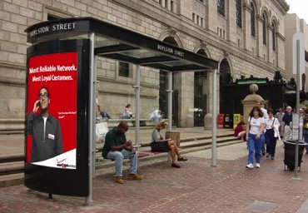
Improved Passenger Comfort & Convenience
Install shelters where possible
Weather protection, seating, comfort
New street furniture
Shelters, benches, trash barrels

Slide 16
MBTA Key Bus Route Improvement Program
The Project
Planning Process
Bus Stop Design
Lessons Learned

Slide 17
Planning Process
Identify existing stops
Existing amenities
Ridership data
Propose stop spacing
4 to 7 stops per mile (750 to 1320 ft)
Propose stop consolidation or relocation
25% reduction in stops
Identify potential amenities
Trash receptacle: Most stops
Bench: Moderate use stops
Shelter: High use stops, public support
Public Meetings

Slide 18
MBTA Key Bus Route Improvement Program
The Project
Planning Process
Bus Stop Design
Lessons Learned

Slide 19
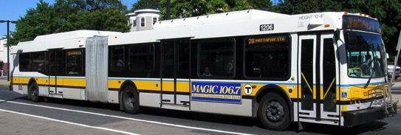
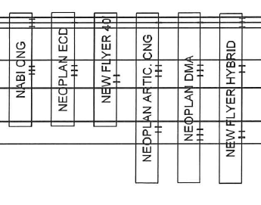
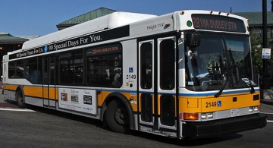
Analysis of Door Spacing
21’
18’
5’x8’
Landing Area
8’x4’
Rear Clear Zone
10’x4’
Middle Clear Zone

Slide 20
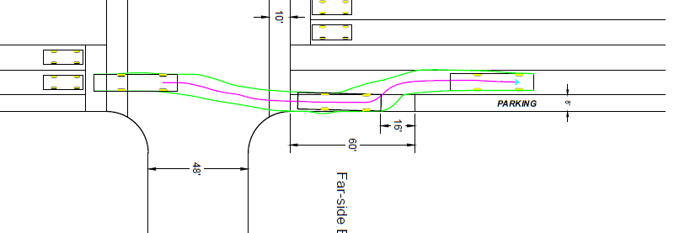
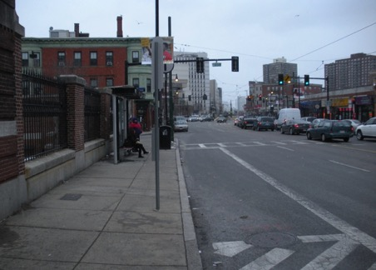
Far Side Stop
Bus Length | Min. Stop Length
40 FT | 60 FT
60 FT | 80 FT

Slide 21
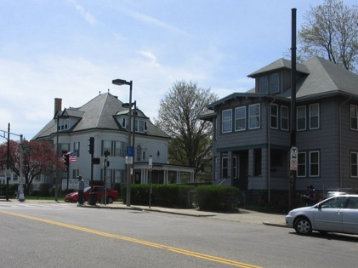
Near Side Stop
Bus Length | Min. Stop Length
40 FT | 80 FT
60 FT | 100 FT

Slide 22
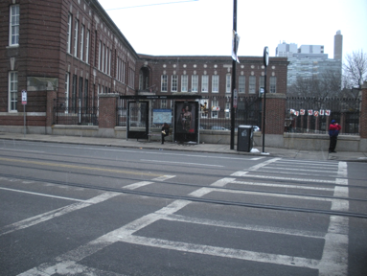
Mid Block Stop
Bus Length | Min. Stop Length
40 FT | 100 FT
60 FT | 120 FT

Slide 23
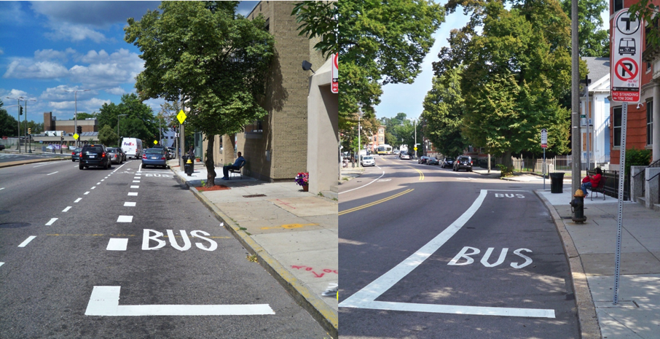
Pavement Marking Design

Slide 24
MBTA Key Bus Route Improvement Program
The Project
Planning Process
Bus Stop Design
Lessons Learned

Slide 25
Lessons Learned
Communication is key
Coordinate with community and abutters early and often
ADA Compliance can be a challenge
Be prepared for trade-offs between bus stop improvements and parking

Slide 26
MBTA Key Bus Routes
Improvement Program
Joanne Haracz, AICP
McMahon Associates, Inc.
617-556-0020
jharacz@mcmahonassociates.com
responsive client solutions since 1976
mcmahonassociates.com
McMahon Associates, Inc. • Serving the Mid-Atlantic, Florida, and New England

