Slide 1
Improving the Passenger Experience Pennsylvania Public Transportation Association (PPTA) April 2015

Slide 2
Two Unique Projects
LANta’s Enhanced Bus Service (EBS)
Bus Rapid Transit (BRT) achieved through Phased Implementation
LANtaFlex
Demand Responsive shared-ride service open to the general public

Slide 3
EBS Project Review
Study conducted by team led by AECOM Technical Services with HDR and Taggart Associates
Study commenced in summer 2012
Numerous Advisory Committee meetings throughout process
Two series of public meetings
Revised Draft Final Report and Executive Summary submitted 2/28/14

Slide 4
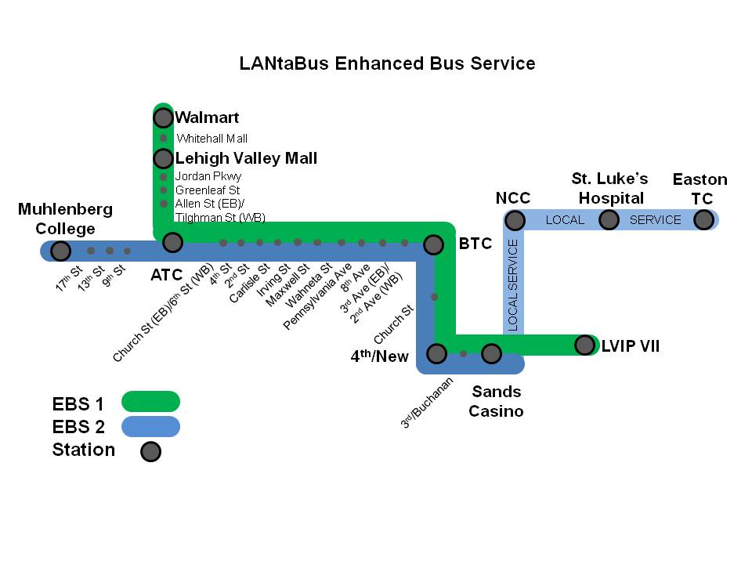
Summary of Recommendations
Two route system

Slide 5
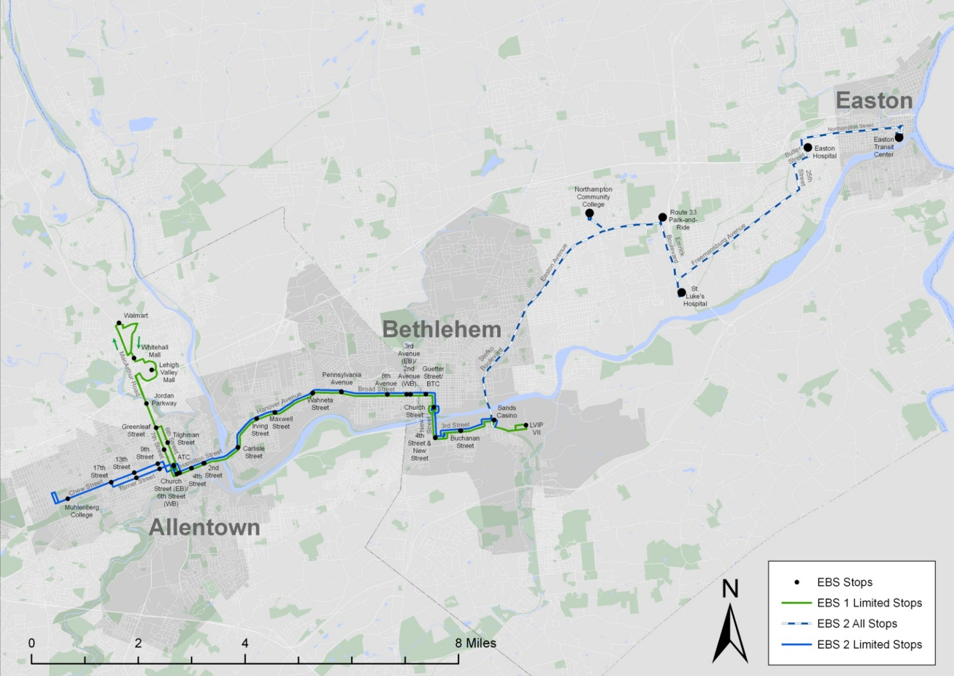
Summary of Recommendations
Two route system

Slide 6
Phased Implementation Approach
Phase I – Implement EBS 1 as local
Phase II – Add limited stop service to EBS 1
Phase III – Implement EBS 2 between West Allentown and South Bethlehem
Phase IV – Increase frequency on EBS 1 and EBS 2
Phase V – Add limited stop in Easton
Phase VI – Add limited stop along entire EBS 2
TSM option identified

Slide 7
Recommended Plan Impacts
 | Net Rev Hours | Net Riders to Corridor | Net Operating Subsidy ($) | Net Riders per Net Rev Hr (Productivity) | Net Op Subsidy per Net Rider ($)
Phase I | 9,191 | 504,198 | 241,175 | 54.9 | 0.48
Phase II | 15,176 | 515,792 | 756,123 | 34.0 | 1.47
Phase III | 29,245 | 594,730 | 1,908,276 | 20.3 | 3.21
Phase IV | 47,548 | 629,744 | 3,483,565 | 13.2 | 5.53
Phase V | 48,983 | 637,130 | 3,601,769 | 13.0 | 5.65
Phase VI | 58,496 | 679,137 | 4,393,696 | 11.6 | 6.47
TSM | 13,676 | 514,225 | 625,599 | 37.6 | 1.22
Current LANtaBus systemwide is $2.80 Op Subsidy/Rider;
Current systemwide productivity is 23.8 riders/hour
Target is 24.0 riders/ hour

Slide 8
Recommended Program of Treatments
Improved Stop Amenities
Bus Bulbs
Queue Jumps
Bus Lanes
TSP

Slide 9
Projected Capital Expenses
 | Queue Jumps | Curb Lanes | Bus Bulbs | TVM's | Shelters | Vehicles | Total
Phase I | 0 | 0 | 0 | 0 | 0 | 0 | 0
Phase II | 50,000 | 0 | 388,850 | 866,400 | 480,000 | 1,200,000 | 2,985,250
Phase III | 0 | 16,670 | 222,200 | 433,200 | 144,000 | 1,800,000 | 2,616,070
Phase IV | 0 | 0 | 0 | 0 | 0 | 6,000,000 | 6,000,000
Phase V | 0 | 0 | 222,200 | 0 | 48,000 | 1,200,000 | 1,470,200
Phase VI | 0 | 108,355 | 0 | 0 | 216,000 | 1,200,000 | 1,524,355
Total | 50,000 | 125,025 | 833,250 | 1,299,600 | 888,000 | 11,400,000 | 14,595,875
TSM |  |  |  |  |  | 1,200,000 | 1,200,000

Slide 10
Initial Approach – Service Enhancements
Implement service elements of Phase I of EBS1 for 3 years
60 minute frequency for all stops local service
Phase I will be designated LANtaBus Route 100 until EBS branding
Additional phases would be pursued as deemed necessary
Demand based
As element of Long Range Transportation Plan
Continued advocacy for transit supportive land use along corridors
Development/densification of corridor could improve ridership/revenue projections
Introduction of brand with Phase II
Need to finalize brand and extent of brand
Prioritization for brand program

Slide 11
Timeline – EBS1 Phase I
Implementation of Phase I beginning in September 2016
Three year operational service
Recommend implementation of Phase II based on:
Performance and demand patterns of Phase I local
Regional transportation strategy
Specific developments
Physical improvements to be pursued separately

Slide 12
Timeline – EBS1 Phase II
Phase II can be implemented in parts
Limited stop express service on top of local service
Peak Service only, then implemented during midday period
Provides 30 minute route frequency between EBS1 express and local
Introduction of Route Branding

Slide 13
Initial Approach - Treatments
Treatments to be pursued independently and as opportunities arise
Most cost effective treatments will be pursued
Coordination with PennDOT, LVPC and municipalities to incorporate recommendations into other planned work
Grant funding to be used to fund conceptual engineering of queue jumps and 6th Street bus lane
Some treatments addressed planned through LANta’s capital program
Transit hub improvements
Shelters program

Slide 14
Financing
Financed through LANta Operating Budget for the first three years
Potential for growth in Operating Funding to account for increased costs
Seek New/Small Starts for future phases on the Capital Program
Pursue and continue detailed planning of service and physical elements of plan to ensure optimal positioning for financing opportunities

Slide 15
Rationale for Recommended Approach
Consistent with Moving LANta Forward by creating high frequency corridors
Responds to riders priorities for higher frequencies of service and longer spans of service
Consistent with LANtaBus Service and Performance Targets
Grows with and can respond to changes in development
Is financially feasible in current environment
Uncertainty/Inapplicability of FTA Small Starts funding program or CDP’s
Potential for funding through PennDOT demonstration project program
Potentially sustainable given growth in operating funding

Slide 17
Flex provided in Macungie/Alburtis area of Lehigh Valley
Previously served by two fixed routes
Eliminated due to poorer ridership performance in 2011
Provides service coverage to area characterized by:
Rapid Development
Numerous Employment Sites
Pockets of low-income populations

Slide 18
Reservation based
Curb-to-curb
Shared-ride service
Open to general public – no eligibility requirements
Hours of operation: 6:00am – 6:00pm Monday through Friday
Reservations required at least one day prior to travel, and no more than 14 days in advance.
Standing appointments allowed

Slide 19
Allows for curb-to-curb service between any origin & desintation point within the Flex Zone
Trips with an origin or destination outside of the Flex Zone are transferred to a LANtaBus fixed route to complete trip
Managed through contract with Easton Coach Company (ECC)
LANtaFlex has same passenger cost as fixed route. All LANtaBus fare instruments accepted on LANtaFlex
Cash accepted
Day passes sold on-board

Slide 20
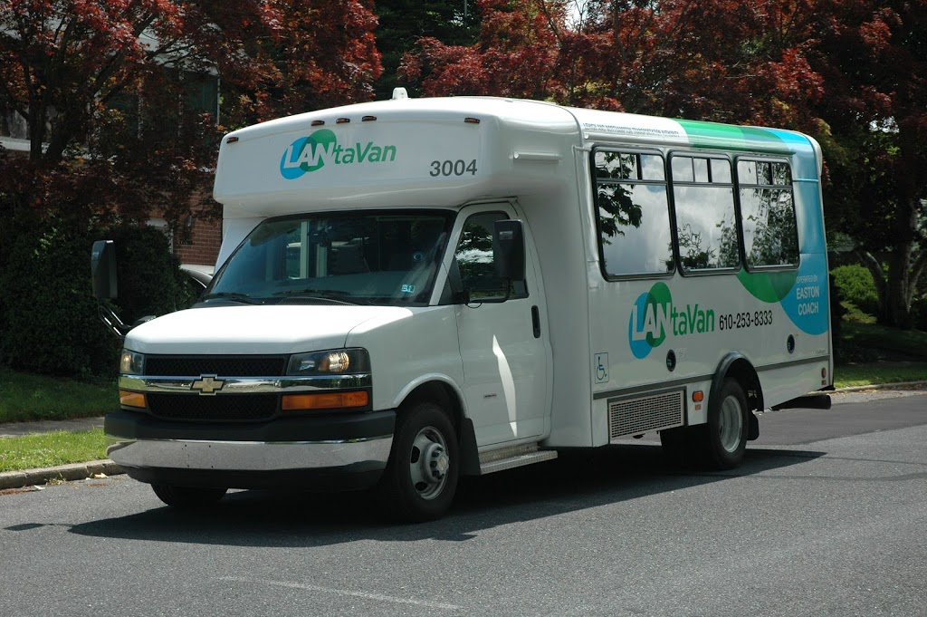
Nature of Service
Small transit vehicles used – 16 passenger
No driver assistance for passengers except wheelchair lifts
“No-show” policy similar to paratransit
Sanctions for repeat violators of the no-show policy
No bike racks

Slide 21
Service Characteristics
Passenger trips cost approximately the same versus former fixed route:
$13.89 cost per passenger trip on fixed route previously provided
$14.00 cost per passenger trip on LANtaFlex
Expanded service coverage
Fixed route operated on a small number of main arterials
Limited pedestrian infrastructure
High vehicle speeds
Twelve (12) hour span of service on Flex compared to a small number of peak period and one midday round trip on fixed route

Slide 22
Contact Information
Brendan Cotter – Director of Planning and Development
610-439-1376
bcotter@lantabus-pa.gov
http://www.lantabus.com/

