Slide 1

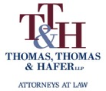
PA Public Transportation Association
Contracts 101
Presented by:
Anthony T Bowser, Esquire
Thomas, Thomas & Hafer LLP
305 N Front Street, 6FL
Harrisburg, PA 17101
www.tthlaw.com

Slide 2
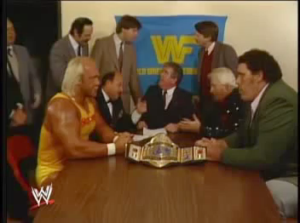
Great Contracts in History

Slide 3
Contracts: The Basics
3
3
Consideration
Offer and acceptance
Legal purpose
Capable parties
Absence of vitiating factors
Performance

Slide 4

Consideration
4
4
Consideration is the benefit that each party gets or expects to get from the contractual deal
Must represent a change in position
    e.g. - Comcast gets my money and I get endless Dukes of Hazzard reruns

Slide 5
Lack of Consideration
5
5
One of the parties was already legally obligated to perform
The promise amounts to a gift, not a contract
The exchange is for "past consideration"
The bargained-for promise is illusory

Slide 6

Consideration
6
6
Unequal consideration
Generally, courts will not consider sufficiency
Exception – Restrictive Covenants

Slide 7
Consideration: PA UWOA
7
7
Pennsylvania’s Uniform Written Obligations Act (“UWOA”), 33 Pa. Stat. § 6
Inclusion of “the signer intends to be legally bound” language in signed, written agreement is sufficient to bind parties even lacking in consideration

Slide 8
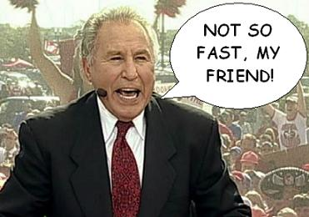
Soooo…we’re good, right?
Socko v.
Mid-Atlantic Systems of CPA

Slide 9

Offer & Acceptance

Slide 10
Offer & Acceptance
10
10
Meeting of the Minds
  An offer is an indication by one person to another of their willingness to contract on certain terms without further negotiations
A contract is then formed if there is express or implied agreement
Critical terms

Slide 11

Offer & Acceptance
11
11
Seems pretty simple, right?
Bilateral versus Unilateral

Slide 12

Offer & Acceptance
12
12
Revocation
Counter-offers

Slide 13
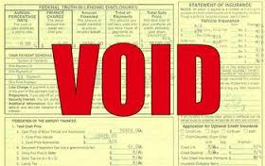
Legal Purpose
13
13
Domestic or social agreements
Usury charges
Illegal purpose

Slide 14
Capable Parties
14
14
To be "capable" of making a contract, the parties must understand what they're doing
  Minors, mentally infirm
Authority to bind

Slide 15
Capable Parties
15
15
Actual authority to bind government U.S. Postal Serv. v. Sunshine Dev., Inc., 674 F. Supp. 2d 619, 625-26 (M.D. Pa. 2009)

Slide 16
Capable Parties
16
16
The actual authority requirement is an additional prerequisite for effective formation of government contracts.
The scope of an agent's authority may be explicitly defined by legislation, properly exercised through the rule-making power

Slide 17
Capable Parties
17
17
Apparent authority
  To establish apparent authority, 3rd party must demonstrate that he reasonably relied on the agent's alleged appearance of authority
Apparent authority inapplicable in government contracting absent ratification (Chainey v. St., 523 F.3d 200, 213 (3d Cir. 2008))

Slide 18

Absence of Vitiating Factors
18
18
Duress
Undue Influence
Mistake
Misrepresentation

Slide 19
Performance / Breach
19
19
Material versus Immaterial
Notice and Opportunity to Cure
  When breach goes “directly to the essence of the contract” and is “exceedingly grave” the non-breaching party may terminate the contract without notice
  LJL Transp., Inc. v. Pilot Air Freight Corp., 599 Pa. 546, 567, 962 A.2d 639, 652 (2009)

Slide 20
Remedies for Breach
20
20
Compensatory Damages
  Expectation Damages
  Consequential Damages

Slide 21
Remedies for Breach, cont.
21
21
Liquidated Damages
Punitive Damages
Nominal Damages
Specific Performance
Rescission
Reformation

Slide 22

Boilerplate Provisions aka “The Fine Print”
22
22

Slide 23
Common Boilerplate Clauses
23
23
Jurisdiction and Venue
Arbitration / ADR
Choice of Laws
Severability
Waiver

Slide 24
Common Boilerplate Clauses
24
24
Integration
Assignment
Amendment
Recovery of Attorneys’ Fees & Costs

Slide 25

Common Pitfalls
25
25
Proper Parties
Price Terms and Modification
Timing of Performance
Accepting Inapplicable Boilerplate
Automatic Renewal

Slide 26

SUCCESS!!!
26
26

Slide 27

Questions/Comments?
27
27

Slide 28

28
28
Anthony T Bowser, Esquire
Thomas, Thomas & Hafer LLP
305 N Front St
Harrisburg, PA 17101
717-441-3959
Twitter: @AnthonyBowser
abowser@tthlaw.com

