Slide 1
Getting Your Board on Board
5 Critical Elements to Board Reporting
Reinsel Kuntz Lesher LLP
Mark S. Zettlemoyer, CPA, CFE
Gretchen G. Naso, MBA, CVA

Slide 2
Getting Your Board on Board
Why is it Important?
Research indicates that most boards aren’t delivering on their core mission: providing strong oversight and strategic support for management.
McKinsey Survey results:
34% of Directors surveyed agreed that boards they served on fully comprehended their organization’s strategies…
22% of Directors said that their boards were aware of how the organization functioned…
16% of Directors said that their boards had a strong understanding of the dynamics of the organization’s industry…

Slide 3
Board Reporting – 5 Critical Elements
1
Effective Agenda
2
Financial Analysis
3
The “Softer” Numbers
4
Risk Assessment
5
Strategic Planning
Notes:
3

Slide 4
Getting Your Board on Board
1
Agenda
Understand why the board exists
Main problem of boards can be a lack of focus
An effective board should set policy, make decisions & direct management
Exclude administrative items
The Chairperson should be in control
Set the agenda and work from it
Keep focused
Keep moving forward
Notes:
4

Slide 5
Getting Your Board on Board
What’s on the
Important developments and key issues
Strategic issues (discussed early and often)
Current & future challenges/opportunities
Limit the number of agenda items-1 deep topic

Slide 6
Getting Your Board on Board
Board Member Responsibilities

Come Prepared
Board meetings are not the time to get up to speed
Put away unnecessary electronic devices
Show up on Time
Exclude administrative items

Slide 7
Getting Your Board on Board
Facilitating the Meeting

Send Out Materials in Advance
Allows board members to come prepared
Management reports should be in writing
Allows for specific questions in advance
Enables research, if necessary
Initiate Discussion
Everyone should participate

Slide 8
Getting Your Board on Board
Keep it Moving
 Stick to the Agenda
Story telling is for another time
Enables board members to focus on important issues
Set Limits
Summarize the agenda in a table format
Set realistic time limits for discussion items
Meeting should last no more than 2.5 hours

Slide 9
Getting Your Board on Board
Board Meetings …The Good and the Bad

The Good
Empowering
Enables communication
Develops leadership skills
Morale booster
The Bad
May lack focus
Too many meetings
Members unprepared or absent

Slide 10
Getting Your Board on Board
A Good Ending Starts with a Good Beginning
Start at the End
Start by thinking what you would like out of the meeting, what are your goals and what do you want and need from the Board
Start the meeting by highlighting these topics and what you expect to get out of the discussion
Stick with the agenda!!!!

Slide 11
Getting Your Board on Board
2
Financial Analysis
What are the key performance metrics that indicates whether the organization is financially healthy?
Go beyond the numbers
Provide context that is lacking in financial statements
Use graphs, charts, and tables to tee up issues for discussion
Use variance analyses to identify key trends and/or performance relative to the budget
Strike a balance with volume
Consider use of dashboard reports
The analysis that works right now, may not work next year
Notes:
11

Slide 12
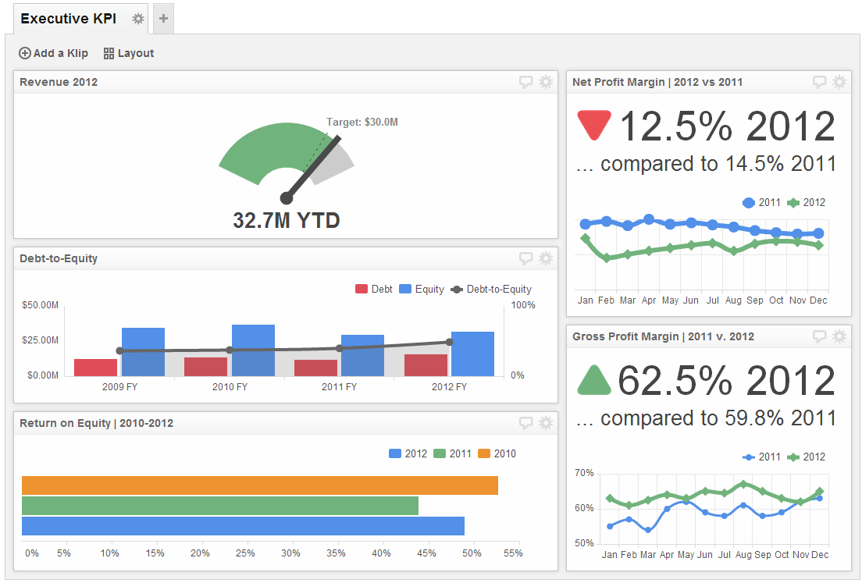
Example Dashboard Report

Slide 13
Example Dashboard Report

Slide 14
Example Dashboard Report

Slide 15
Getting Your Board on Board
3
The “Softer” Numbers
ACT 44 statistics (benchmarking)
Service statistics
Call center data (productivity)
Hiring rates, turnover
Notes:
15

Slide 16
Getting Your Board on Board
System Performance Criteria-ACT 44
Passengers per revenue vehicle hour 
Operating cost per revenue vehicle hour 
Operating Revenue per revenue vehicle hour 
Cost per passenger trip

Slide 17
Getting Your Board on Board
4
Risk Assessment
Is the Board aware of the critical risks facing the organization?
What is the priority of these risks?
Does the board agree on why these risks are significant? Are the organization’s responses to these risks understood?
Is there a formal risk assessment that allows management to continuously identify, source and measure the key business risks impacting the organization’s performance?
Notes:
17

Slide 18
Getting Your Board on Board
Risk Oversight

Enterprise Risk Management
Generally done on a very limited basis
Not well understood
Not easy to implement
Risk profiles continually change
Risk Oversight
Understand risks
Understand critical assumptions
Be aware of organization behaviors

Slide 19
Getting Your Board on Board
Risk Oversight Considerations
 Risk Profiles
Developed, reflective, reported on?
Increases/decreases
New or excluded
Impact/probability
Emerging Risks
Pay attention to critical assumptions for changes
Apply scenarios to business plan
Game changing risks

Slide 20
Getting Your Board on Board
Identifying Risks and Managing

Board Considerations
Emphasize 5 to 10 and focus on likelihood of occurrence
Refresh as business/social environment change
Assign ownership
Look out for blind spots!
What are the key assumptions used?
Is there reporting on the top risks?
Extreme events considered?
Skills to manage

Slide 21
Getting Your Board on Board
Own the Risks
 What Does Risk Ownership Mean?
Someone must own each identified risk
Ensure that a process is in place to manage and monitor
Ensure that reporting is timely
Discuss what risks to take
Open communication
Sharing of knowledge
Best practices
Integrate risk management into what matters

Slide 22
Getting Your Board on Board
IT Management Risk Assessment
 Key Considerations
Big picture – game changer
What are the risks?
How are they managed?
How do we know?
IT is a busy unit
Integrated with operational, financial & compliance processes
Continuity planning
Security & privacy considerations are business issues
Consider compliance aspects

Slide 23
Getting Your Board on Board
Cyberspace – Risk Considerations

Customers and employees need access 24/7
Cyber threat responses
Develop a plan
Educate employees
Prepare an incident response plan

Slide 24
Getting Your Board on Board
Managing Risk and Compliance

Key Elements
Board oversight
Management supervision
Documented policies, procedures and reporting
Continual risk assessment
Internals controls and monitoring
Employee education

Slide 25
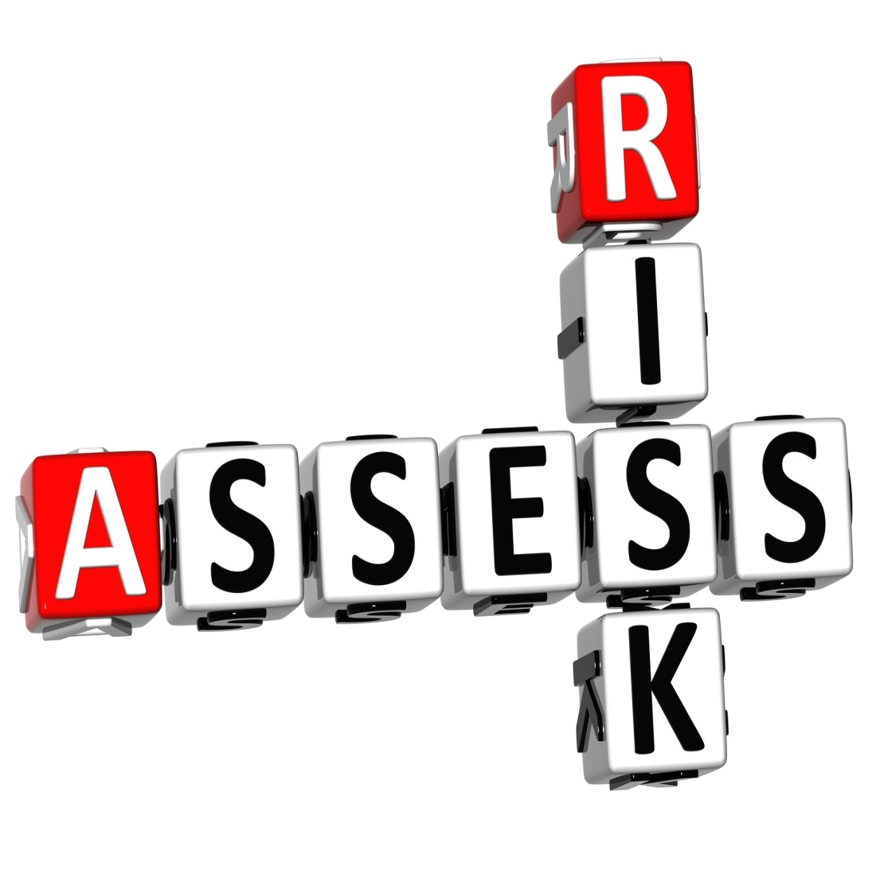
Getting Your Board on Board
Risk Assessment -Getting Started & Moving Forward
Define objectives
Integrate
Address cultural issues
Identify needs
Identify the owners
Support from the top

Slide 26
Getting Your Board on Board
5
Strategic Planning
Governance suffers the most when boards spend too much time looking in the rear view mirror and not enough time scanning the road ahead
Build an agenda that includes forward-looking issues
Board should look further out than anyone else in the company
Conversation should include technological, economic and demographic trends
Notes:
26

Slide 27
Getting Your Board on Board
Discuss strategic plan at each meeting
Increase board input into plan
Present strategic context for significant decisions
Tie into risk assessment process
Tie into Act 44
How to Build Strategic Thinking into Board Meetings

Slide 28
Getting Your Board on Board
One Last Thing…Consider Technology
Use technology to distribute high quality information
Consider use of technology to push information to board members (i.e., board portal)
New “best practice” in board reporting
Going paperless increases collaboration between board and management
Technology can increase board engagement
Costs are offset in long run by savings
Notes:
28

