Slide 1
PennDOT CNG Fueling Stations P3 Project for Transit
Pennsylvania Department of Transportation
Pennsylvania Public Transportation Association
Conference
April 8, 2015

Slide 2
Project Goals & Objectives
Cost Effective CNG Fuel Availability
Operational Cost Savings
CNG Operational, Maintenance and Safety Expertise.
Continuing CNG Technology Upgrades
Stimulation of Non-Transit Agency Demand
Inter-Agency Consistency of CNG related operations

Slide 3
Location of Potential Transit Agencies

Slide 4
Project Delivery
Accept proposals offering a turn-key solution:
For the design and construction of fueling stations and necessary facility upgrades
Upfront private-sector investment
Ongoing operation and maintenance responsibility for fueling stations

Slide 5
Contractual Arrangement
PennDOT will purchase Natural Gas for each site
Private Partner will:
Make necessary utility upgrades
Compress the gas and make it available for fueling both for transit and third parties.
Operate and Maintain the Stations
Be compensated for capital costs
Be subject to liquidated damages for failure to perform
Provide royalty payments based on volume of 3rd party sales

Slide 6
PennDOT Agreement w/ Transit Agencies
Agencies that opt-in to the project will agree to an established conversion schedule and fuel purchase commitment
Individual site plans and access requirements will be agreed to
All collective bargaining agreements will be accommodated

Slide 7
Agreement Structure
PennDOT
Private Partner
Local Transit Agency
Local Transit Agency
Royalty Payments
Capital Costs (subject to non-performance deductions)
Fuel Purchase Commitment
Fuel Purchase Commitment
Royalty Revenue

Slide 8
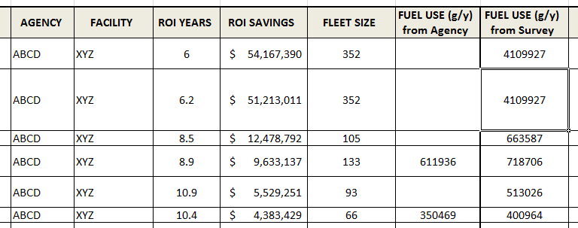
Payback Assessment Tool

Slide 9
Procurement Timeline
Draft RFP Process – On Going
Proposal Selection – Late Summer / Early Fall
Review of Conceptual Plans for Facilities – Early Summer
Agency Site Visits – Began March 23
Shortlisted Teams Announced – Jan. 16

Slide 10
Contact Information
www.P3forPA.com
www.P3forPA.pa.gov
Public-Private Partnerships (P3) Office
Bryan Kendro, Director
(717) 787-8765
brkendro@pa.gov

