Slide 1
Developing a Marketing Strategy That Works For You
Marketing 101
PREPARED BY SEPTA MARKETING – APRIL 2015

Slide 2
Marketing 101
Entertain
Inspire
Educate
Convince
Quizzes
Contests
Trivia
Celebrity Endorsement
Reviews
Infographics
Industry Articles
Press Releases
Service Advisories
Nothing But The Facts
Green
Cost Savings
Testimonials
PREPARED BY SEPTA MARKETING – APRIL 2015

Slide 3
Marketing 101
Plan versus Strategy
A marketing plan sets out your goals
A marketing strategy helps you identify ways to achieve them
Should evolve & change, adapting to what works & what doesn’t
As marketers, we’re on a mission to track and measure our efforts and their success
Collect information on almost everything you can think of, from purchase history and demographics to psychographic data and everything in between
It’s important to know how to find the useful data that helps us make strategic decisions
PREPARED BY SEPTA MARKETING – APRIL 2015

Slide 4
Marketing 101
What To Do First
Your marketing goals
Set goals for each channel you use
If you have several, it may help to put them in order of priority
By this point, you should have agreed on goals with your management team; but if you haven’t, now is the time to get on the same page
The key performance indicators (KPIs) you’ll use to measure marketing effectiveness
Your plan for gathering this performance information
Who will be responsible for collecting and reporting this data and how frequent
PREPARED BY SEPTA MARKETING – APRIL 2015

Slide 5
Marketing 101
Getting Started
Measurement can be as simple or as complicated as you make it
Don’t measure simply for the sake of having some numbers to present to your upper management
If you aren’t certain what you should be measuring, ask yourself these two questions:
Do these metrics support my key goals?
Can I take action on these metrics (i.e., will they provide me insight into how I can improve my program)?
Unless you can answer “yes” to the questions above, you likely don’t need to be collecting the data — at least at first
PREPARED BY SEPTA MARKETING – APRIL 2015

Slide 6
Marketing 101
Make It A Priority
Measurement processes are constantly evolving, and it definitely takes time to track, analyze and report on performance
But measurement and optimization is essential to being successful and ultimately growing ridership
Track conversions
Collect actionable metrics
Be ready to adapt
PREPARED BY SEPTA MARKETING – APRIL 2015

Slide 7
Marketing 101
PREPARED BY SEPTA MARKETING – APRIL 2015

Slide 8
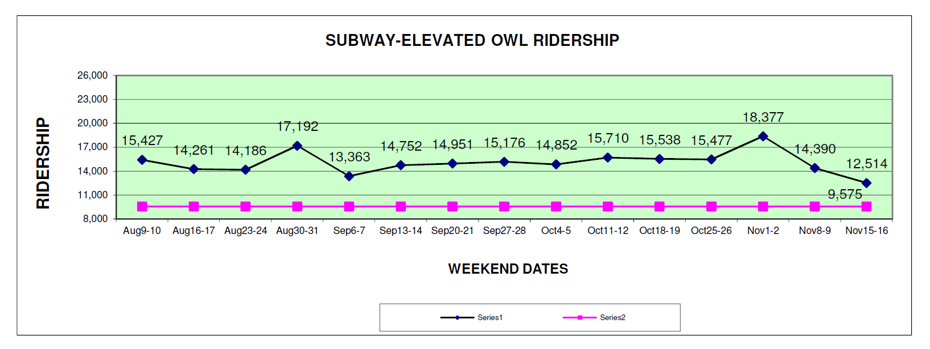
Marketing 101
PREPARED BY SEPTA MARKETING – APRIL 2015

Slide 9
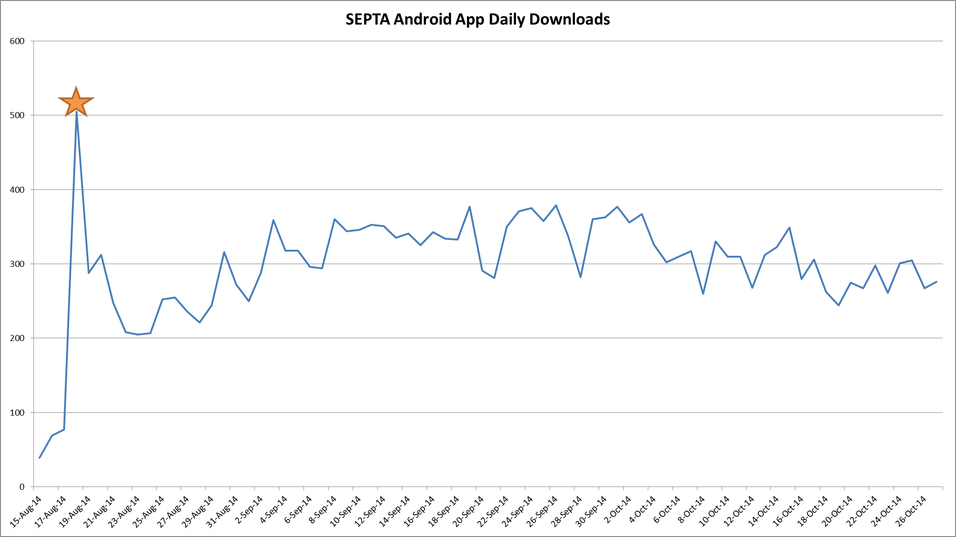
Marketing 101
PREPARED BY SEPTA MARKETING – APRIL 2015

Slide 10
Marketing 101
PHILADELPHIA EAGLES HOME GAMES
BROAD STREET LINE RIDERSHIP
AVERAGE REGULAR SEASON TOTALS
2007: 7,900 (+55%)
2008: 8,200
2009: 7,900
2010: 8,600
2011: 8,440
2012: 8,500
2013: 10,200 (+20%)
2014: 12,240
PREPARED BY SEPTA MARKETING – APRIL 2015
Source: SEPTA Revenue & Ridership Department

Slide 11
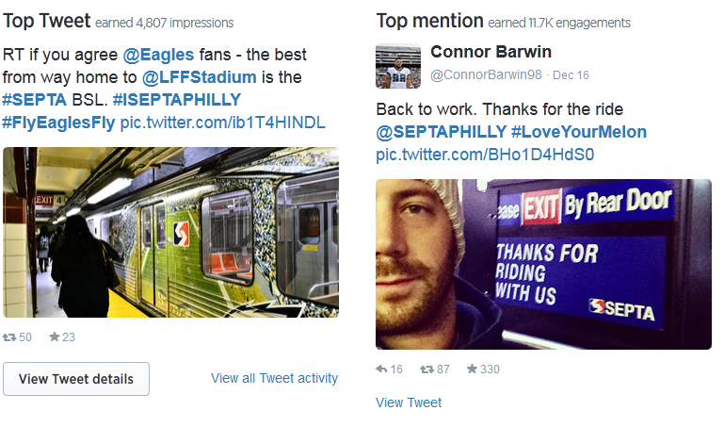
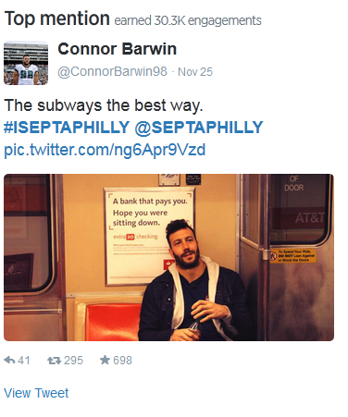
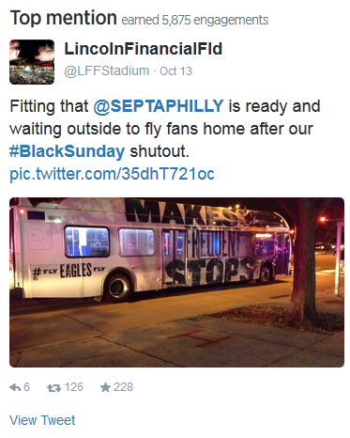
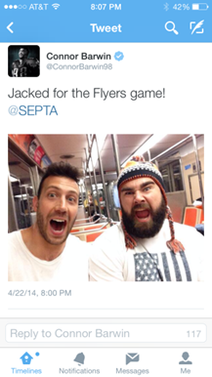
Marketing 101
PREPARED BY SEPTA MARKETING – APRIL 2015

Slide 12
Marketing 101
Be Original
Use original content to keep customers interested and engaged with your brand
Allows you to directly track reactions from potential customers to certain ideas or offerings
On Social Media, you can measure the number of likes, retweets and shares you receive and use analytics to see which items generate the most interest and response
See which content encourages users to explore your website and product offerings, and where they look when they visit your site in response to these posts
Google Analytics are great ways to see where your content travels and how it’s shared
PREPARED BY SEPTA MARKETING – APRIL 2015

Slide 13
Marketing 101
More Traffic
Great content can inspire people to visit your website, but it won’t necessarily convince them to act
You could have the greatest marketing strategy in the world, but if your website is hard to navigate users might tend to think so is your system
If you’re getting a lot of additional traffic — but that traffic isn’t converting — it’s a sign that you need to give your website an honest assessment - can open your eyes to issues you never knew existed
PREPARED BY SEPTA MARKETING – APRIL 2015

Slide 14
Marketing 101
PREPARED BY SEPTA MARKETING – APRIL 2015

Slide 15
Marketing 101
Be Social
No matter what industry you’re in and who your target audience is, original, relevant content will establish you as a legitimate expert
Provide insight, solutions and answers that your target audience desperately needs that encourages follows on Facebook, Twitter, Instagram, etc.
Even just one high-quality piece of content can make your follower list bigger, but if you can keep the great content flowing, you’ll see your social media presence grow by leaps and bounds!
PREPARED BY SEPTA MARKETING – APRIL 2015

Slide 16
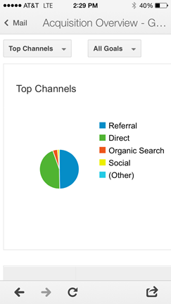
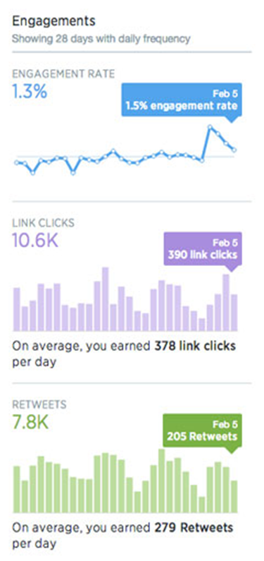
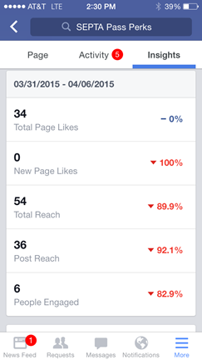
Marketing 101
Tools of the Trade
Google Analytics are great ways to see where your content travels and how it’s shared
Platforms like Twitter offer analytics for your social updates
Tweetreach
Facebook Insights
Foursquare
Hootsuite, TweetDeck
PREPARED BY SEPTA MARKETING –APRIL 2015

Slide 17
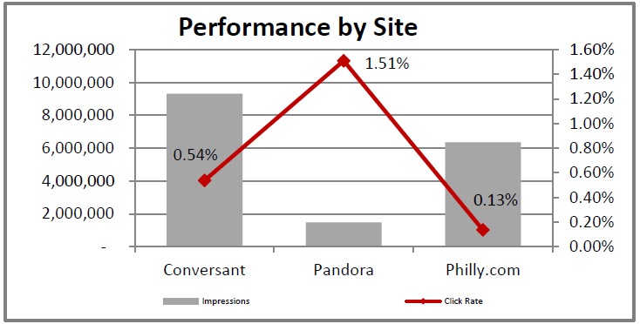
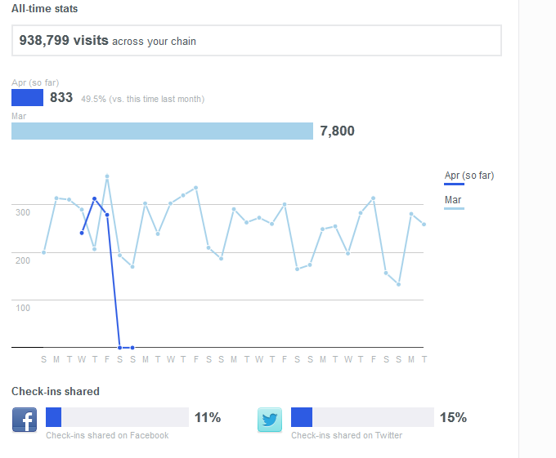
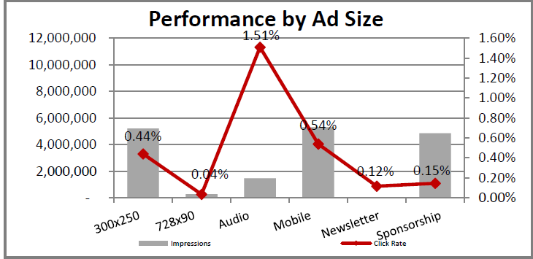
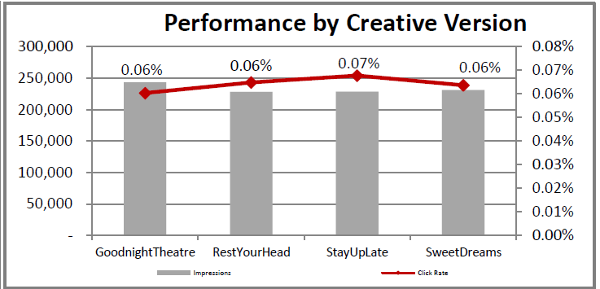
Marketing 101
PREPARED BY SEPTA MARKETING –APRIL 2015

Slide 18
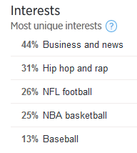
Marketing 101
PREPARED BY SEPTA MARKETING –APRIL 2015

Slide 19
Marketing 101
Tools of the Trade
Timing Messages/Posts
Reviewing usage by day and time
Make sure you’re posting within 30 minutes of your users’ peak activity times
Sometimes one day of the week offers a 50-100% larger audience; These are opportunities you don’t want to overlook
Track Format Preferences
Over the past few years, there’s been a shift toward more visual content (photos & videos)
It’s important to base your strategy on what your fans/customers prefer
PREPARED BY SEPTA MARKETING – APRIL 2015

Slide 20
Marketing 101
Tools of the Trade
Sort Your Posts
By going through your top-performing posts in the page’s entire history (relative to your strategy and KPIs), you can start to identify some qualitative factors you might not have thought about before.
Is there a visual or contextual theme that has consistently performed well over time? Maybe your fans have a soft spot for Star Wars references.
Are there sentence structures that consistently outperform others? Copy length, personality nuances and literary devices can be a factor.
Is there something consistent in the imagery you’ve been using? Bright colors, 3D styling or photography might outperform illustration.
PREPARED BY SEPTA MARKETING – APRIL 2015

Slide 21
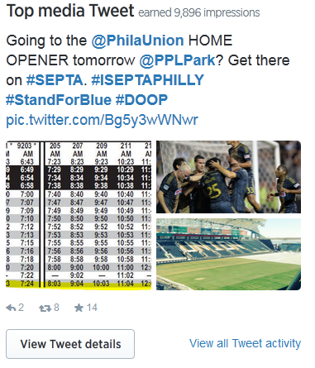
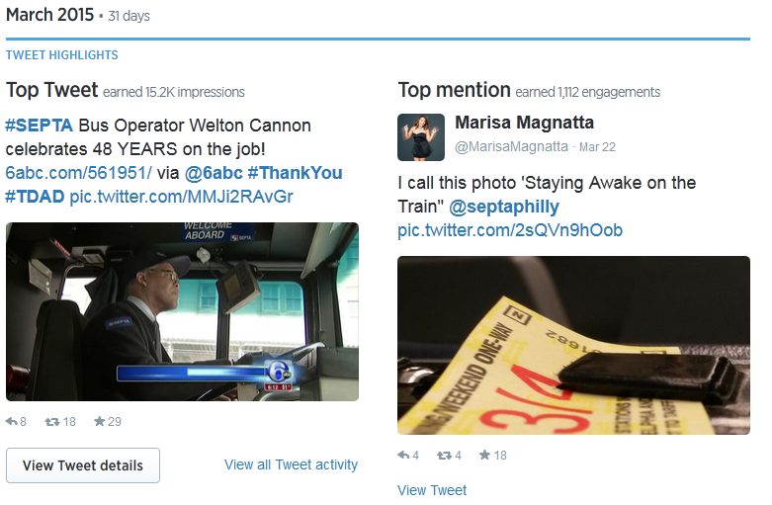
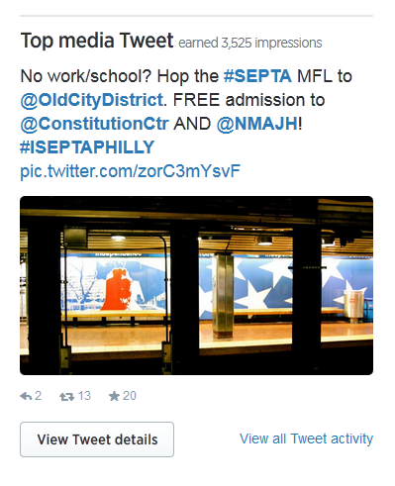
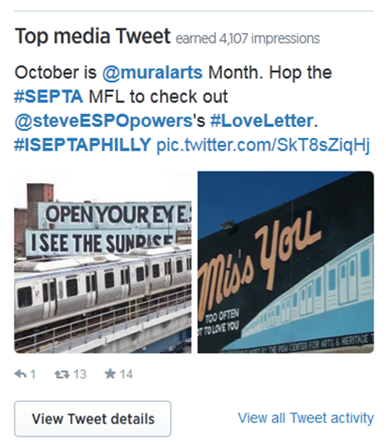
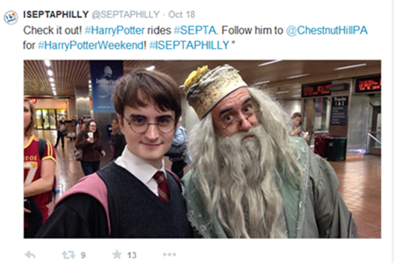
Marketing 101
PREPARED BY SEPTA MARKETING – APRIL 2015

Slide 22
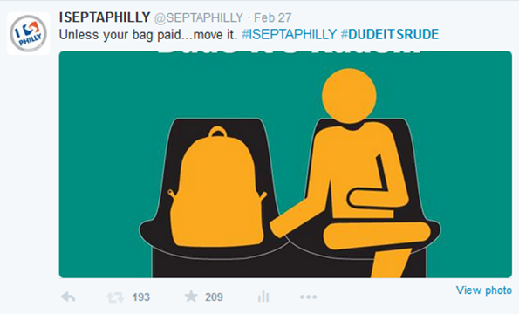
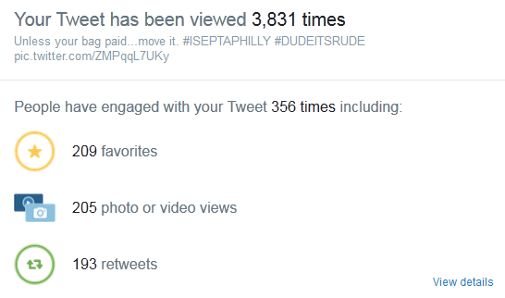
Marketing 101
PREPARED BY SEPTA MARKETING – APRIL 2015

Slide 23
Marketing 101
The True Test – More Riders
This is, obviously, the biggest measuring stick you’ve got
After all, if you’re not getting more money out of all the content you’re slaving away at (or paying someone to slave away at for you), your strategy isn’t working!
OK, so you’re not going to see the money train pull up after one ad, tweet, post or spot, but if your content has had time to “make the rounds” and your bottom line still isn’t getting a boost, it’s time to re-think your strategy
PREPARED BY SEPTA MARKETING – APRIL 2015

Slide 24
Marketing 101
10 Reasons Your Strategy Isn’t Working
You haven’t refined your strategy
You don’t spend enough money and/or time
You aren’t promoting your content
Your content…just isn’t very good
You’re in a tough niche
You’re up against a goliath of a competitor
You haven’t waited long enough
You have horrible SEO
Your expectations are too high
You’re not having any fun with it
PREPARED BY SEPTA MARKETING – APRIL 2015

Slide 25
Marketing 101
Entertain
Inspire
Educate
Convince
Quizzes
Contests
Trivia
Celebrity Endorsement
Reviews
Infographics
Industry Articles
Press Releases
Service Advisories
Nothing But The Facts
Green
Cost Savings
Testimonials
PREPARED BY SEPTA MARKETING – APRIL 2015

Slide 26
Marketing 101
Thank you!
PREPARED BY SEPTA MARKETING – APRIL 2015

