Slide 1
Improving the Health Care-Transportation Connection
Presented to PPTA
April 9, 2015
York Adams Transportation Authority

Slide 2
What’s working – 31% / 91K
Notes:
Out of almost 300K trips,
1/3 was medical related.

Slide 3
What Demand Responsive Looks Like

Slide 4
Capacity Demand

Slide 5
Operating (In)efficiencies

Slide 6
Operating (In)efficiencies
Lost Productivity
March 6 – 599 Completed Trips in York County
Average Stop Duration was 3.38 minutes
Total of all durations greater than 2 min = 1120 Minutes
1120 minutes = 18.6 hours
18.6 hours x $65/hour = $1,213
___________
49 No Shows – Randomly Selected 3
Average travel time between the pick before and after No Show = 23 minutes
Total 1127 Minutes
1127 minutes = 18.8 hours
18.8 x 65 = $1,222
$2,435/$14 = 173 trips

Slide 7
And the survey says…

Slide 8
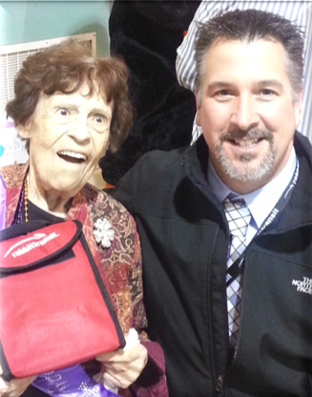
Aging in place – Monthly cost: Transit $190.74 vs. County home $7,756
YATA Survey states average senior takes 11 trips per month. Average trip cost $17.34. County home cost $255 per day.
Meeting specialized health needs – Nearly 22,000 trips to dialysis per year
PwD – 60%+ use it to go to work
Senior Centers Participation

