Slide 1
Workforce Development: People, Priorities, and Programs APTA’s National Initiatives
Louwana Oliva, General Manager, CATA &
Vice Chair - APTA Human Resources Committee
Pennsylvania Public Transportation Association, April 8, 2015

Slide 2
Workforce Development: Advancing the Agenda
Top Priority for APTA, executive leadership, industry
Celebrating members’ successes and sharing breakthrough outcomes
Addressing realities & tough challenges
Researching and promoting innovative approaches
Engaging with new partners and developing creative solutions
Listening to members’ needs & responding to requests
Taking calculated risks & delivering results

Slide 3
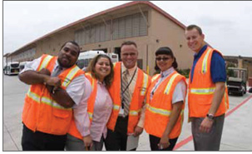
Workforce Development: Top Priorities
APTA Chair Phillip A. Washington – Career Pathways
APTA’s Strategic Plan – 2015-2019
APTA Members
APTA Human Resources Committee

Slide 4
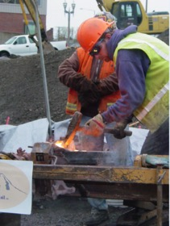
APTA Chair Request: Conduct Transit CEO Special Survey
Top Five Hardest-to-Fill Positions
The results: Vehicle and facilities maintenance
Traction Power
General Repair Mechanic
Rail Signal Maintainer
Route Cutter/Planner
Track Maintainer
Other Hard-to-Fill positions:
Vehicle operations; engineering
Advanced radio/communications mechanics
Mid-level safety/security positions and others

Slide 5
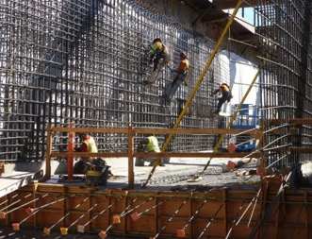
Transit CEO Survey – Other Questions “Career Pathways - Hardest to fill positions”
“Do you have career pathways for your hardest-to-fill positions”
34.8% – programs in place
65.2% - no programs in place
Developing dynamic career ladders for public transportation’s frontline workforce should be our top priority.
– Phillip A. Washington, APTA Chair
Next steps: Deeper Dive
Data, recommendations, actions

Slide 6
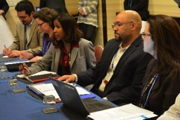
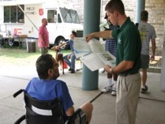
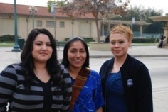
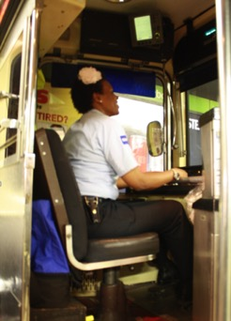
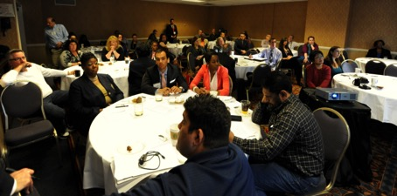
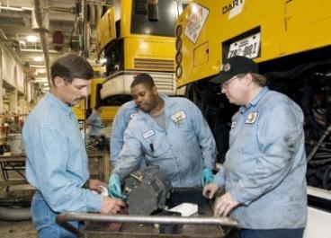
APTA Strategic Plan 2015-2019: Workforce Development - GOAL
Help members attract, develop, and retain a diverse workforce

Slide 7
APTA Strategic Plan 2015-2019 Workforce Development - STRATEGIES
Turn APTA into a hub for workforce development models and resources
Leverage both the public and private sectors to showcase successful practices
Develop more public transit-specific education and training programs with partners and through alliances
Support the development of local and regional mentoring and internship programs
Continue to enhance industry attractiveness through branding and image development

Slide 8
Human Resources Committee
Align Committee’s strategic and work plans with strategic and business priorities of APTA and APTA’s Chair
Address key industry priorities
Emphasize needs of front line workforce
Open up opportunities for students and young people
Offer and support new and
on-going programs
Enrich current resources
Broaden outreach to Veterans
Improve the transit brand for
new audiences

Slide 9
Human Resources Committee & Subcommittees - Project Highlights
Garrett Morgan Program – (middle school) - May 2015
National Public Transportation Career Day – (K-12) - May 14, 2015
National Public Transportation Youth Summit, Washington, DC
(50 rising high school juniors/seniors) - June 28-July 2, 2015
With large support from APTA’s business members
Student Ambassador Programs (Higher Ed students)
Bus, Rail, and Annual Meeting
National Workforce Development Webinars – Spring through December, 2015 – Emphasis on Front Line Workforce
Frontline Workforce Technical Workshops - 2015 Bus Conference
Mid-Level Manager Leadership Workshops at 2015 Conferences: Bus & Paratransit; Rail; & Annual Meeting
Workforce Development sessions at APTA’s major conferences and seminars

Slide 10
Human Resources Committee & Subcommittee - Project Highlights
National Infrastructure Day – April 9, 2015
Veterans Job Fair – 2015 Bus & Paratransit Conference
AREMA/pREES – Educational Workshop for Rail Engineering college and university faculty - July 2015 - sponsored by APTA’s Business members
Labor Management Virtual Think Tank – Summer/Fall 2015
National Transit 101 Curricula – Fall 2015
National Mentorship and Internship programs - Ongoing

Slide 11
Transit Virtual Career Network
Web Portal Launch
Pamela L. Boswell
Vice President – Workforce Development &
Educational Services
2015 Pennsylvania Public Transportation Association Conference
April 8, 2015

Slide 12
Transit Virtual Career Network (TVCN)
Comprehensive on-line career development tool for the Transit industry
Job descriptions
Local data on wages and education trends
Local job & training search
Other key features
Innovative solution to workforce challenges
Strategically builds on multiple federal investments

Slide 13
Background

Slide 14
Key Workforce Challenges in Transit
Baby boomer retirements
Critical need to hire and train skilled workers
Lack of awareness of transit careers among jobseekers, students, and career counselors
Changing technology and job requirements

Slide 15
Early Solutions: “The Guide”
Goals:
Expand awareness of Transit careers
Offer “at a glance” visual representations
Provide detailed information on job, skill and training requirements
Create a useful tool for transit insiders and jobseekers/educators/counselors

Slide 16
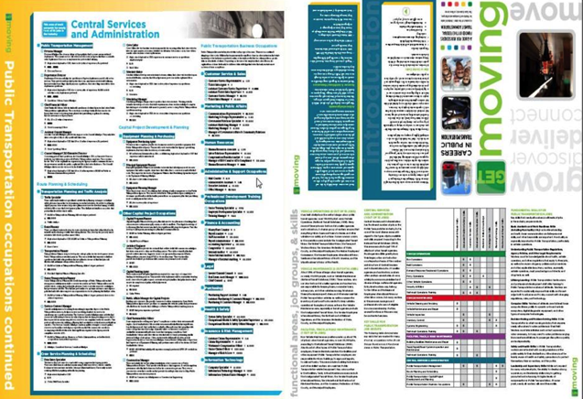

Slide 17
Virtual Career Network Platform
Addresses workforce challenges in Healthcare & Green Jobs industries
Funded by US Dept. of Labor
Multi-partner implementation led by American Association of Community Colleges

Slide 18
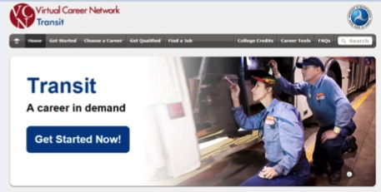
New Opportunities & Partnerships: FTA Workforce Innovations Grant

Slide 19
Transit VCN Highlights
Over 50 Transit Jobs Profiled
A Focus on entry-level occupations in 4 work areas
Jobs organized by Expertise Level
Basic, Intermediate, Advanced
Access Locally-Available information
Jobs & Training

Slide 20
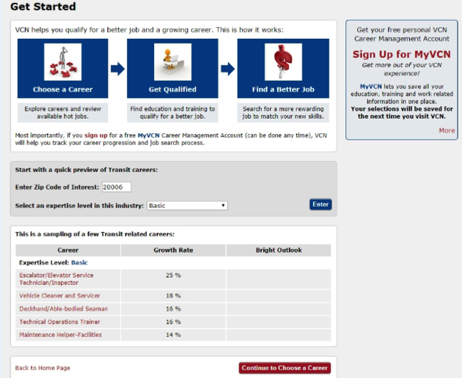
Quick Start
Save personalized searches & info.
Provides overview of expected job growth in local areas
(Data fram: USDOL, BLS)

Slide 21
Choose Careers based on Area of Work and Expertise Level

Slide 22
In-depth Job Descriptions & Occupational Photos

Slide 23
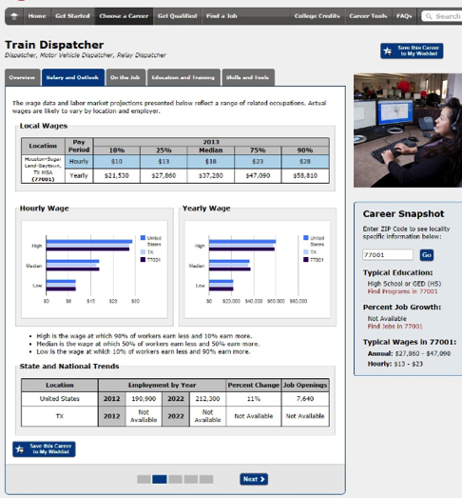
Local and national data on education and salaries

Slide 24
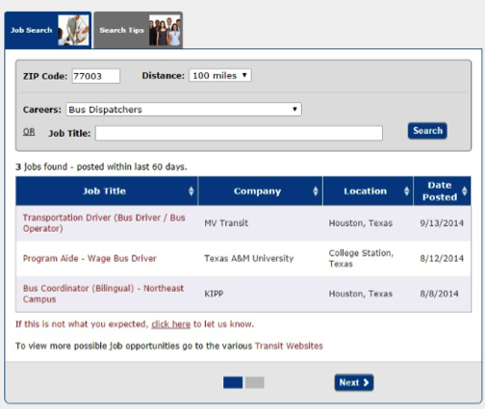
Search for Jobs & Education

Slide 25
Other Key Features
Match interests to careers
Request credits for prior learning & military service
Financial aid information

Slide 26
Transit Virtual Career Network
For additional information visit:
https://www.vcn.org/transit

