Slide 1


Bus Stop Design Guidelines -
In Support of Effective Service Planning
Mark Cassel, AICP Senior Operations Planner
Presentation to Pennsylvania Public Transportation Association
Spring Meeting

Slide 2
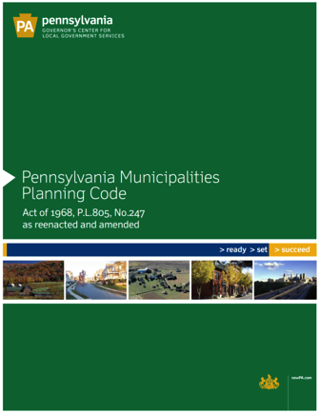
PA Municipalities Planning Code calls for “coordinated development”
    Municipal Comprehensive Plans are to examine “the movement of people and goods, which may include… public transit systems…”
Basis for Designing for Transit

Slide 3
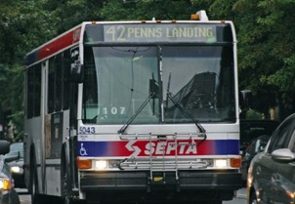
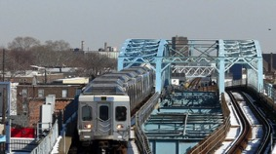
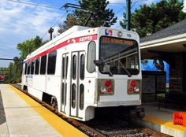
Budgets
  Capital
  Operating
Strategic Planning
  Strategic Business Plan
  Sustainability Plan
Service Planning
  Service Standards and Process
  Annual Service Plan
  Bus Stop Design Guidelines
Important SEPTA Tools

Slide 4
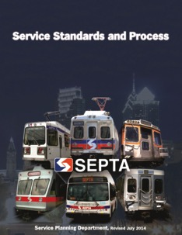
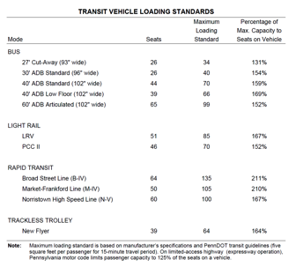
Public rules to make best use of limited resources
Fair, objective comparisons of service requests:
  Service coverage and route economic performance
  How service is delivered (frequency, span, transfers, and on-time performance)
Context: Service Standards and Process

Slide 5
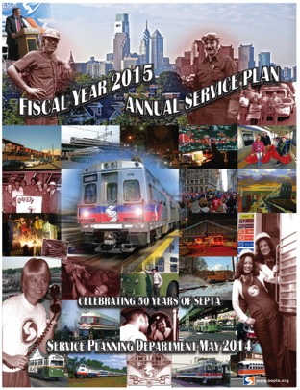
Fiscal analysis
  Three Variable Cost Model
    Hours/Miles/Peak Vehicles
  Projected revenue
  Cost recovery – Operating ratio
Community Benefit Analysis
  # of passengers
  Transfers
  Travel time & walking distance
Context: Annual Service Plan

Slide 6
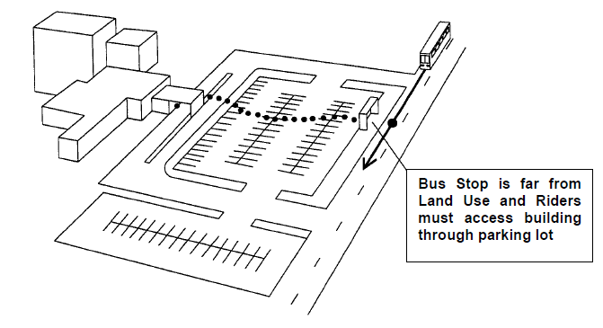
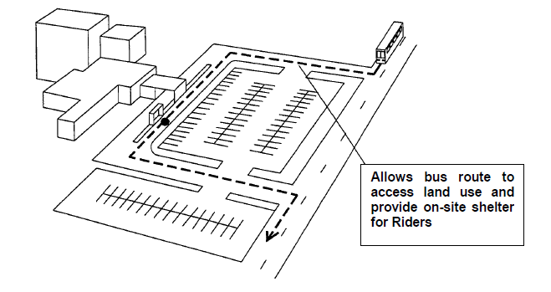
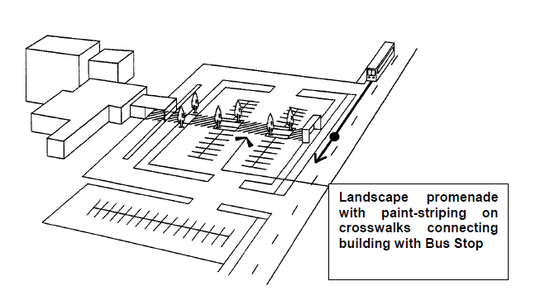
How site design affects service

Slide 7
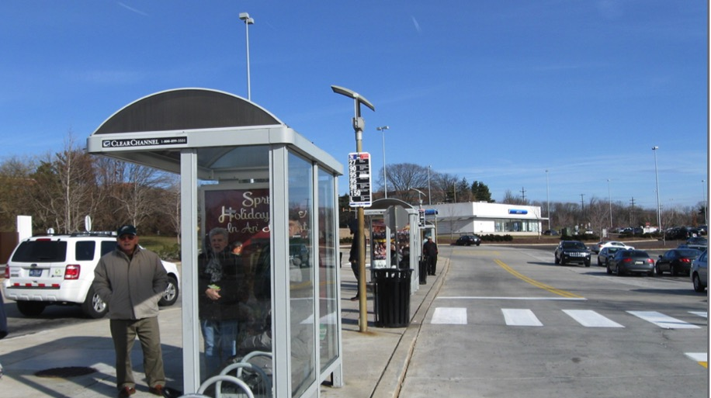
Relationship between street design, SEPTA operations/performance
Consideration of transit needs, amenities by municipalities, developers
Improve safety for passengers, vehicles
Encourage investment to bring new users to SEPTA system
Why Bus Stop Design Guidelines?

Slide 8
Bus Stop location
In-Street Design
Curbside Design
Passenger Amenities
Bus Stop Design Guidelines: Structure

Slide 9
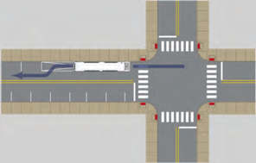

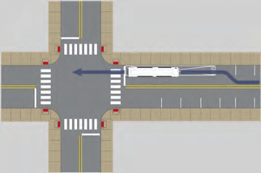
Document has diagrams to show advantages, disadvantages of stop locations
Near side
Far side
Mid-block
Bus Stop Locations

Slide 10
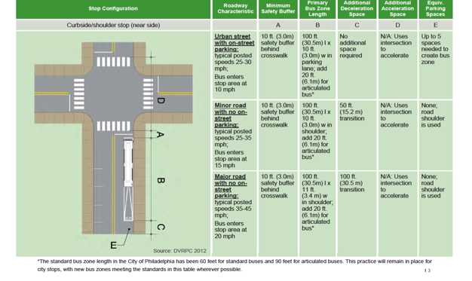
Detailed information about optimal dimensions for decelerating, stopping, accelerating
Specifications

Slide 11
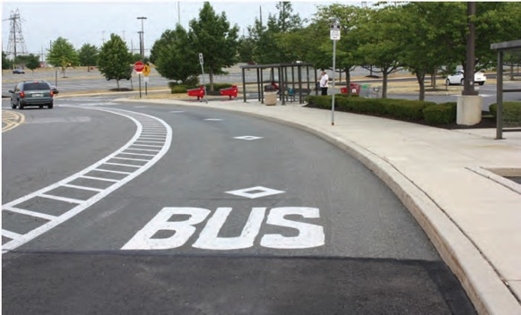
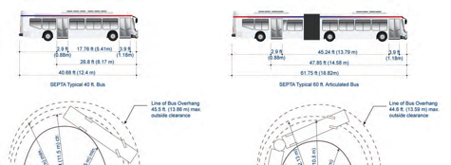
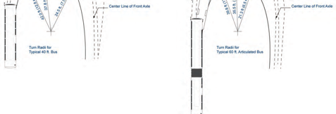
Loading area horizontal & vertical clearances
Turning radii
In-Street Design: Engineering Considerations

Slide 12
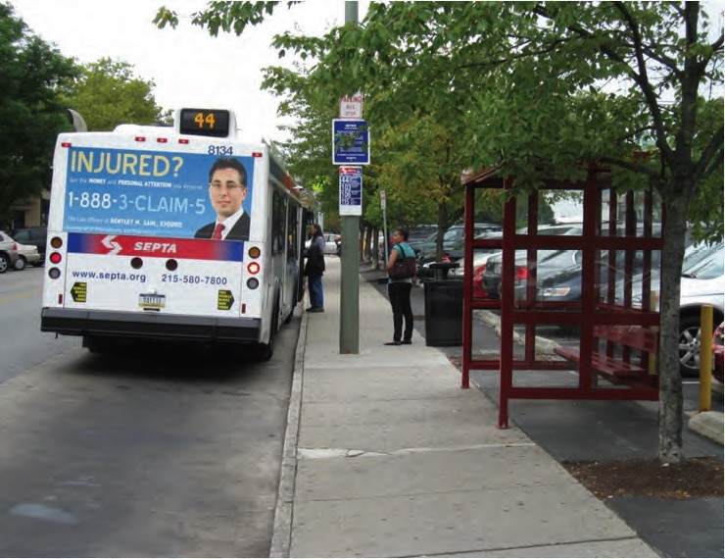
Addressing heavier than normal loads
(about 21.5 tons for 40’ bus)
In-Street Design: Roadway Paving

Slide 13
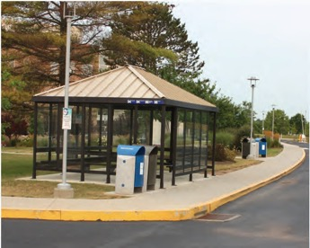
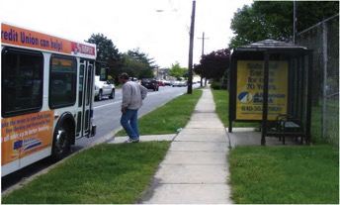
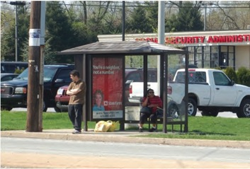
Shelter scaled to reflect ridership levels & passenger movement
Clear zone given for boarding/ alighting - ADA
Separate pedestrian path and waiting area where possible
Curbside Design: Loading/Waiting Area

Slide 14
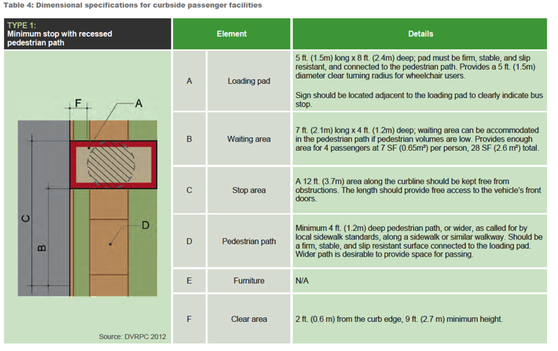
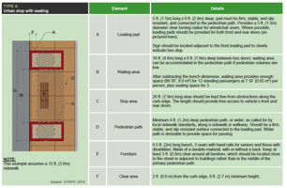
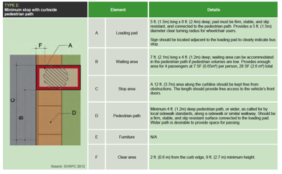
Curbside Design: Dimensional Information

Slide 15
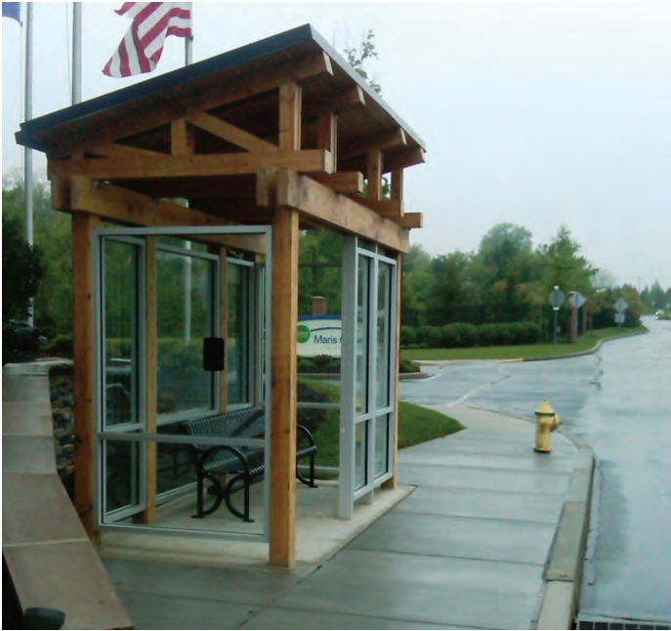
Transit shelters
Stop area seating
Bicycle racks/ storage
Passenger Amenities at Bus Stops

Slide 16
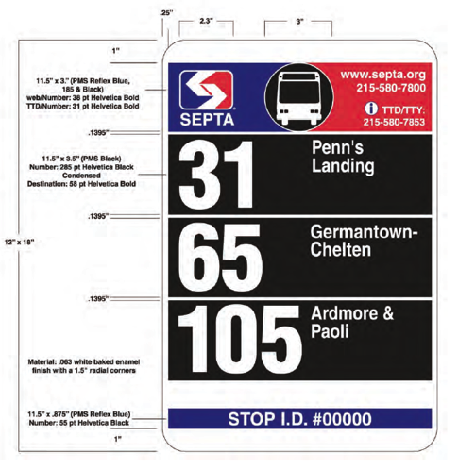
SEPTA contact information
Stop ID information connected to real-time bus information
Bus Stop Signage

Slide 17
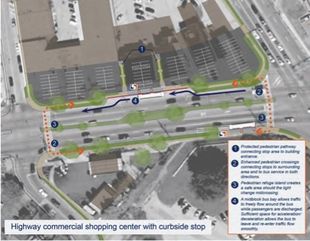
Highway commercial shopping center with curbside stop
Shopping mall transit hub
Urban neighborhood stop – curb extension
Urban stop – coordination between routes
Case Studies in Guidelines Document

Slide 18
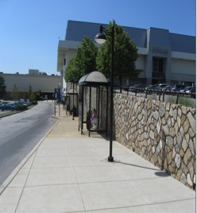
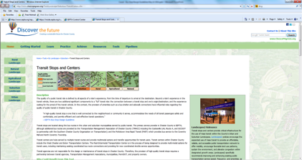
Copies sent to municipalities
Presentations to traffic engineers, planners
Referenced at various meetings, project discussions
Planning staff reviews
Bus Stop Design Guidelines’ use so far

Slide 19
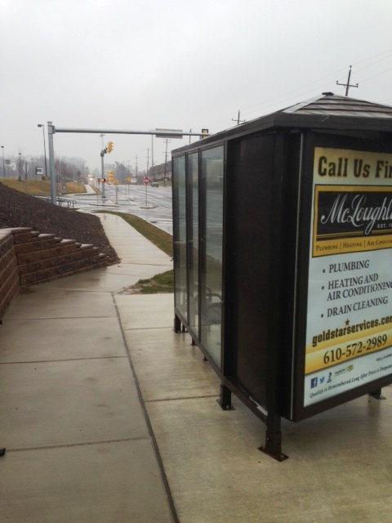
Customers benefit when new developments improve bus stop facilities
Safety is key factor
Lead time needed for reviews
  Field investigation may be needed
  Review letters from senior Surface Transportation staff
Overarching Issues for SEPTA Reviews

Slide 20

Mark Cassel, AICP, Senior Operations Planner
# 7238, mcassel@septa.org
Bus Stop Design Guidelines and other planning documents found on the SEPTA Strategic Business Plan website (Link from www.septa.org)
Questions?

