Slide 1
Wednesday, April 8, 2015
Rich Sampson
Communications Specialist
Community Transportation Association of America

Slide 2
Speaking Up For Transit
The Importance of Speaking Up
Key issues
CTAA’s Resources
Completing the Circle

Slide 3
The Importance of Speaking Up
You are the transit expert and leader
Tell your story
Talk to everyone/anyone
The danger of silence

Slide 4
Key Issues
The need to invest in community and public transportation
We are infrastructure
The looming bus capital crisis

Slide 5
Activity in D.C.
GROW America Act: Great, but…
Extension Likely
Reality: Flat or Increase = Inflation
It’s Congress’ Job to Find Funding

Slide 6
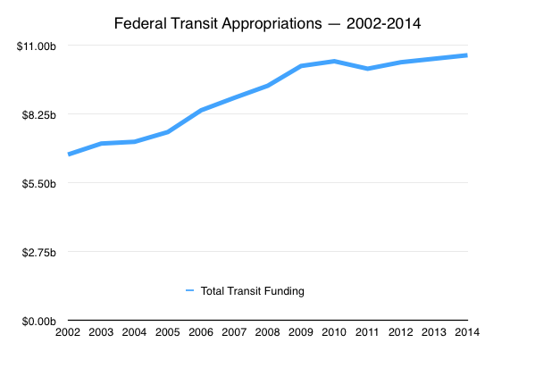
Growth Rate Slowing

Slide 7
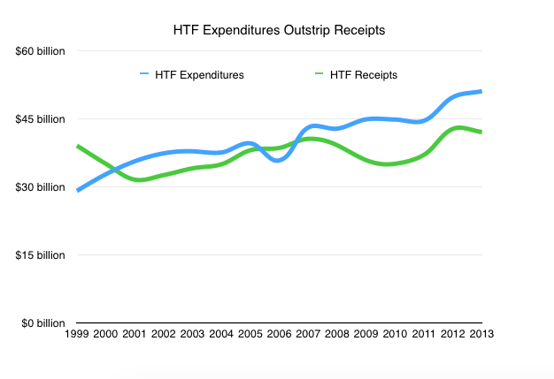
Trust Fund Spending Outpacing Receipts

Slide 8
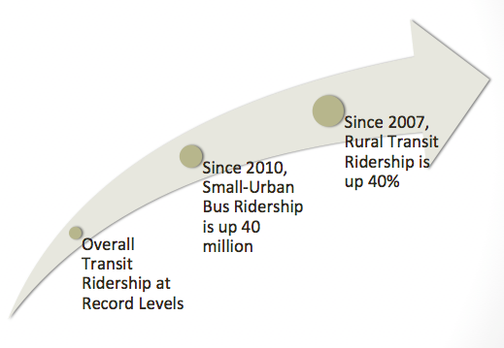
Sustained Ridership Growth

Slide 9
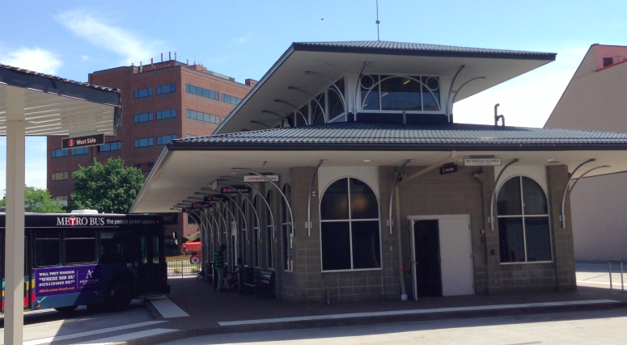
Transit is Infrastructure

Slide 10
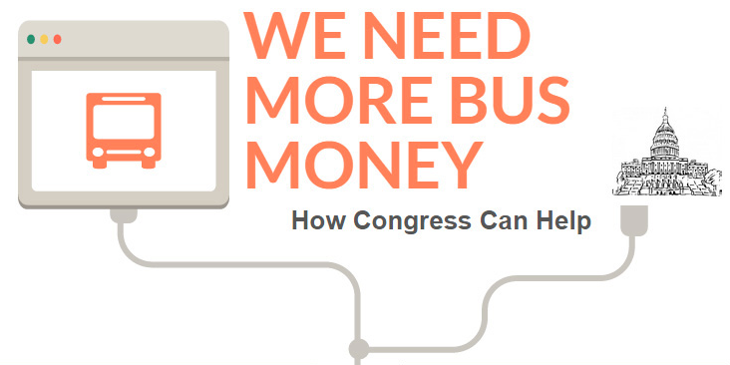

Slide 13
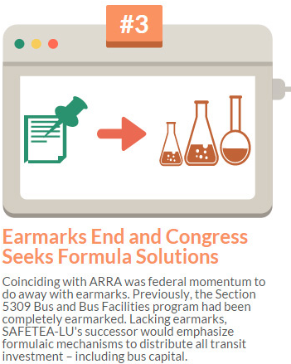

Slide 14
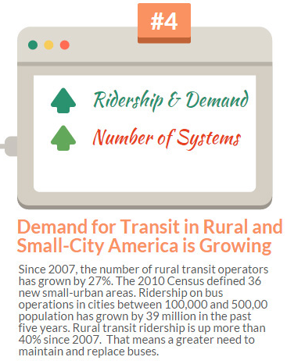

Slide 15
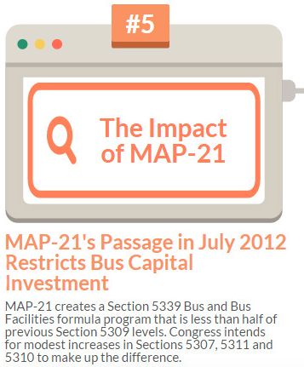

Slide 17
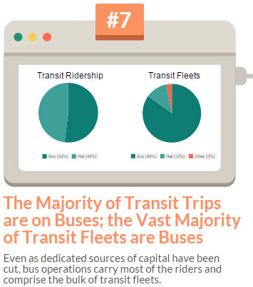

Slide 19
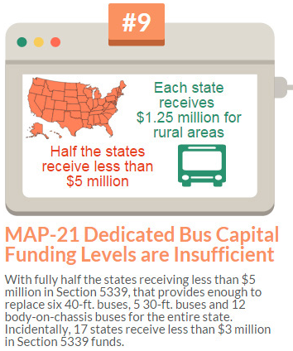

Slide 20
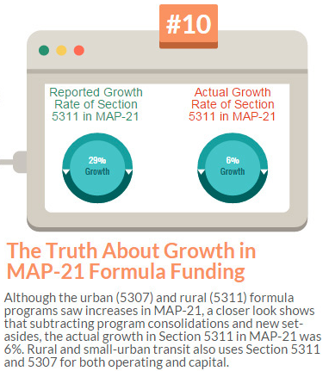

Slide 22
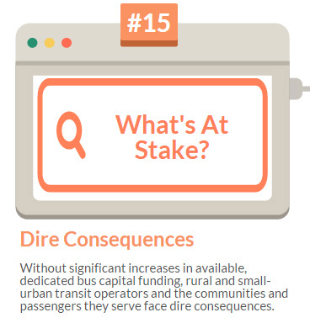

Slide 23
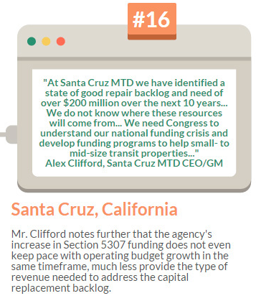

Slide 24
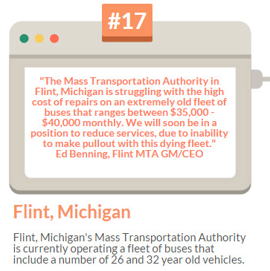

Slide 26
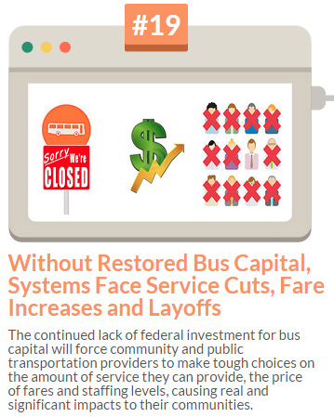

Slide 27
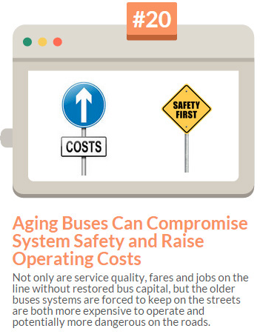

Slide 28
Our Resources
The Communications Card
How to Talk Transit
Reauthorization Priorities
Hints and Tips

Slide 29
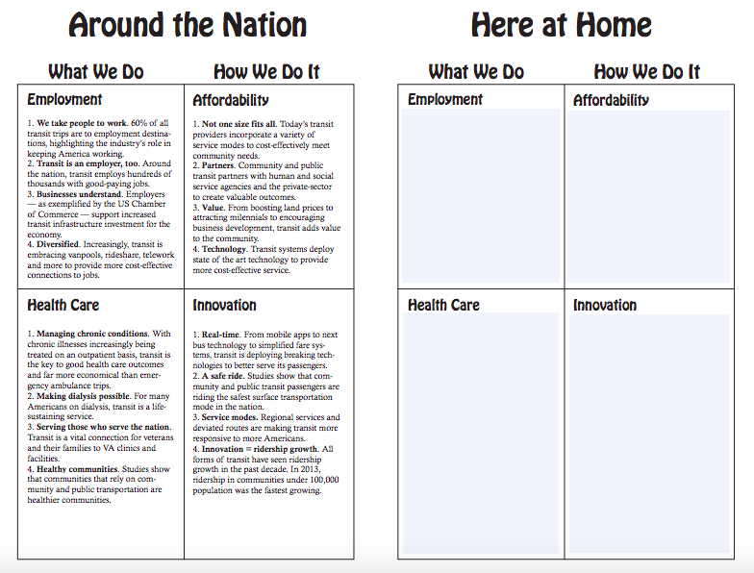
Community and Public Transportation: What Access Means
What We Do & How We Do It

Slide 30
How to “Talk Transit”

Slide 31
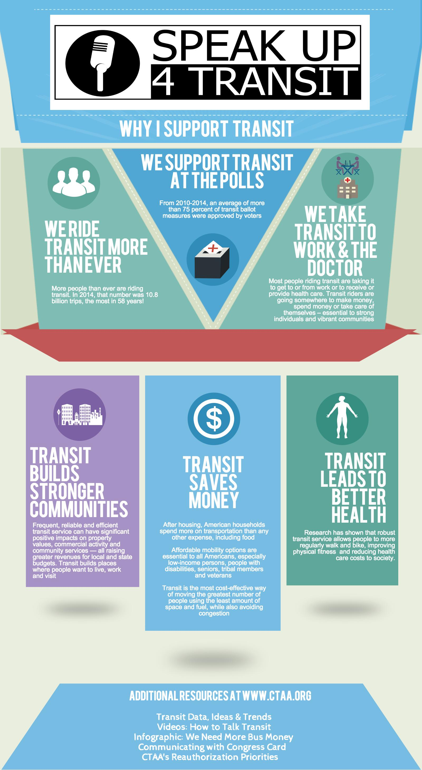
Advocate Talking Points

Slide 32
CTAA’s Reauthorization Priorities

Slide 33
Hints & Tips
Local level is the perfect place to start
Educate and establish a relationship
Engage your local advocates
Be succinct, do your homework and listen
Follow up and say “Thank you”

Slide 35
Completing the Circle
Let us know how your meetings go
Share with the #SU4T hashtag
On Twitter: @CTMag1 & @RAILMag
sampson@ctaa.org
Good Luck and Thank You!

