Slide 1
APTA Legislative Update
2015 PPTA Spring Conference
“Mission: Possible”

Slide 2
Budget and Appropriations
FY 2015 Appropriations completed
FY 2016 Budget process underway
House and Senate have agreed to Budget Resolution
Agree on top line number
Allocations to subcommittees affect General Fund transit programs
New Starts, TCRP, Standards, and Workforce Development

Slide 3
Authorization
Current authorization extends through May 2015
House T&I Committee started hearings with Secretary Foxx – Foxx and Shuster Twitter Townhall
Chairman Shuster and Sec. Foxx continue their outreach
Senate Environment and Public Works Committee has also held hearings with Secretary Foxx and Governors, and “owners, operators, and users” (Heminger/MTC and UT DOT)
Banking Committee held bus and rail roundtables, with additional roundtables and hearings planned
Revenues for HTF will shape much of what happens

Slide 4
Authorization
GROW AMERICA re-released
New proposal is over 6 years
$478 bill total for highways, transit and rail
$115 billion for transit
Several new provisions throughout proposal
Multi-modal Transportation Trust Fund, using General Fund transfers (mandatory spending) and intended to be offset by tax on repatriated foreign profits of U.S. corporations

Slide 5
Authorization – HTF Status
Congressional Budget Office:
“Beginning in fiscal year 2015, CBO projects, revenues credited to the highway and transit accounts of the Highway Trust Fund will be insufficient to meet the fund's obligations.”
“To help balance the trust fund’s resources and outlays, lawmakers could choose to reduce spending for surface transportation programs, boost the fund’s revenues, authorize additional transfers, or adopt some combination of those approaches.”

Slide 6
Authorization – HTF Status
Congressional Budget Office (in response to question for the record):
(On what would happen if the 2.86 cents per gallon in gas taxes currently going to the Mass Transit Account were instead deposited into the Highway Account:
It would take five years to pay off existing mass transit obligations.
In other words, just ending the Mass Transit Account does not solve the Highway Account shortfall.

Slide 7
Trust Fund Revenue
Senate Finance Committee looking at process and issues for tax reform
Senate Finance Committee Working Groups formed
Senators Dean Heller (R-NV) and Michael Bennet (D-CO) leading working group on infrastructure
House Ways and Means Committee has not indicated a specific approach
House-Senate agreement on Budget Resolution “could” lead to process that will support tax reform or some tax/revenue legislation

Slide 8
Pennsylvania Public Transportation Funding
Urban (UZA) Capital Funding
(Five year average - 2009-2013)
Fares, Directly Generated, and Local = 9.6%
State Funding = 32.3%
Federal = 58.2%

Slide 9
Pennsylvania Public Transportation Funding
Total Rural (non-urban) Capital Funding
(Five year average - 2009-2013)
Federal = 76.1%
Total Urban and Rural
Federal Capital= 58.6%

Slide 10
Capital Investment that flows through to private sector
73%

Slide 11
Public Transportation Private Sector in Pennsylvania
ICF International
Trapeze Group
Atkins
Lea+Elliott, Inc.
CDM Smith
HNTB Corporation
Eckert Seamans Cherin & Mellott, LLC
Hatch Mott MacDonald
Gannett Fleming, Inc.
AECOM
Parsons Brinckerhoff
Parsons Corporation
HDR
STV Incorporated
Gannett Fleming Transit & Rail Systems
CHK AMERICA
Keville Enterprises, Inc.
Encada, LLC
Stantec Consulting Services Inc.
TransIT Solutions LLC
ARINC
Urban Engineers, of Erie, Inc.
Jacobs
Interfleet Technology, Inc.
System One Holdings, LLC
LXTCH, LLC
Urban Engineers, Inc.
Talson Solutions, LLC
TranSystems Corporation
SYSTRA Consulting, Inc./SYSTRA Engineering, Inc.
Accenture
Quandel Enterprises, Inc.
RK&K Engineering
Mercator Advisors LLC
Parsons Transportation Group
Transportation Resource Associates, Inc.
CH2M HILL
The Louis Berger Group, Inc.
The Burns Group
Hill International, Inc.
Macro a Division of Ross & Baruzzini
Trapeze Group/Assetworks
Sam Schwartz Engineering
LTK Engineering Services
Educational Data Systems, Inc
Keville Enterprises
John A. Dash & Associates
Spartan Solutions, LLC
Michael Baker Jr. Inc.
Safe Fleet
SAIRA/Far Systems Americas
Hall Industries, Inc.
Crane Payment Innovations, CPI
Miller Ingenuity
Axalta Coating Systems
Haysite Reinforced Plastics
General Electric Company
Ansaldo STS USA, Inc.
Freedman Seating Company
Nord-Lock
ORX
USSC Group/4ONE/FMNA
Bentley Systems, Inc.
Bentech, Inc.
Siemens Infrastructure & Cities, Rail Systems Division
Avail Technologies, Inc.
Shaner Industries
BBM Railway Equipment, LLC
Phoenix Contact
Wabtec
Siemens
Axis Communications Inc.
AerosUSA, Inc.
L.B. Foster Company, Inc.
Bombardier Transportation-Propulsion and Controls
Kelox IRT USA, LLC
Trans/Air Manufacturing Corporation
Bombardier Transportation-Systems
Bombardier Transportation-Rail Control Solutions
Thales Transport & Security, Inc.
Souriau USA, Inc.
Mobile Climate Control
Voith Turbo Inc.
Bosch Security Systems, Inc
S.K.I. Company
CCI Thermal Technologies Inc.
Brush Industries/Q-Card Company
SEKISUI Polymer Innovations, LLC
I/O Controls Corporation
Sure-Lok, Inc.
Logena Automotive LLC
Bus Stuf Inc.
AlliedBarton Security Services
Xerox
Continental Corporation
BEA/Sensorio Inc.
Faiveley Transport, USA Inc.
ZF Industries
Irwin Transportation Products
Chestnut Ridge Foam, Inc.
Penn Machine Company
MEN Micro, Inc.
AxleTech International (ATI)
Cummins Power Systems
Kustom Seating Unlimited, Inc.
Brookville Equipment Corp.
Vossloh
Ecolane USA, Inc.
BAE SYSTEMS
Bombardier Transportation
Mitsubishi Electric Power Products, Inc.
Altro Transflor
Kidde Dual Spectrum
Wabtec Corporation
UTC/Rail & Airsources, Inc.
AMETEK Precision Motion Control
Al Engel Consulting
Joe Boscia Resources
Teumim Technical, LLC
Hugh A. Mose, P.E. – Transportation Consultant
Shapiro Rail Consulting, Inc.
Thomas E. Frawley Consulting, LLC
First Transit, Inc.
Transdev North America

Slide 12
Mass Transit Account
Two bills introduced to eliminate the Mass Transit Account dedicated revenues.
H.R.1461, The DRIVE Act of 2015 (Rep. Massie R-KY) – legislation which would immediately eliminate the Mass Transit Account of the Highway Trust Fund and redirect all motor fuels tax revenue previously dedicated to public transportation to the Highway Account of the Highway Trust Fund.
H.R.1551, The Highway Restoration Act of 2015 (Rep. Sandford, R-SC) – legislation which would phase out and eliminate the deposits of motor fuels excise taxes into Mass Transit Account of the Highway Trust Fund over five years.
Expect them to be offered as an amendment during House consideration.
Unlike HR 7, this is not advanced by the Chairman or Leadership, but rather by conservative activists.

Slide 13
Rail legislation
Full House approved Transportation Committee bipartisan bill with a heavy focus on Northeast Corridor
Full House approved bill H.R. 749, the Passenger Rail Reform and Investment Act of 2015 (PRRIA) by a vote of 316 – 101, majorities from both parties supported passage.
Authorizes appropriations for Amtrak for Fiscal Years 2016-2019 (FY 2016-2019). $7.1 billion four-year authorization.
$1.9 billion for the Amtrak Northeast Corridor Improvement Fund account; approximately $3.9 billion for the Amtrak National Network account; $96 million for the Amtrak Office of Inspector General; and $1.2 billion for capital grants to states for new intercity passenger rail.
Senate has not introduced a bill yet

Slide 14
Rail Legislation
Positive train control deadline is fast approaching in 2015
Senate Commerce Committee passed bill, S.650, to extend the positive train control system implementation deadline.
Sens. Blunt (R-MO), McCaskill (D-MO), Thune (R-SD), Nelson (D-FL)
Extends deadline to 2020, plus two 1 year optional extensions for DOT Secretary

Slide 15
Tax Issues
Congress passed a one year retroactive tax extenders package for 2014
Included:
Extension of parity for employer-provided mass transit and parking benefits. Retroactivity unusable for transit commuters.
Extension of excise tax credits relating to certain fuels. Transit agencies can claim the $0.50 per gallon alternative fuel tax credit for fuels used in 2014.
Extension of credit for alternative fuel vehicle refueling property. The provision would extend through 2014 the credit for the installation of non-hydrogen alternative fuel vehicle refueling property.

Slide 16
Transit Commute Benefits
HR 990, The Commuter Parity Act
Rep. Peter King (R-NY)
Rep. Blumenauer, Earl [D-OR-3]*
Rep. McGovern, James P. [D-MA-2]*
Rep. Maloney, Sean Patrick [D-NY-18]*
Rep. Hultgren, Randy [R-IL-14]*
Rep. Dold, Robert J. [R-IL-10]*
Rep. Lance, Leonard [R-NJ-7]*
Rep. Lipinski, Daniel [D-IL-3]*
Rep. Wittman, Robert J. [R-VA-1]
Rep. Costello, Ryan A. [R-PA-6]
Rep. Edwards, Donna F. [D-MD-4]
Rep. Farr, Sam [D-CA-20]
Rep. Nadler, Jerrold [D-NY-10]
Rep. Israel, Steve [D-NY-3]
Rep. Sires, Albio [D-NJ-8]
Rep. Rice, Kathleen M. [D-NY-4]
Rep. Smith, Christopher H. [R-NJ-4]

Slide 18
The Pre-Application deadline is 11:59 E.D.T. on May 4, 2015.
The Final application deadline is 11:59 E.D.T. on June 5, 2015.
For more information on the 2015 TIGER 2015 Grant program, please visit:
2015 Webinar Series
Wednesday, April 8, 2015 1:00-3:00 pm: How to Compete for TIGER Discretionary Grants
Friday, April 10, 2015 1:00-3:00 pm: How to Compete for Non-Traditional Applicant
Tuesday, April 14, 2015 1:00-3:00 pm: How to Compete for TIGER Discretionary Grants
Thursday, April 23, 2015 1:00-3:00 pm: Preparing a Benefit Cost Analysis (BCA)
Tuesday, April 28, 2015 1:00-3:00 pm: How to Compete for TIGER Discretionary Grants
Registration links will be available on this page soon: http://www.dot.gov/tiger/outreach

Slide 19
ADVOCATE

Slide 21
#SU4T

Slide 22
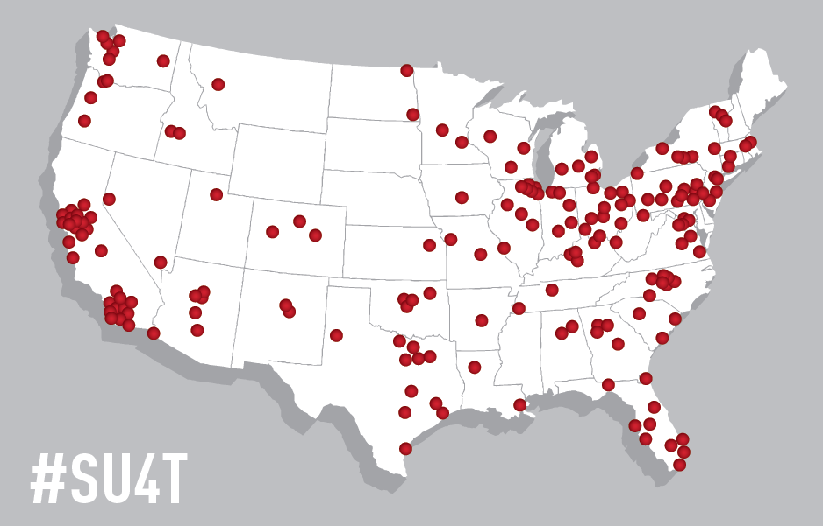

Slide 23
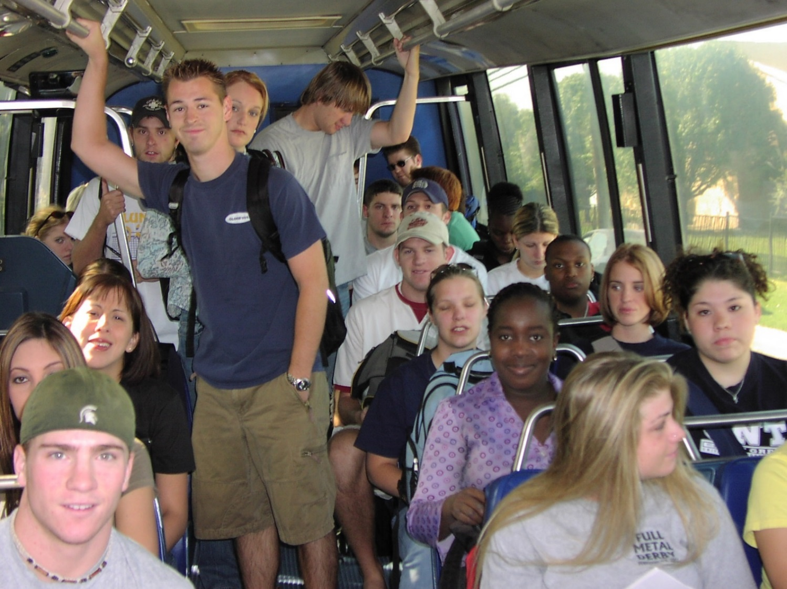
10.8 Billion

Slide 24
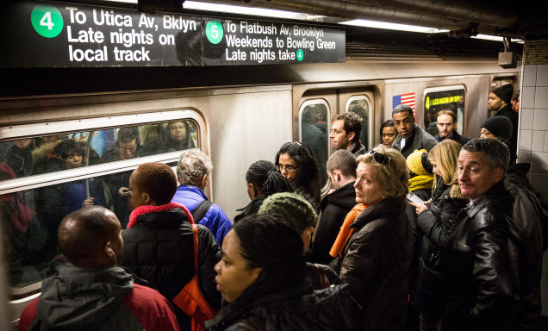
10.8 Billion

Slide 25
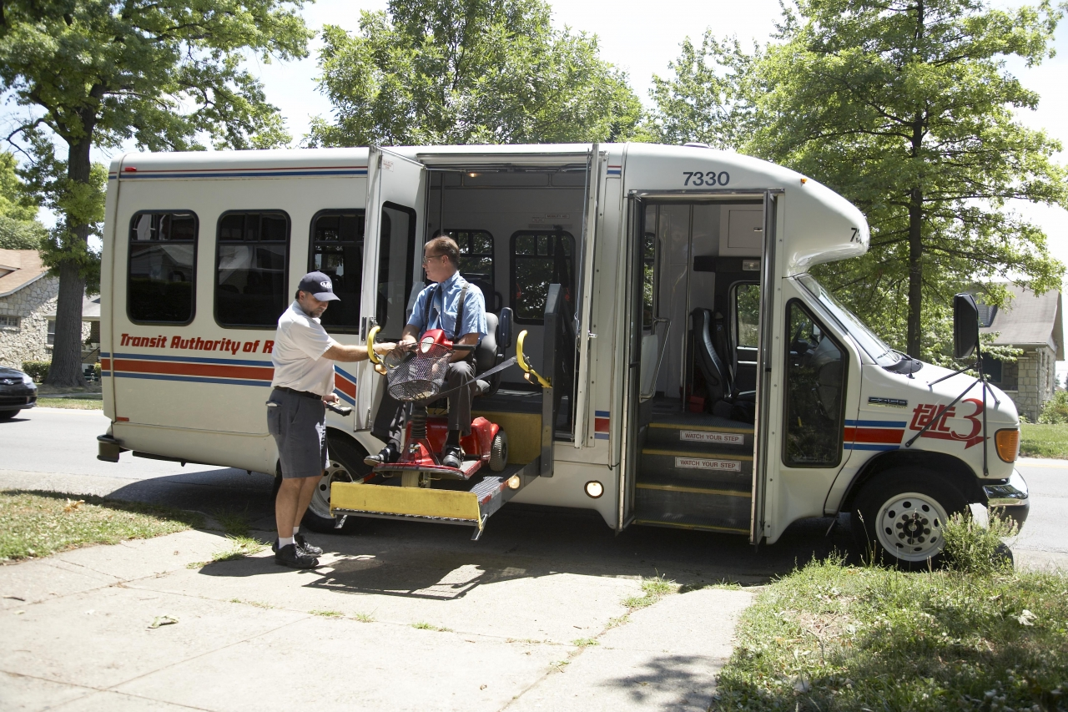
10.8 Billion

Slide 26
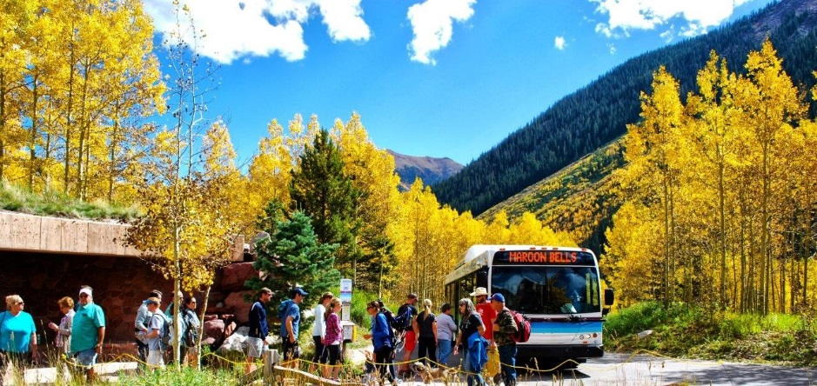
10.8 Billion

Slide 27
Ridership 2014
Salt Lake City, UT
2.2%
Muncie, IN
1.4%
Urbana, IL
7.5%
New York, NY
6.4%
Denver, CO 3.2%
Columbus, OH
3%
Everett, WA 7.7%
Eden Prairie, MN 7.3%
Arlington, VA
1.2%
Birmingham, AL 1.1%
Boone, NC 6.1%
Los Angeles, CA
6.2%
Scottsdale, AZ
1.9%
San Diego, CA
7.6%
Houston, TX
2.1%
New Orleans, LA
2%
Tampa, FL
2.5%

Slide 29
